Slide 1
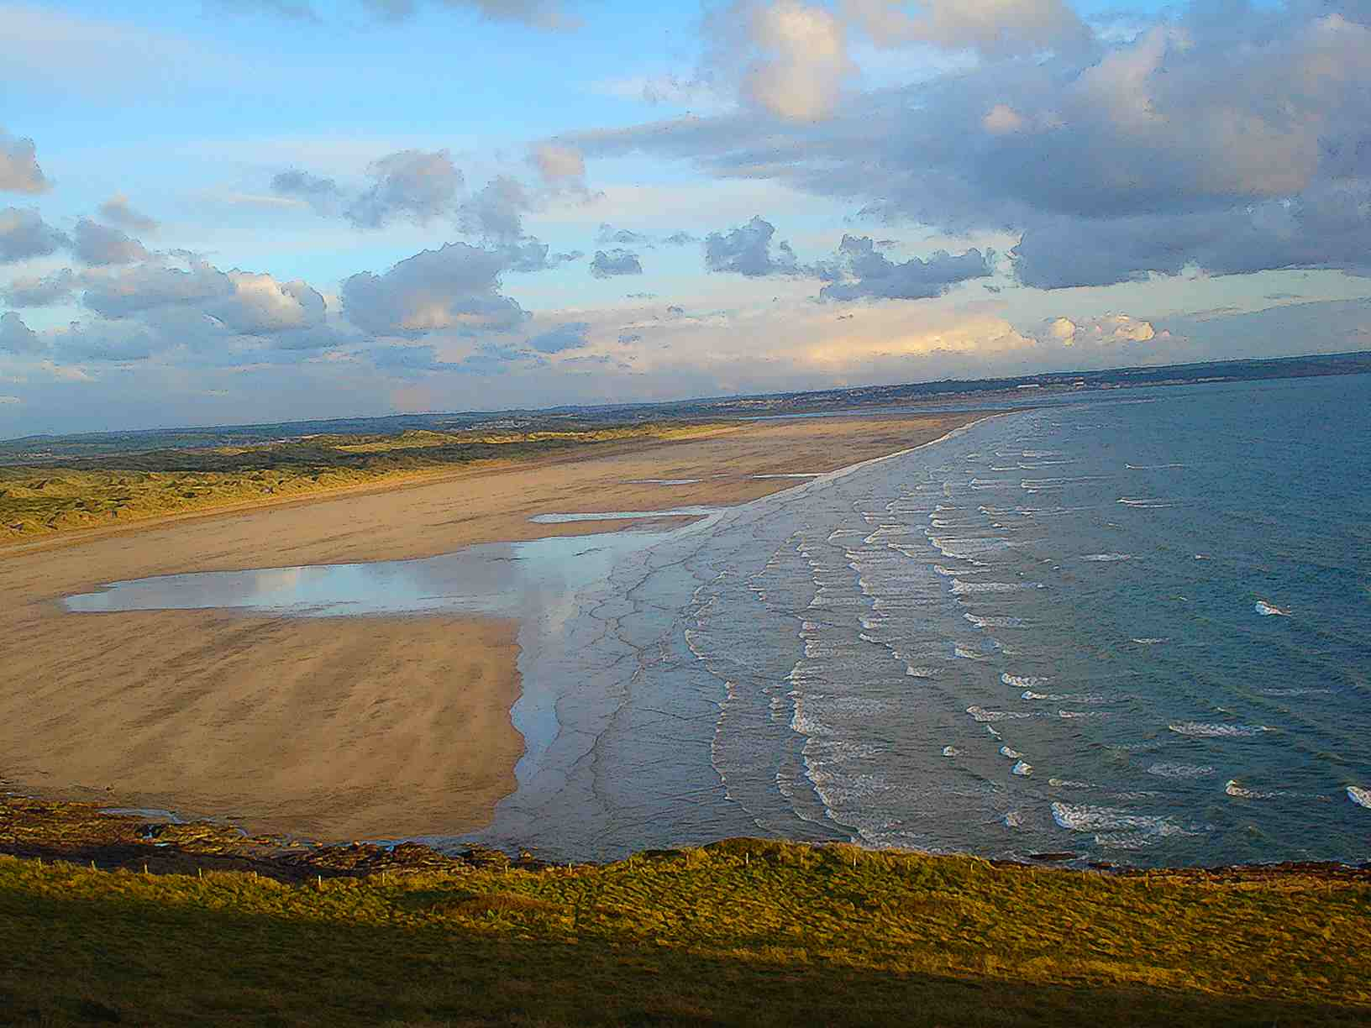
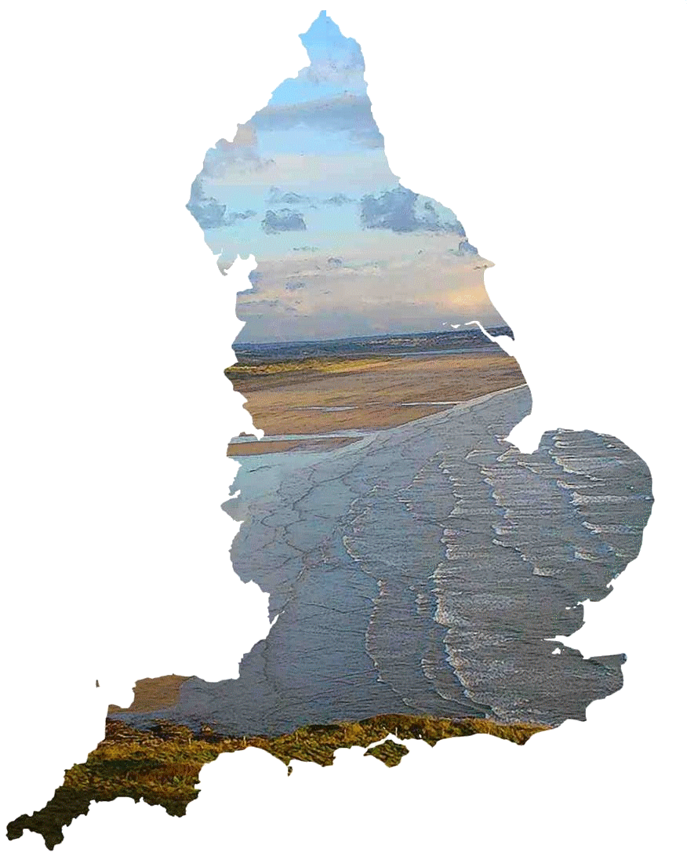

COMENIUS PROJECT MEETING
Different numbers. Same values
BARNSTAPLE-PILTON
UK
8 – 12 June 2011

Slide 2




The project and its partners
The Comenius project Different numbers. Same values is a partner school project.
It includes 6 schools from 4 countries:
Austria: Europahauptschule in Wiener Neustadt
Spain: Colegio Maria Auxiliadora in Salamanca
France : Martinique : Lycée Joseph Gaillard in Fort de France
Metropolitan : Institution du Sacré Cœur in La Ville du Bois
United Kingdom : Braunton School and Community College in Braunton
Pilton Community College in Barnstaple

Slide 3
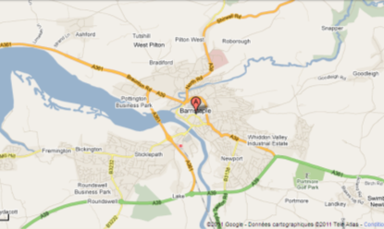
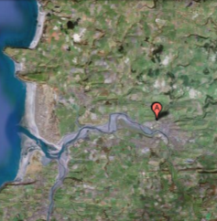
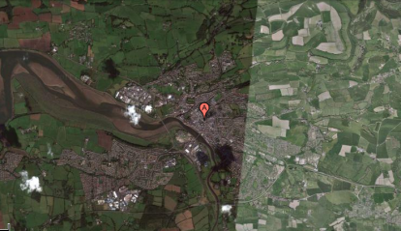
Barnstaple
GEO LOCATION:
51.08 ° North
4.05 ° West

Slide 4
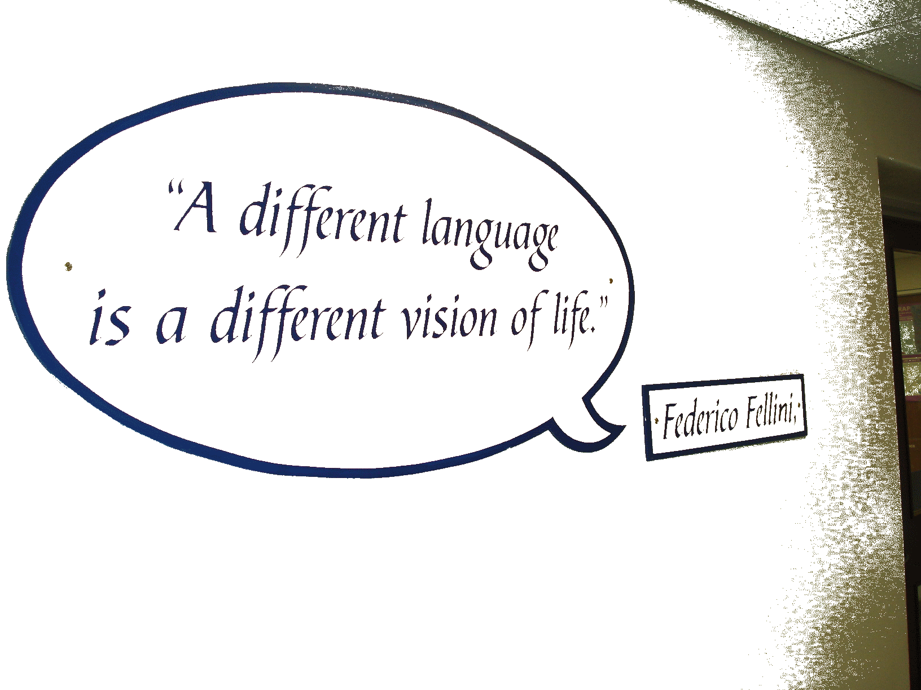



L’école d’accueil

Slide 5

Programme of the meeting
Wednesday, June 8th : arrival of the delegations
Thursday, June 9 th : visit of the College - Treasure hunt- Lunch at school- Project meeting
Friday, June 10 th : surf lesson– Lunch packet- Visit of Exeter Project meeting
Saturday, June 11 th : in Family
Sunday, June 12 th : departure of the European delegations

Slide 6

Wednesday, June 8 th

Slide 7
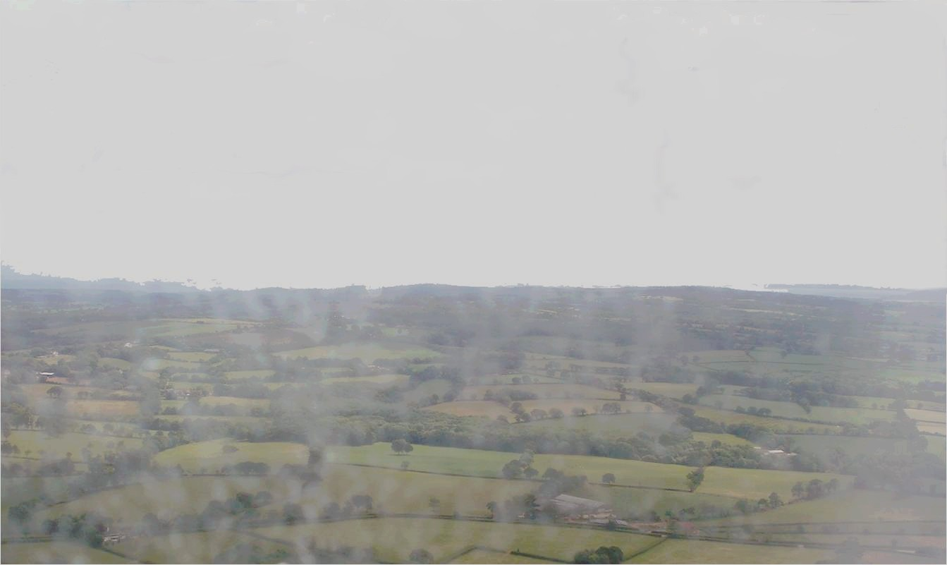
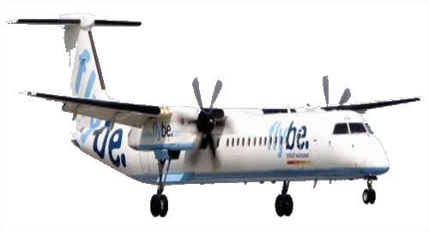
Departure of the French delegation …

Slide 8
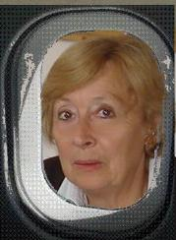
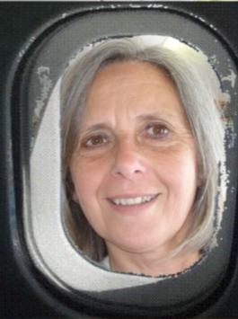
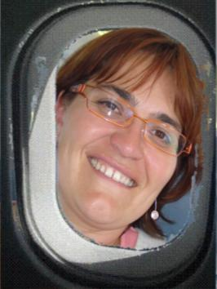
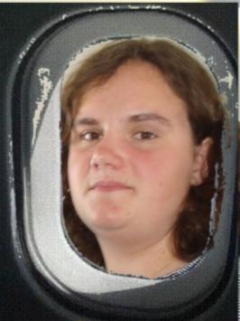
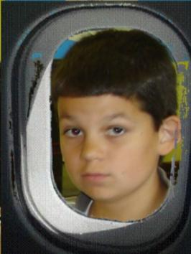
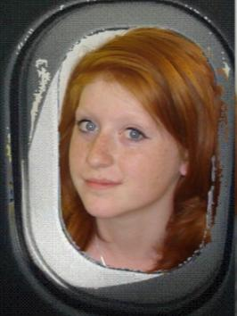
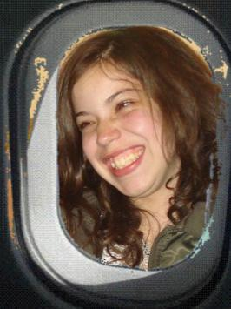
The pedagogical team:
D. LAVOLLEE N. VILLET L. MARTIN
The team of the students:
Laura Etienne Ellina Downa

Slide 9
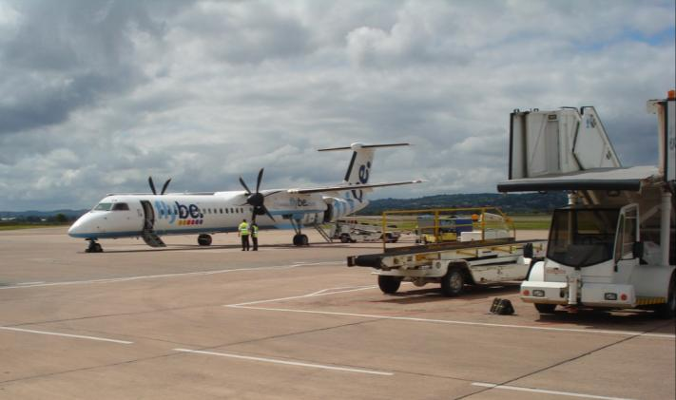
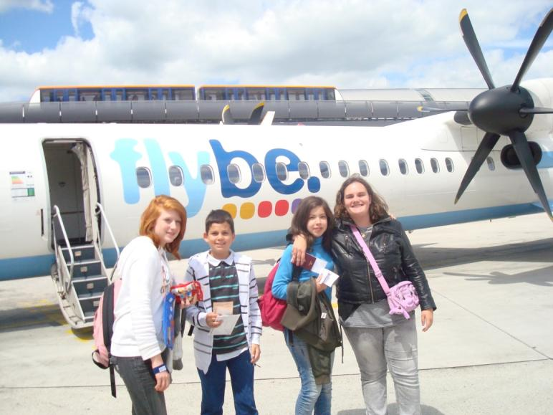
First steps in the UK:
Exeter

Slide 10
Thursday, June 9 th

Slide 11
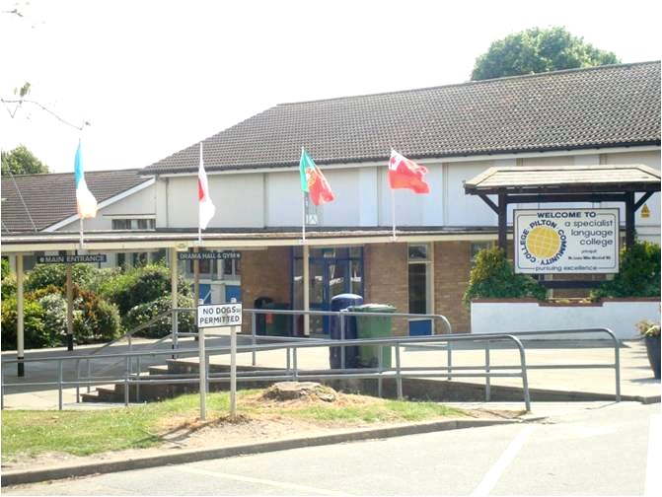
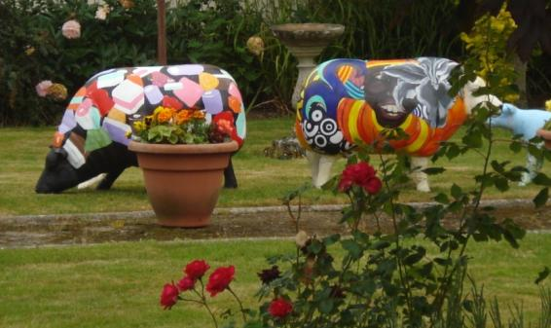
The partner school: Pilton Community College
In Barnstaple, Devon

Slide 12
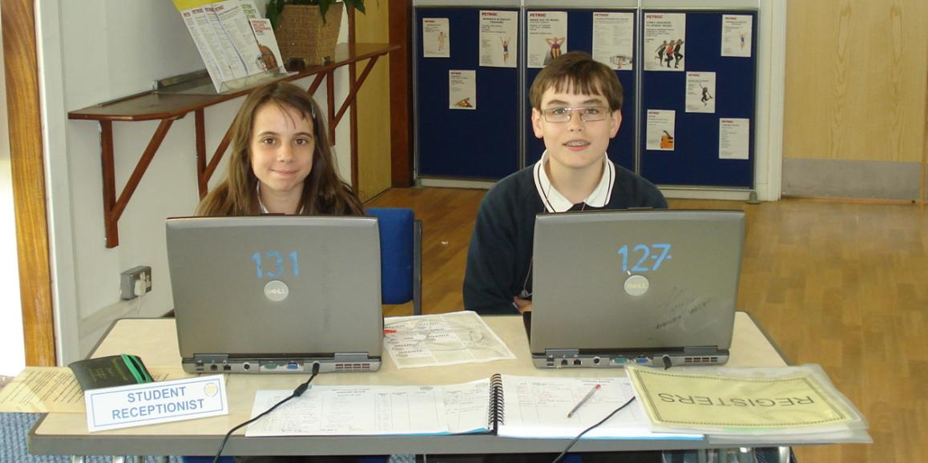
Visit of the College
Every day 2 students check the entrances of visitors who receive a badge

Slide 13
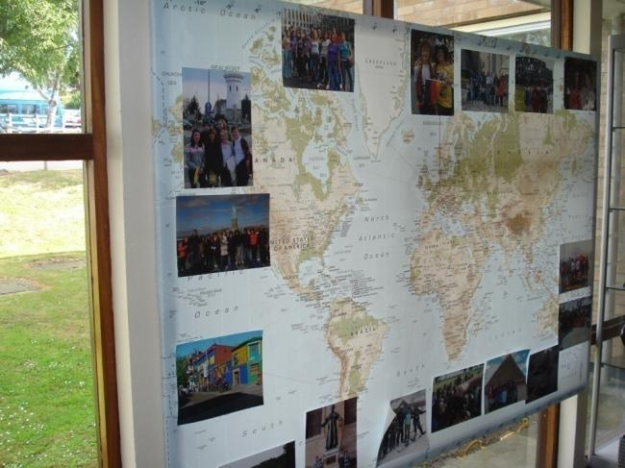
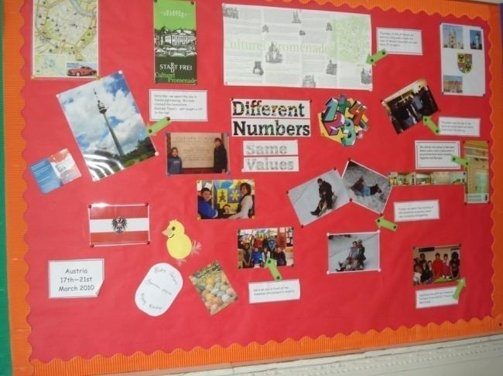
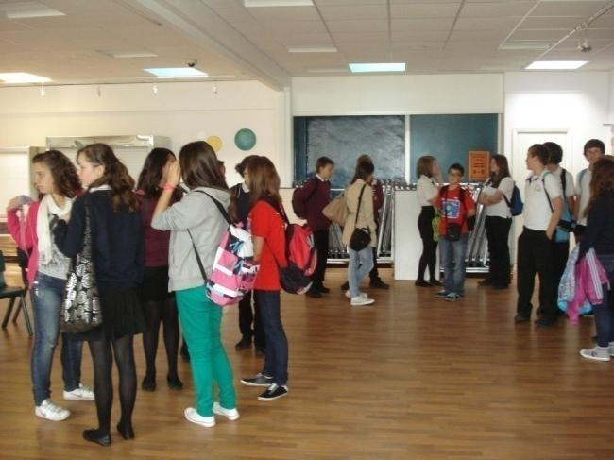
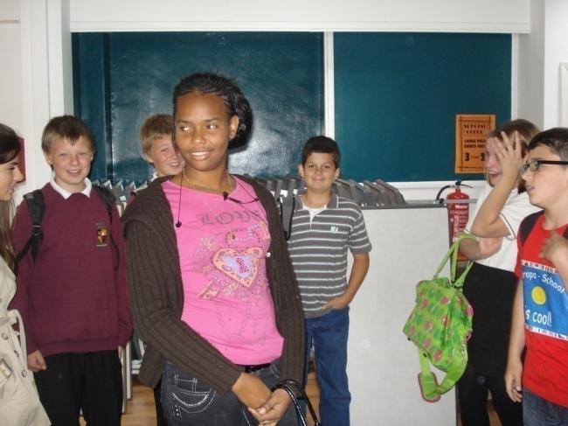
The European delegations meet for the first time

Slide 14
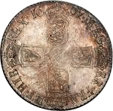
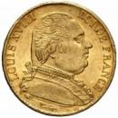
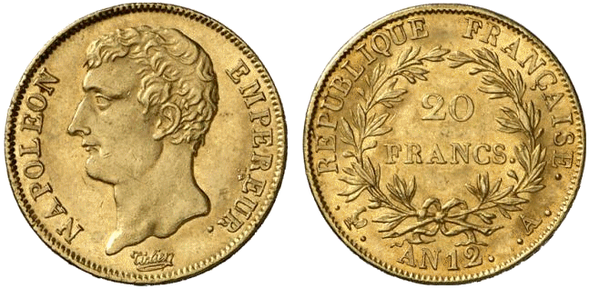
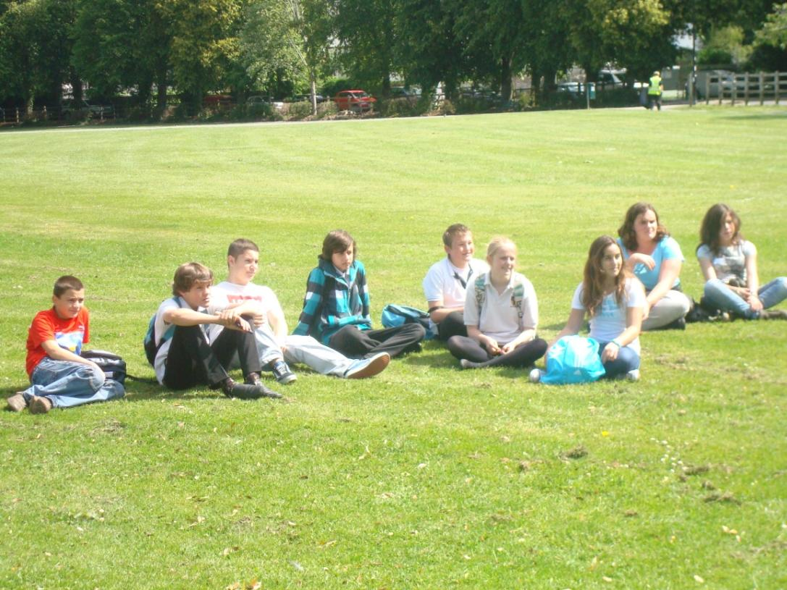
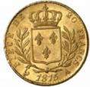
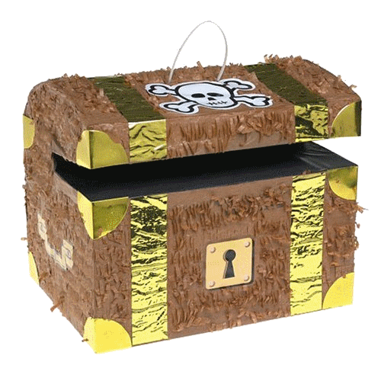
«European» treasure hunt

Slide 15
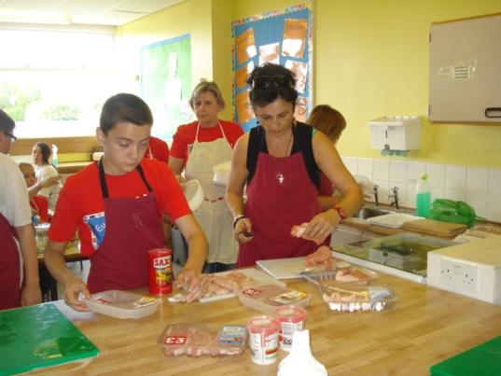
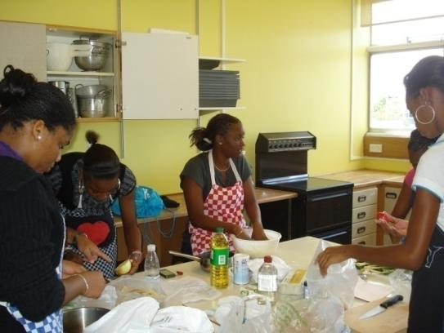
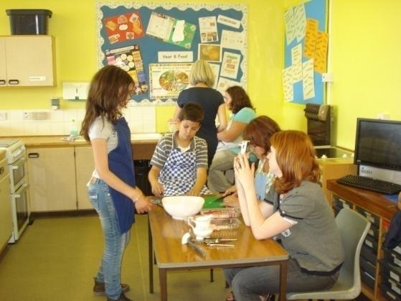
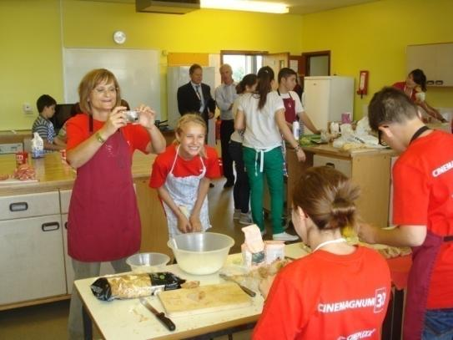
Preparing the European meals

Slide 16
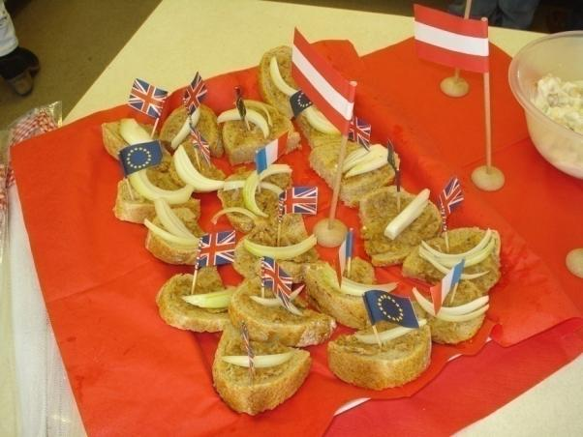
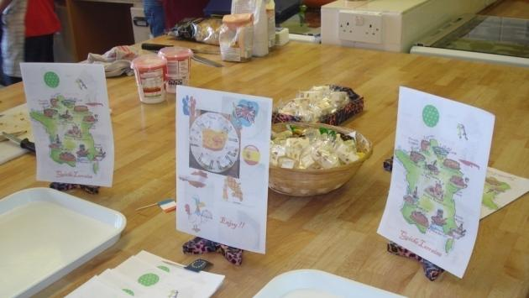
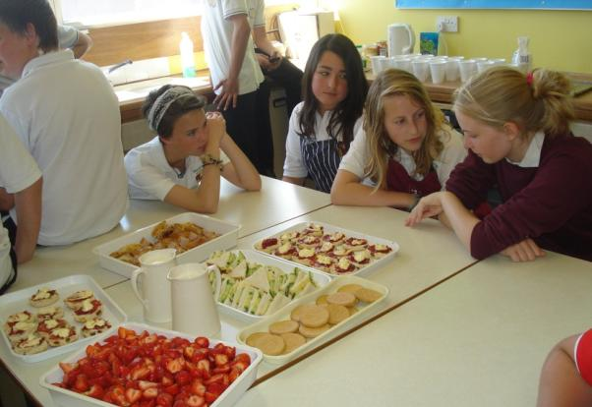
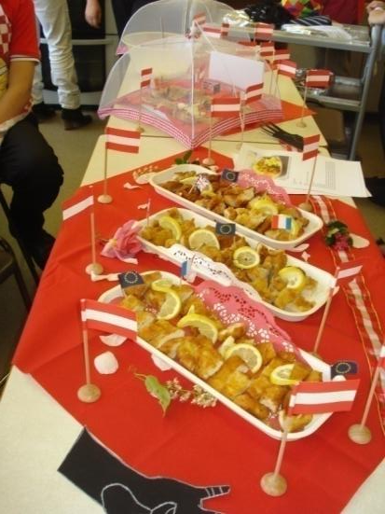
Miam
Miam

Slide 17
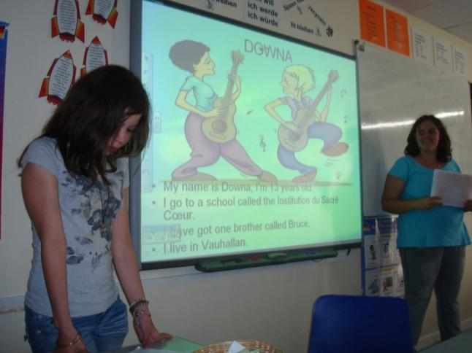
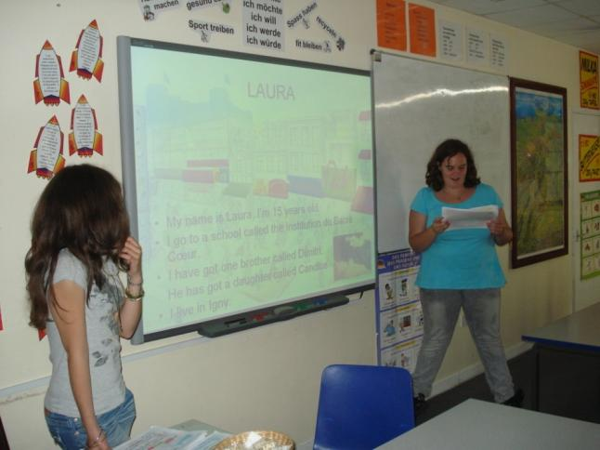
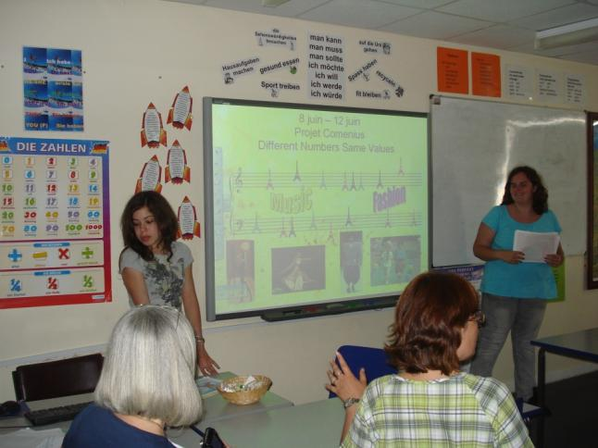
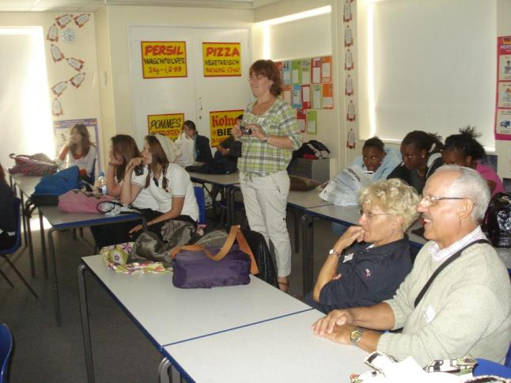
Presentation by Downa and Laura, with their responsables, Laurence Martin and Nicole Villet

Slide 18
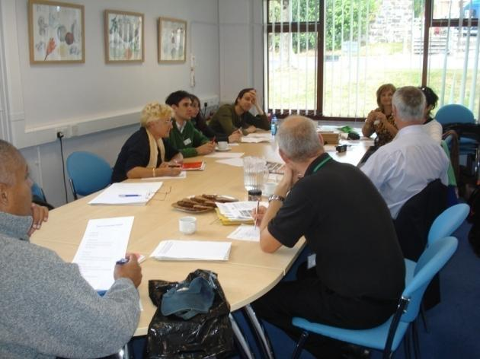
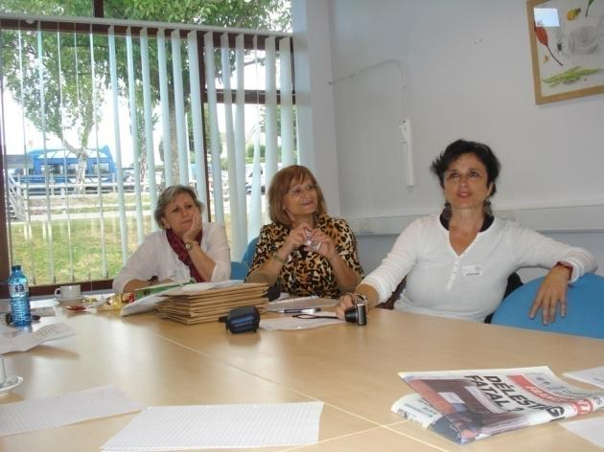
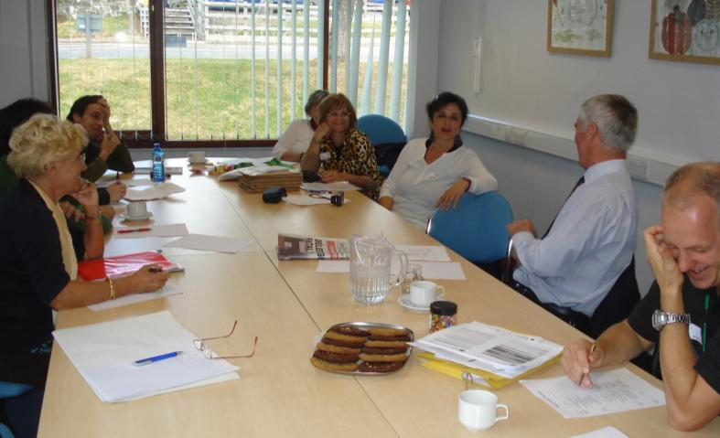
Project meeting for the teachers

Slide 19
Friday, June 10 th

Slide 20
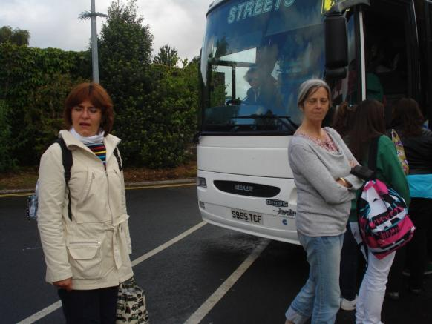
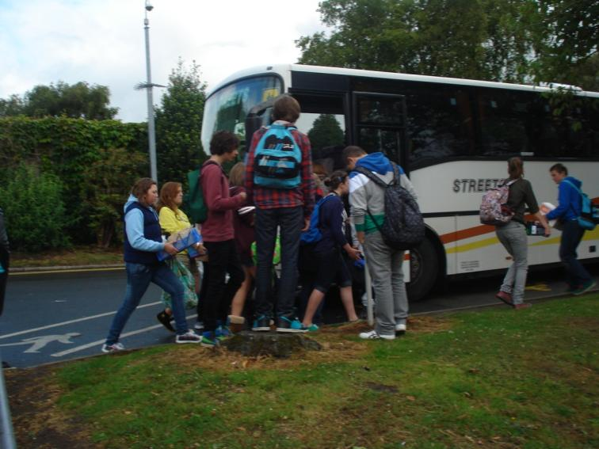
Departure for the surf lesson.
Laurence Martin and
Nicole Villet are ready! But…
the water will be cold!!

Slide 21
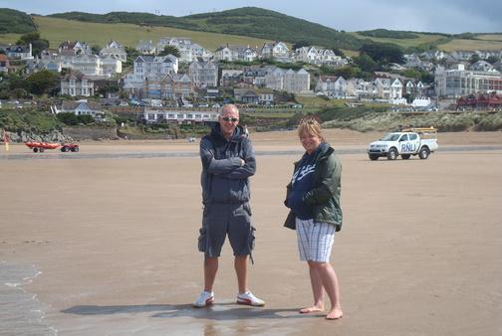
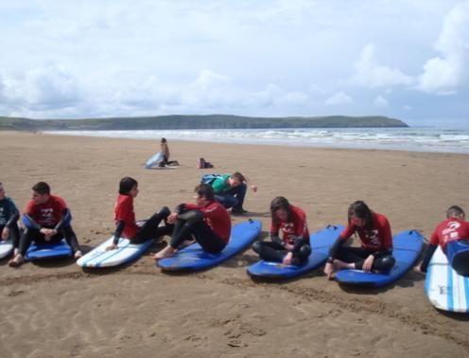

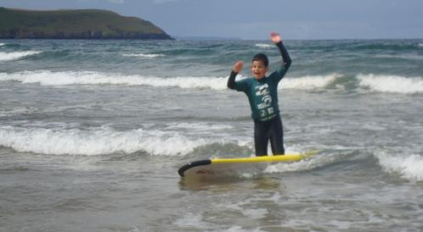


Slide 22



During the surf lesson for the students the coordinators are hard working

Slide 23



Visit of Exeter for all!

Slide 24
Saturday, June 11 th

Slide 25


Discovering of the region

Slide 26
Saturday, June 12 th

Slide 27



The 2 french delegations are flying back:
The lycée Joseph Gaillard of Fort de France and the ISC of la Ville du Bois

Slide 28


Logos réalisés par les élèves pour ce projet
European logo made by a spanish student and selected by all the partners
French logo of Julien M., Student of the class 3^{ème C} at the ISC

Slide 29




END OF OUR EUROPEAN ADVENTURE
Different numbers. Same values
Thank to all the partners

Slide 30
Photos : Danielle Lavollée, Etienne Pruvost and Nicole Villet
English version: Downa, Ellina, Etienne, Laura
Pedagogical team : D. Lavollée, L. Martin, N. Villet
Coordination of the PowerPoint : Danielle Lavollée
Technical support: Sté CJSC

