Slide 1
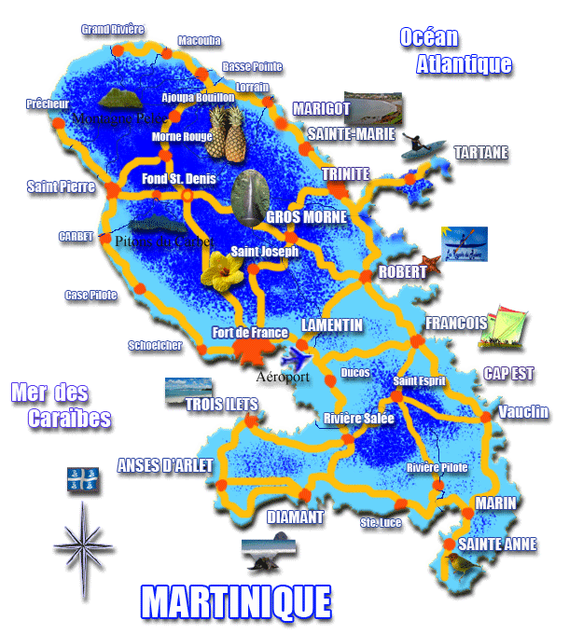
Comenius Project Turning Ideas Into Actions
2013 – 2015
Mobility 1 : Lycée Joseph Gaillard, Fort-de-France, Martinique
Tourism in Martinique

Slide 2
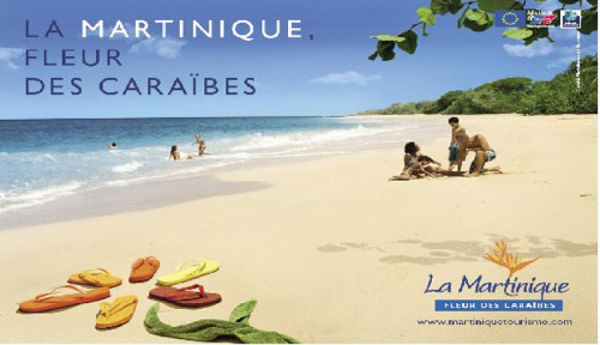
TOURISM in MARTINIQUE

Slide 3
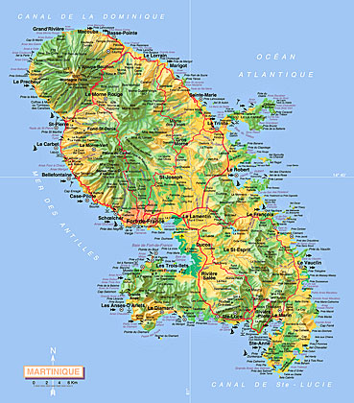
In Martinique one of the main sources of economy is tourism. Since 1900, for North Americans and Europeans, Martinique has been one of the first tourist destination. Between 2008 and 2009 tourism has generated 40 millions American dollars, 14% of the GBP. This sector creates more than 600 000 jobs and in 2011 it offered 3000 jobs and 12000 inducted jobs for the population.

Slide 4
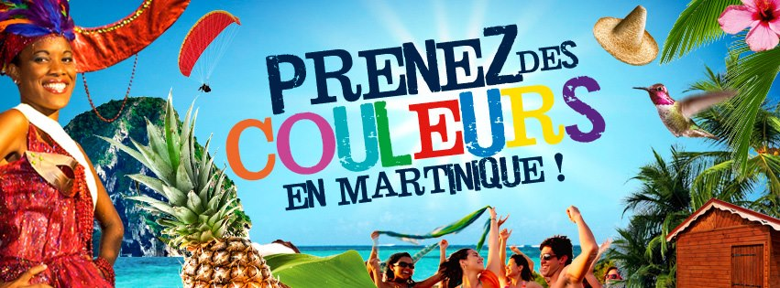
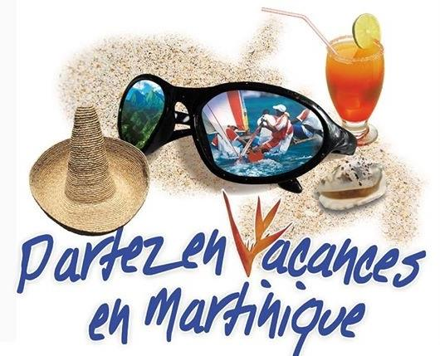
The tourists are attracted to this island by beaches and tropical climate.

Slide 5
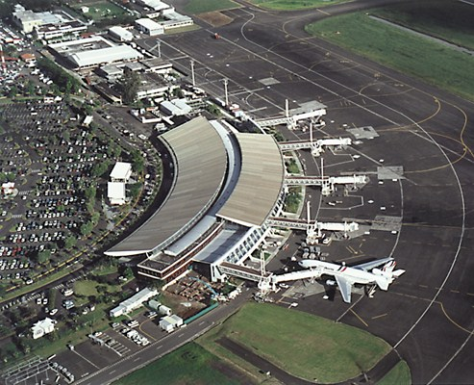
The Airport « Aimé Césaire »
The building of the airport in Fort-de-France in 1950, restarted the touristic activity that ceased after the WW II.

Slide 6
Sea, Sex and Sun
The tourism has evolved when people's way of thinking has changed. The stereotypical idea of Martinique with beaches, sea, sun, rum and coconut trees, that attract tourists, has been created by publicity.
The tourism here has been impulsed by the three « S »: Sea, Sun, and Sex.

Slide 7
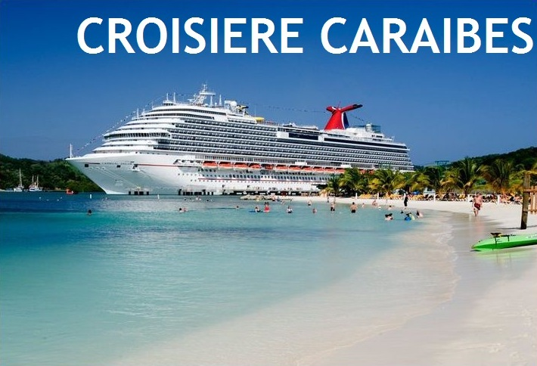
The cruise boats
The modernisation of the boats has permitted the development of the tourism on cruise boats.

Slide 8
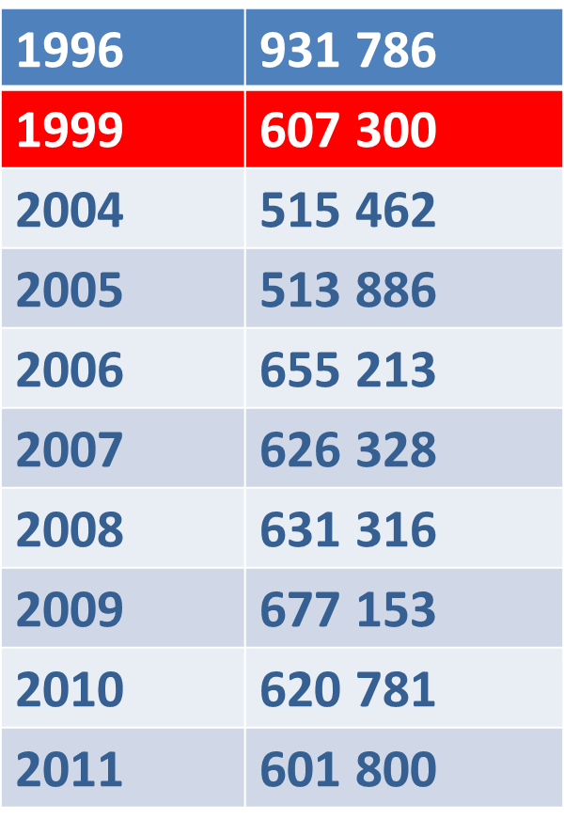
The decline of the tourism
Since the end of 1990 the tourism in Martinique has decreased because of the competition from other Caribbean islands, like the Dominican Republic, Jamaica, etc.
In Martinique and Guadalupe the standard of living is the highest in the Caribbean. Because of this, less tourists visit these places.

Slide 9
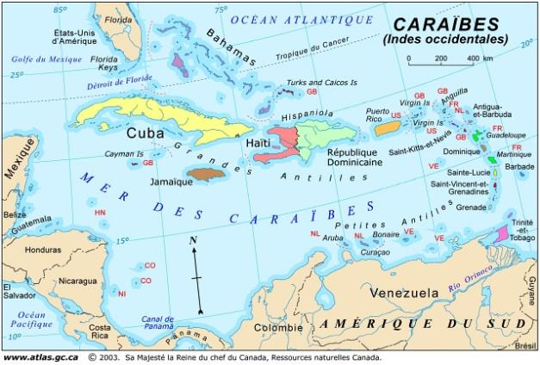
TOURISME AUX CARAIBES EN 2010
BAHAMAS : 1 368 053 tourists
DOMINICAN REPUBLIC : 4 124 543 tourists
PUERTO RICO :
1 369 814 tourists
MARTINIQUE :
ONLY
476 492 tourists
JAMAIQUE : 1 921 678 tourists

Slide 10
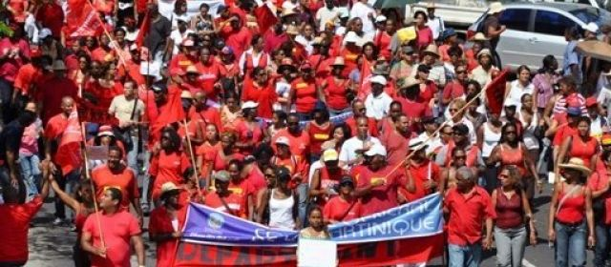
Another reason for this decline are the numerous strikes especially in the hotels. The Accord group, in 2002 and the Club Med in 2007, went on strike for weeks, flights from Canada were cancelled and the Canadians were very unhappy.

Slide 11
VISIT OF MARTINIQUE
Martinique is bathed by the Atlantic Ocean and by the Caribbean Sea. The island of Martinique has a surface of 1.080km² (417miles²) with a length of 70km (43 miles) and 30kms (19 miles) wide on her largest point.

Slide 12
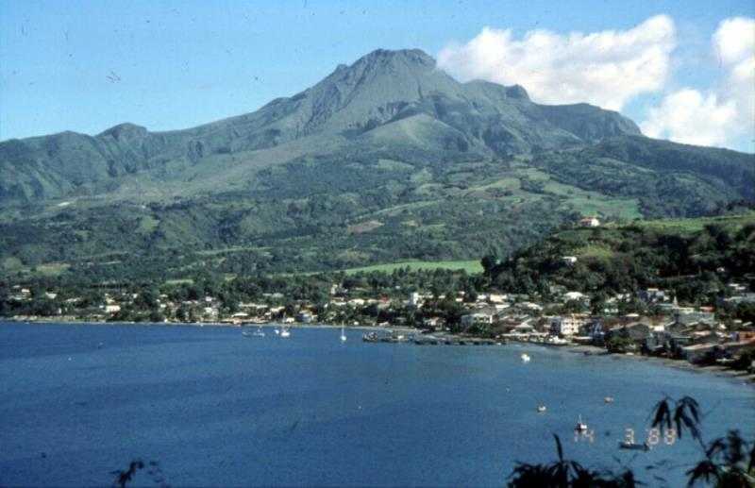
The active vulcano "Montagne Pelée"
The active vulcano "Montagne Pelée" is the highest peak at 1397m (4583ft).

Slide 13
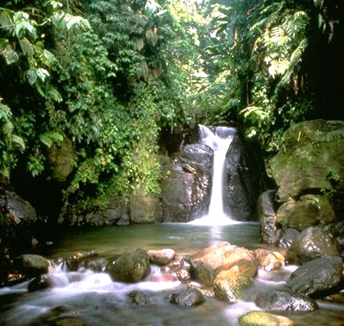
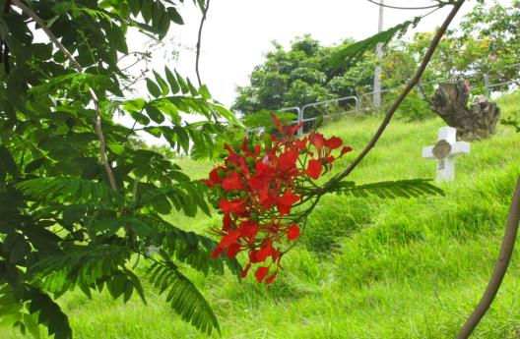
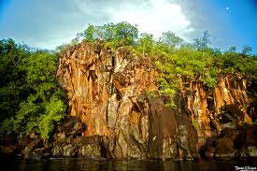
Despite her small size, the island offers a great diversity as for the landscape: steep mountains, rain forest, green hillsides, cliffs, savannas, gentle beaches....

Slide 14
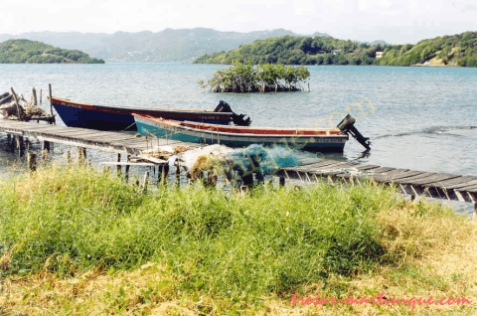
Photo of Point Savanna (Le Robert, Martinique)

Slide 15
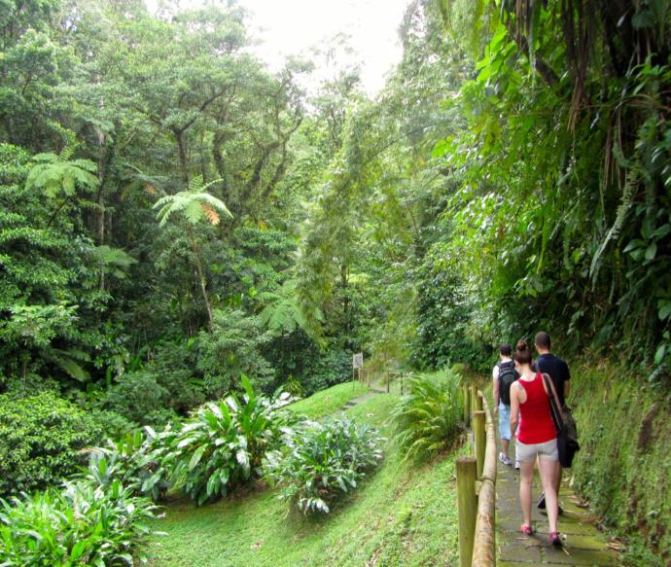
THE NATIONAL PARK
This natural park of 700km² (270miles²) is divided in several parts. It comprises the rain forest on the vulcanoes, as well as the peninsula "Caravelle", furthermore the South coast with the petrified forests and the "Salines", and also the "Diamant" region. 31 hiking trails have been marked by the National Forest Office and you can dicover Martinique's fauna and flora without orientation problems.

Slide 16
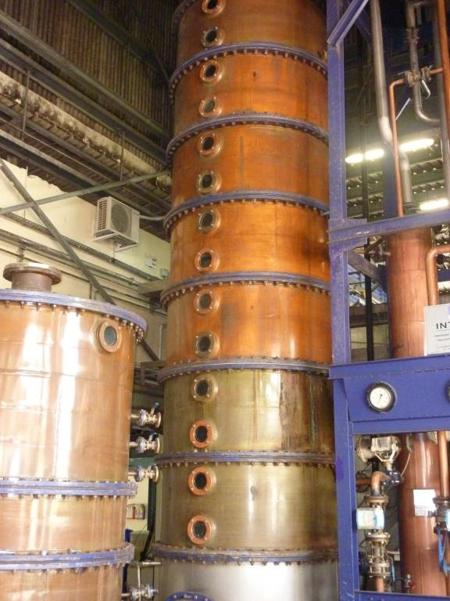
RUM DISTILLERIES
You can visit some rum distilleries to understand an ancient tradition of more than 300 years.

Slide 17
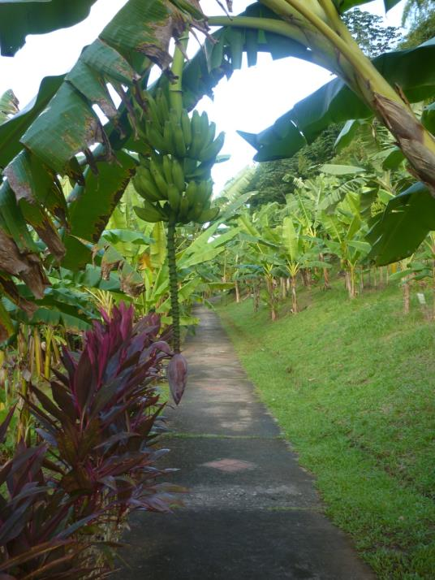
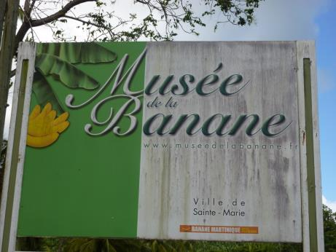
BANANA PLANTATIONS
You can visit also banana plantations and the museum…

Slide 18
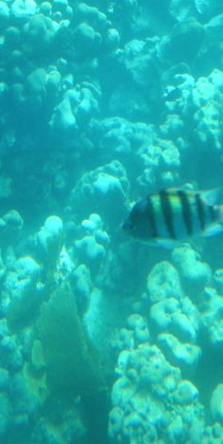
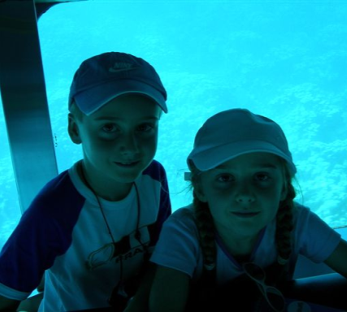
THE SEA
You can also discover the magical underwater world of coral reefs with the glass bottom boats or submarines.

Slide 19
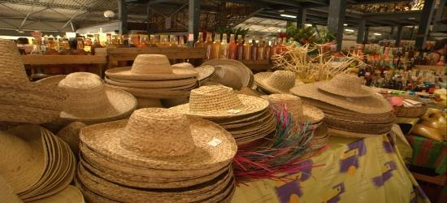
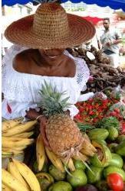
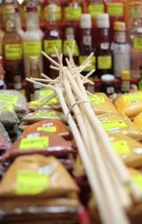
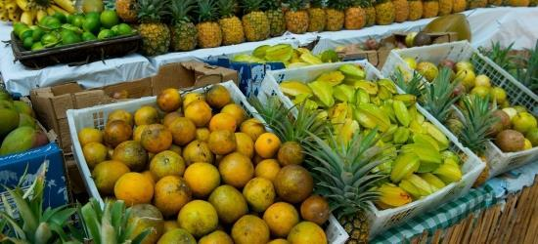
Don’t forget the Creole Markets: A blend of aromas, colours and flavours!

Slide 20
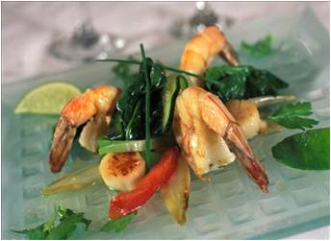
Happy stay in Martinique … and « bon appétit » !

Slide 21
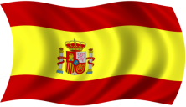
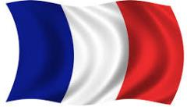
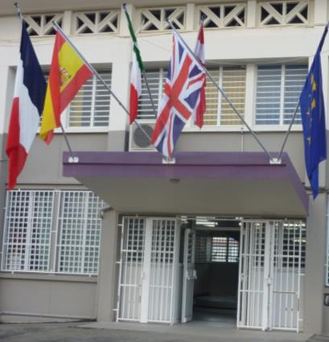
Ce diaporama a été réalisé
au Lycée Joseph Gaillard, Fort de France, MARTINIQUE,
dans le cadre du projet COMENIUS
« Turning Ideas Into Actions »,
le jeudi 21 novembre 2013.
Il est le fruit d’une collaboration
franco-anglo-espagnole avec la participation
des élèves suivants :
Marie AIRAUD
Lucie OVION
Erin HALL
Salva MATEOS
Nous remercions les professeurs documentalistes du Lycée Joseph Gaillard, Claire Lanuqueitte et Jean-Claude Necker qui nous ont accueillis au C.D.I et nous ont apporté leur aide précieuse.

