Slide 1
Going for gold Mobility 4 in ISC, La Ville du Bois From the16th of october to the 21st of october 2012
Comenius project !!!
Presentation of the French delegation of the ISC

Slide 2
My school is healthy because …
Security. Wellbeing. Rest.
Relaxation. Recreation.
Studies. Discovery ......

Slide 3
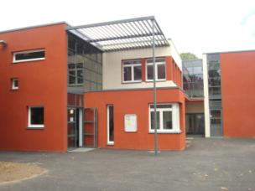
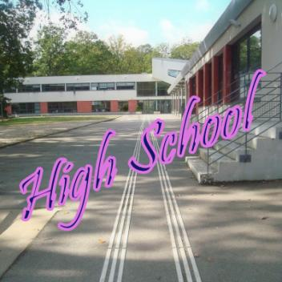
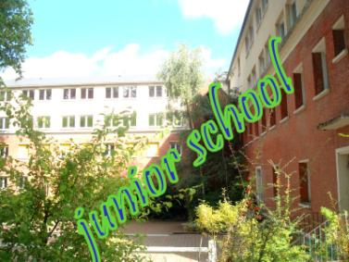
THE SPACES
THE NEW BUILDING !!!!!

Slide 4
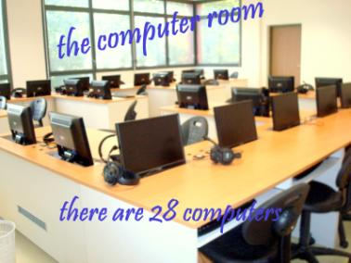
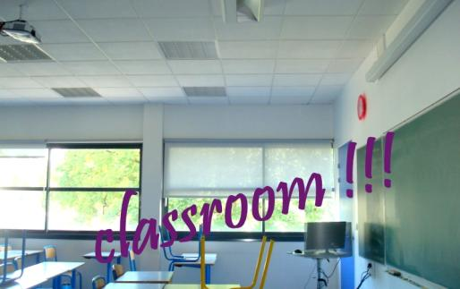
the Room !!!!!
overhead projector

Slide 5
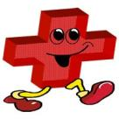
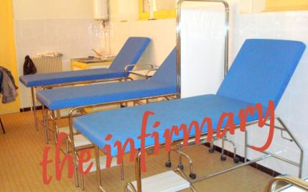
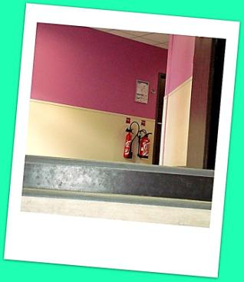
the safety
Color band

Slide 6
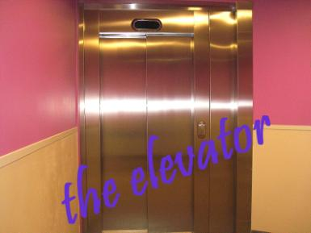
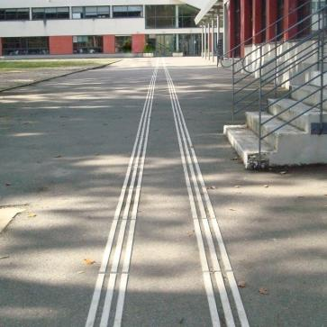
Our school is taking care of desable people
band for someone with low vision

Slide 7
Fresh food
. commission self ...

Slide 8
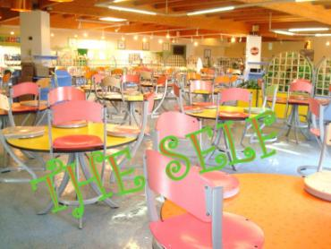
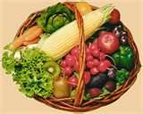
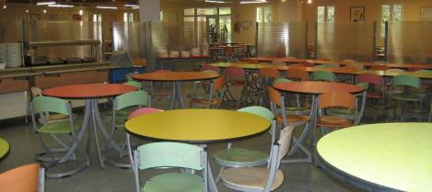
a large self
the self welcomes 950 people
per day
balanced meals

Slide 9
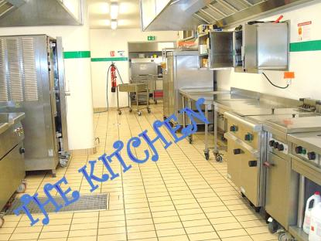
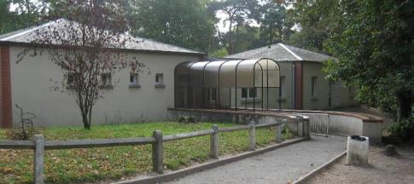
SELF !!!

Slide 10
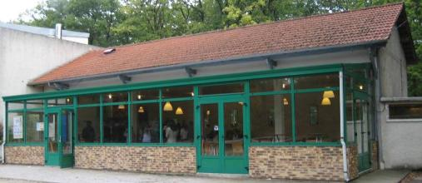
the cafeteria

Slide 11
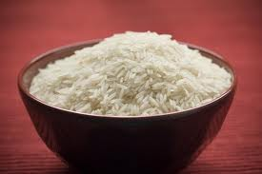
self commission
Every day 950 student’s take their lunch in the canteen
And every day 100 kg of food is throw to the carbadge
Day bowl of rice

Slide 12
Theater, yoga , sport, lake …

Slide 13
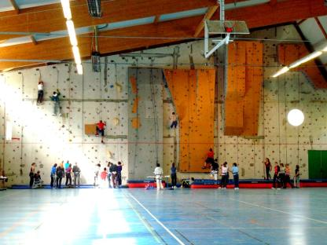
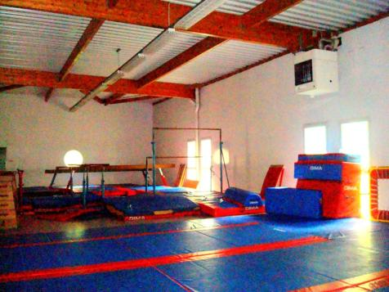
the gymnasium
CLIMBING WALL

Slide 14
Sports
climbing table tennis
riding horses Badminton
Basketball Volleyball
dance gymnastics, orienteering, mountain biking, football

Slide 15
Environment and ecology
15 hectars of forest

Slide 16
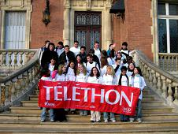
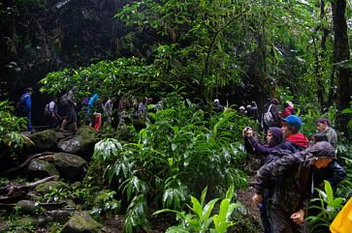
projects
Equator Project
Romania
Project

Slide 17
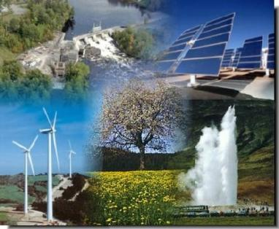
Project about Sustainable Energies with the UNESCO Associated schools in France

Slide 18
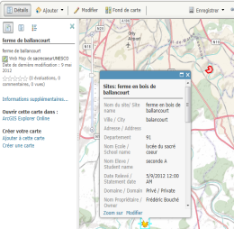
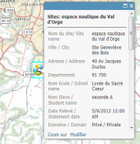
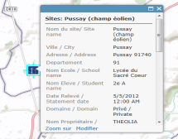
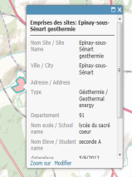
The students collect informations and make the legends to document their digital map

Slide 19
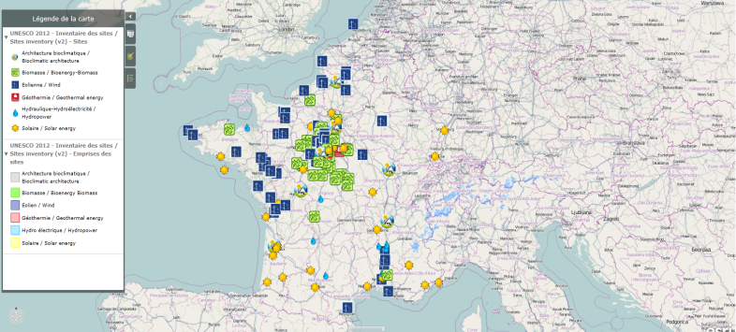
Conclusion of the students of six associated schools:
a digital map of Sustainable Energies in France

Slide 20
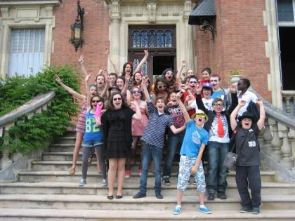
accept different pupils
the last day of school

Slide 21
quizz
How is made the roof of the new buildings ?
Is our college environmental friendly ?
How many kilograms of food are waste per day
in the canteen?

Slide 22
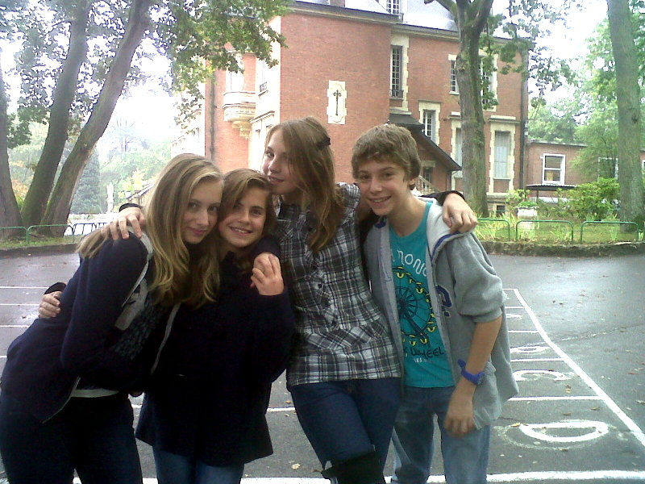
SIRHINE
JEANNE
HELOÏS
ANNE-LOU
Thank you!!!!!!
Miss Nicole Villet
This project is funded by the European Commission

