Slide 1
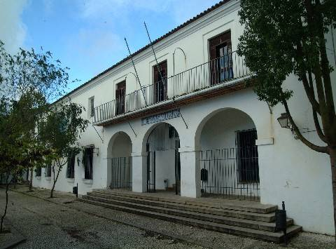
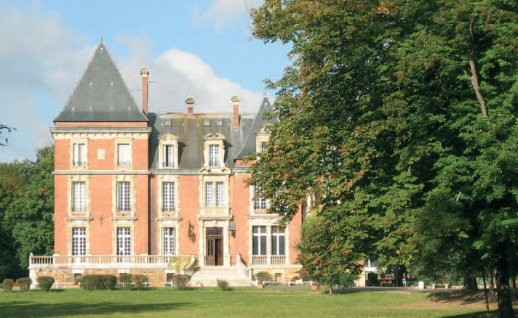
Comenius project: Tunrning Ideas Into Actions (2013-2015)
Mobility 3- Project meeting : Aracena - Spain – From 12th to 18th May 2014
IES San Blas – Aracena
ISC – La Ville du Bois
PRESENTATION OF THE FRENCH DELEGATION
ISC - Students

Slide 2
CONTENTS
I- The European partnership of the project
II- Subjects studied during the project « Turning ideas into Actions »
III- From France to Spain
IV- All you want to know about PIG and never dare to ask !
Tour de France of famous pork recipes
Pig in the French culture and language
Main figures about the pork industry
V- Quizz

Slide 3
I-The European partnership of the project

Slide 4
Comenius project Turning Ideas Into Actions 2013-2015 European partnership with 7 schools in 5 countries

Slide 5
II- Subjects studied during the project
Turning Ideas into Actions

Slide 6
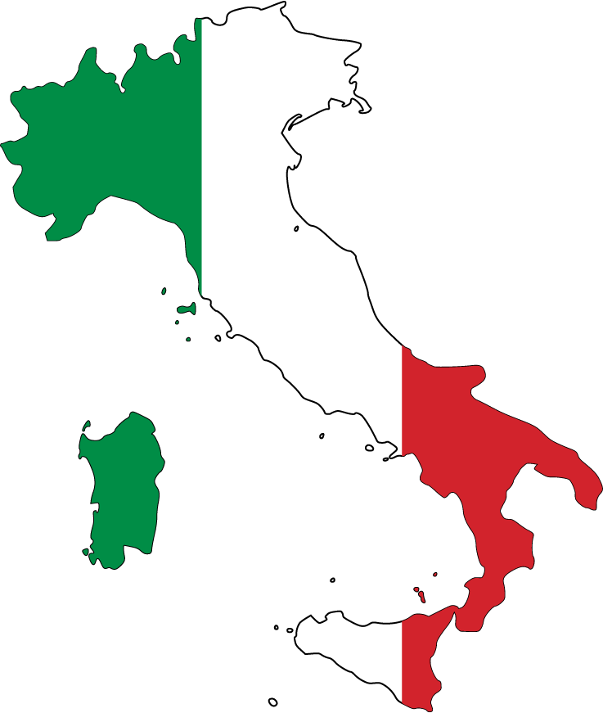
SHEEP ECONOMY
TOURISTIC ECONOMY
May 2015
Mobility 6
SKI ECONOMY
BANANA ECONOMY
March 2015
Mobility 5
March 2014
Mobility 2
PORK ECONOMY
WINE ECONOMY
November 2013
Mobility 1
May 2014
Mobility 3
October 2014
Mobility 4

Slide 7
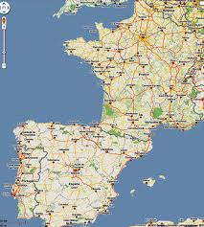
III- From FRANCE to SPAIN
La Ville du Bois, France
Aracena, Spain
about 1 685 km

Slide 8
SPAIN
Area : 506 000 km²
Population : 47 Million people
Population density/ km² : 92.5
Capital : Madrid
FRANCE
Area : 550 000 km²
Population : 66 Million people
Population density/ km² : 103
Capital : Paris

Slide 9
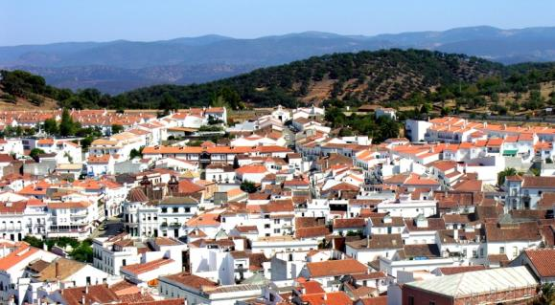
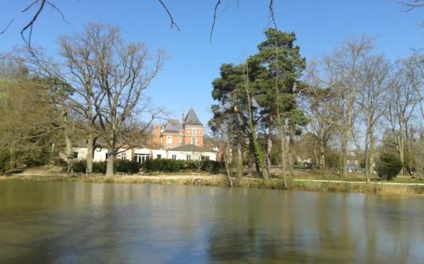
OUR SCHOOL :
ISC (Institution du Sacré Cœur)
Location : La Ville du Bois, France
25 km from Paris.
Environment :
At the heart of a very nice park including a lake.
Students : 1480
Headmaster : Thierry Dubois
Website :
www.isc-villedubois.com
THE SCHOOL WE VISIT :
IES San Blas
Location : Aracena, Spain
90 km from Sevilla
Environment :
In a nice city surrounded by the hills of the Sierra Huelva
Students :
Headmaster :
Gabriel de la Riva Pérez
Website : http://www.juntadeandalucia.es/averroes/centros-tic/21700381a/helvia/

Slide 10
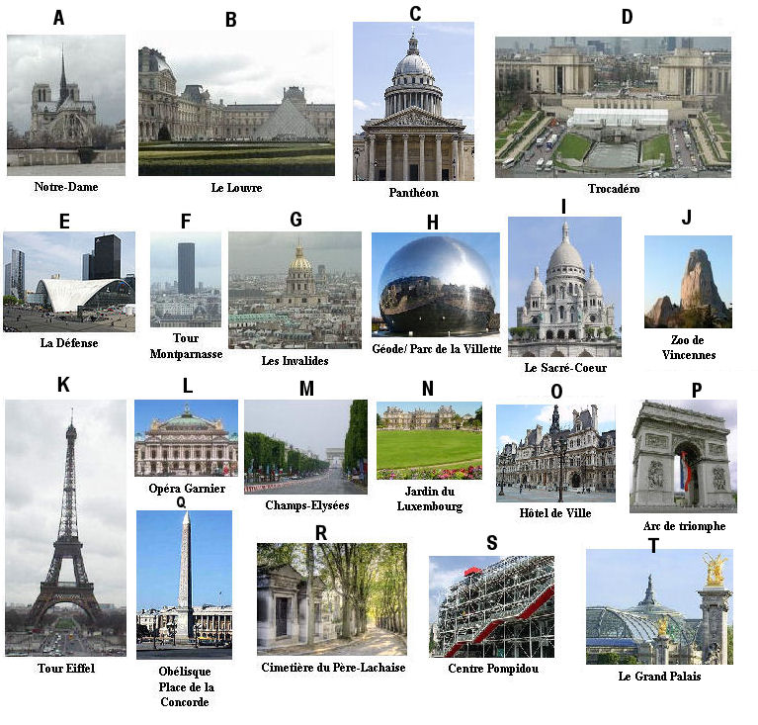
Our school, ISC, is near the capital Paris

Slide 11
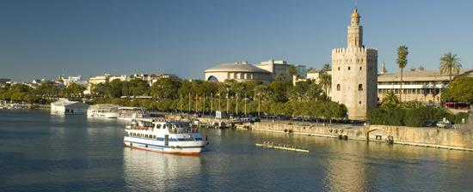
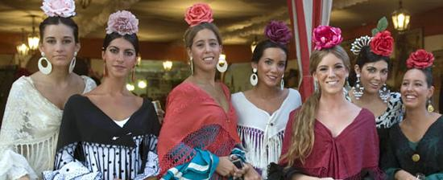
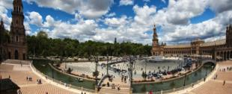
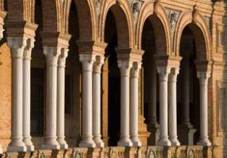
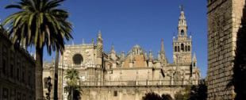
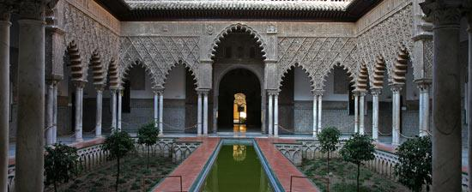
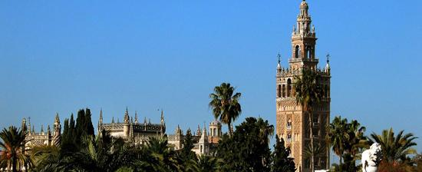
The school we visit, IES San Blas, is near Sevilla, the capital-city of Andalousia
Torre del Oro
Plaza de España
Catedral
Real Alcàzar
Giralda

Slide 12
IV- All you want to know about
and never dare to ask !!!
Tour de France of famous Pork recipes
Pig in the French culture and language
Main figures about the Pork industry

Slide 13
Pork has a very important part in French food :
each region has specialities…
Some are very original !

Slide 14
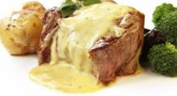
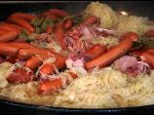
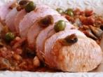
Map of France and specialities examples
In Picardie :
«Filet mignon with Maroilles cheeese»
In Alsace :
«Choucroute» (Sauerkraut).
In Ile de France : « Paris Ham».
In Franche Comté : «Morteau
sausage».
In Pays de la Loire: «Rillettes du Mans».
In Limousin : «Black Pudding with chestnuts»
In Corse :
« Figatellu sausage».
In Côte d’Azur : «Provençal Pork Joint».

Slide 15
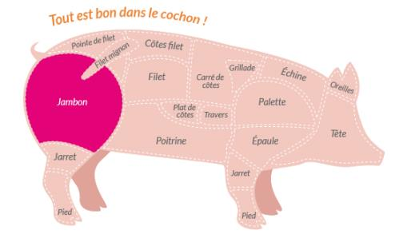
«Paris Ham»
Ingredients :
Boiled ham !

Slide 16
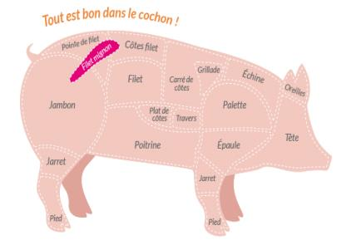
«Filet mignon with Maroilles cheese»
Ingredients :
- Cheese : Maroilles
It’s the tenderest part of Pork,
The most expensive too.

Slide 17
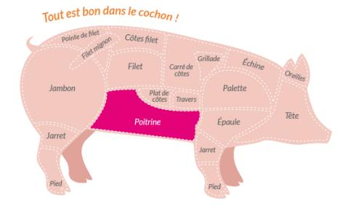
«Sauerkraut from Alsace»
Ingredients :
Frankfurt sausages
Bratwurst sausages
- Bacon
- Onions, - Green cabbages
- Juniper berries

Slide 18
«Morteau sausages»
Ingredient :
- Wood smoked pork meat made into a Sausage

Slide 19
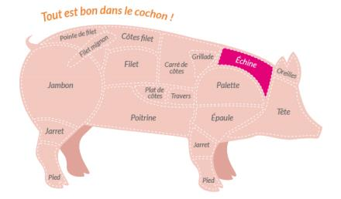
«Provençal Pork joint»
Ingredients :
- Pork joint
- Tomatoes
- Olives
- Wild Mushrooms

Slide 20
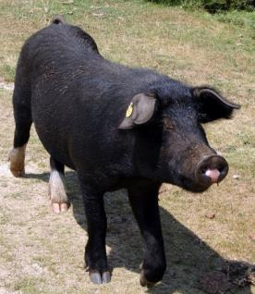
«Figatellu»
Ingredients :
- Corsican black Pigs meat
Black Pigs liver
Red wine
Garlic
It ‘s made into a dried sausage

Slide 21
«Black Pudding with chestnuts»
Ingredients :
- Pork meat and blood
- Onions
- Chestnuts
- Apples

Slide 22
«Rillettes from Le Mans»
Ingredients :
- Pork meat
- Bacon
- Salt
- Pepper

Slide 23
2. Let’s talk about Pig in the French culture and language

Slide 24
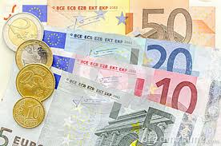
A)
Piggy bank :
Most of young French peole have a pork-shaped moneybox to put their little savings inside.

Slide 25
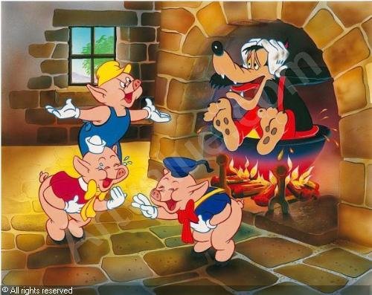
B)
Three little Pigs :
The story of the three little Pigs is very popular in France.
Every child knows this tale :
Naf-Naf, Nif-Nif, Nouf-Nouf are three Pigs brothers.
They build three different houses one for each :
- Naf-Naf = He builds a straw house
- Nif-Nif = He builds a wood house
- Nouf-Nouf = He builds a brick house
The wolf destroys Nif-Nif and Naf-Naf’s houses, he blows them off !
but not Nouf-Nouf’s house which is in brick and very solid. The three brothers lives in the same house.
They burn the wicked wolf in the pot.

Slide 26
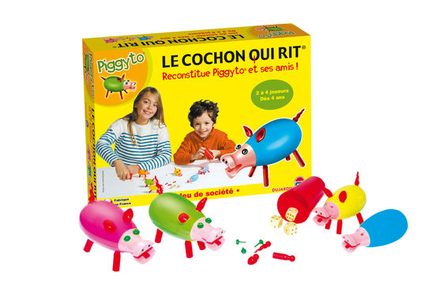
C)
The laughing Pig :
The laughing pig is a very popular family game in France for young children, from 5 to 8 years old.
The principle of this game is to assemble a pig figurine as quickly as possible.

Slide 27
Some very popular French expressions…

Slide 28
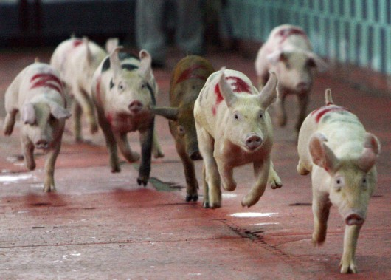
A)
Buddies like Pigs :
Be « buddies like Pigs » is a French expression to say « be very good friends », because the Pigs are always in group.

Slide 29
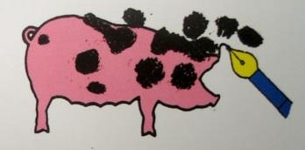
B)
Write like a pig :
To write in a very dirty way.

Slide 30
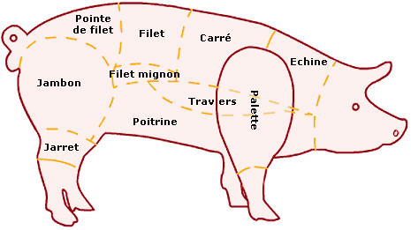
C)
Everything is good in the Pork
Each part of the Pork can be eaten.
From ears to feet.

Slide 31
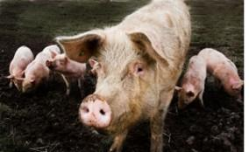
D)
Be dirty like a Pig
A person who doesn’t take care of himself, with a lack of hygiene.

Slide 32
E)
Be a big Pig :
A man, interested in looking at beautiful women...

Slide 33
3. Main figures of the pork industry in France

Slide 34
A) French consumption
Pork meat is the French favourite meat with 34 kg per year per person.
Around :
¼ is eaten as meat,
¾ as cooked pork meats « charcuterie » (sausages, pâtés, ham…)

Slide 35
B) Breeding/farms
France counts 20 000 farms of porks breeding. At around 6 months , porks are ready to go to the slaughterhouse.
French breedings mainly belong to farmers and not to private society like often in Spain or the United States.
Size of French breedings is among the smallest one in Europe

Slide 36
C) French production
French farmers product 25 million of porks per year. It places France at the third place in Europe after Germany (1st) and Spain (2nd).
As French people eat the equivalent of 23 millions porks, France is self-sufficient at 106% for its consumption.

Slide 37
D) Commercial exchanges
Because tastes and eating habits are different from one country to another, France exports a part of its production (offal, belly) and imports some other pork’s piece (ham).
1/3 of the European production is exchanged through EU countries.
EXPORTS
IMPORTS
Italy is our first customer and represents 26% of French exports.
Spain is our first supplier and represents 48% of French imports.

Slide 38
QUIZ 1- Our country France
How many inhabitants?
52 million
60 million
66 million

Slide 39
2- Our Capital
Give 3 famous monuments in Paris

Slide 40
3- Our town La Ville du Bois
Where is the town located ?
from Paris
60 kms
100 kms
25 kms

Slide 41
4- Our ISC School
How many students:
1480
2500
720

Slide 42
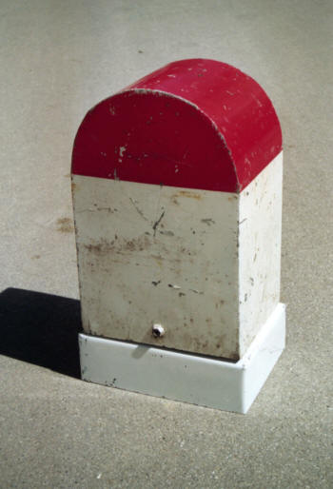
5- How far is our ISC school from IES San Blas ?
1400 km
1685 km
1205 km

Slide 43
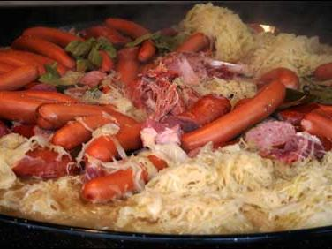
6- From which part of France does the Choucroute come ?
NORTH ?
WEST ?
EAST ?
SOUTH ?

Slide 44
7- French consumption of pork per year
☺ Find the numbers
11 kg per person
23 kg per person
34 kg per person

Slide 45
8- What is the grade for the French production of porks in Europe ?

Slide 46
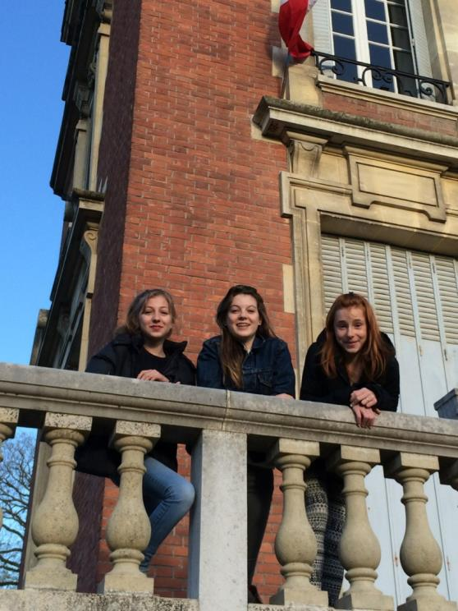
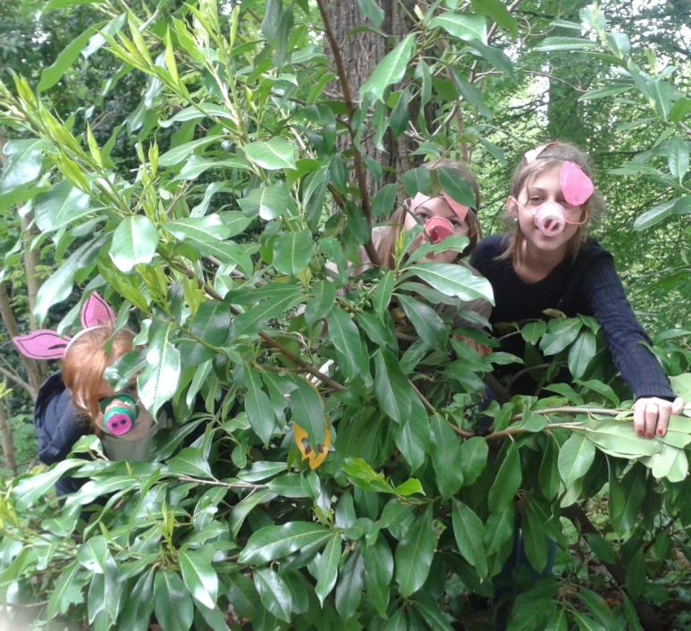
Students team Anne-Lou, Cléa, Lise-Marie
Teachers team
Danielle Lavollée (French coordinator), Agnès Mahé, Laurence Martin

