Slide 1
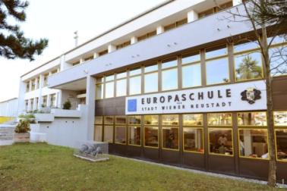
Presentation of the French delegation Our country, our school and winter sports in France Isc- La Ville du Bois- France
Comenius Project Turning Ideas Into Actions
Mobility - Project meeting : Europaschule - Wiener Neustadt
Austria- March 2-9, 2014

Slide 2
CONTENTS
I- The European partnership of the project
II- Where do we come from? Where are we going to?
III- Skiing in Europe and in the world
IV- Winter sports in France
A) Skiing in France
B) The French most popular skiing areas
C) Our mountain ranges
D) Economic issues
E) Different winter sports
V- Winter Olympics 2014 in Sotchi : Some French champions
VI- Future Comenius champions of the ISC School!!!

Slide 3
I-The European partnership of the project

Slide 4
Comenius project Turning Ideas Into Actions 2013-2015 European partnership with 7 schools in 5 countries

Slide 5
II- Where do we come from?
Where are we going to?

Slide 6
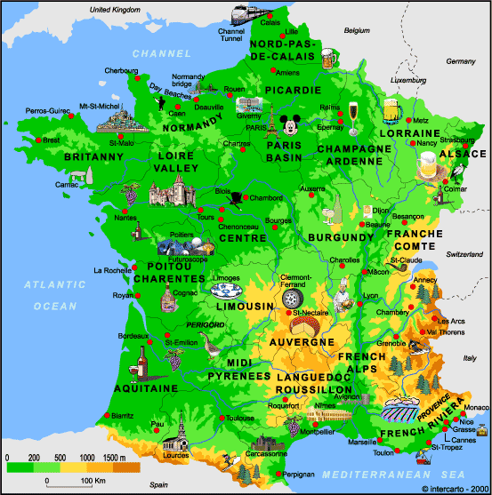
Where are we coming from? (1) Our country: Metropolitan France
Area: 550 000 km²
Population: 66 Million people
Population density/ km²: 103
Capital city: Paris

Slide 7
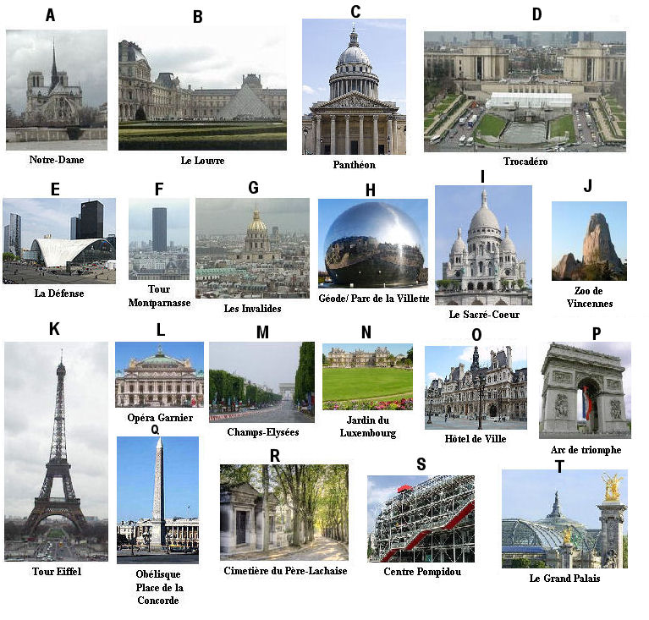
Where are we coming from? (2)
Famous monuments in the capital: Paris

Slide 8
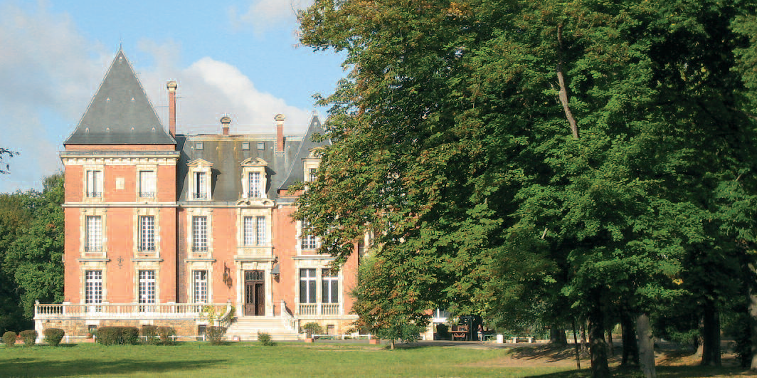
Where are we coming from? (3)
Our ISC SCHOOL: Collège du Sacré-Coeur
The ISC School
is located 25 km in the south of Paris
lies in a very nice green park with a lake
has 1480 students and a staff of 130 persons
its motto : The reason of being is to permit pupils to reach their own level of excellence.

Slide 9
Where are we going to? (1) Austria
Area: 98 000 km²
Population: 8,5 million people
Population density/ km²: 102
Capital city: Vienna

Slide 10
Where are we going to? (2) Famous monuments in the capitale: Vienna

Slide 11
Where are we going to? (3) Europaschule, Wiener Neustadt
The project on the school website: a nice and very good documented presentation

Slide 12
III- Skiing in Europe and around the world

Slide 13
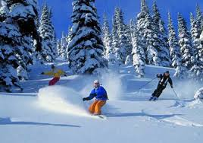
Skiing in Europe and in the world
Skiing is a sport practiced in 80 countries
1700 ski resorts in the world
☞ 100 million skiers Europe is the largest skiing area in the world
4 countries in Europe stand out by the number of their ski resorts :
☞ Austria
☞ France
☞ Italy
☞ Switzerland
 The Alp resorts (France, Italy, Switzerland and Germany) boast 45 % of ski days - more than USA (23%).

Slide 14
IV- Winter sports in France

Slide 15
A) Skiing in France
France was ranked the worldwide leader in winter sports in 2009 and 2012.
France has a favourable geographical situation and offers 350 ski resorts in 7 mountains.  France is one of the countries that offers the biggest number of ski lifts and attracts the largest number of foreign skiers.
10 million visitors a year
7 millions are skiers
2 millions are foreign visitors

Slide 16
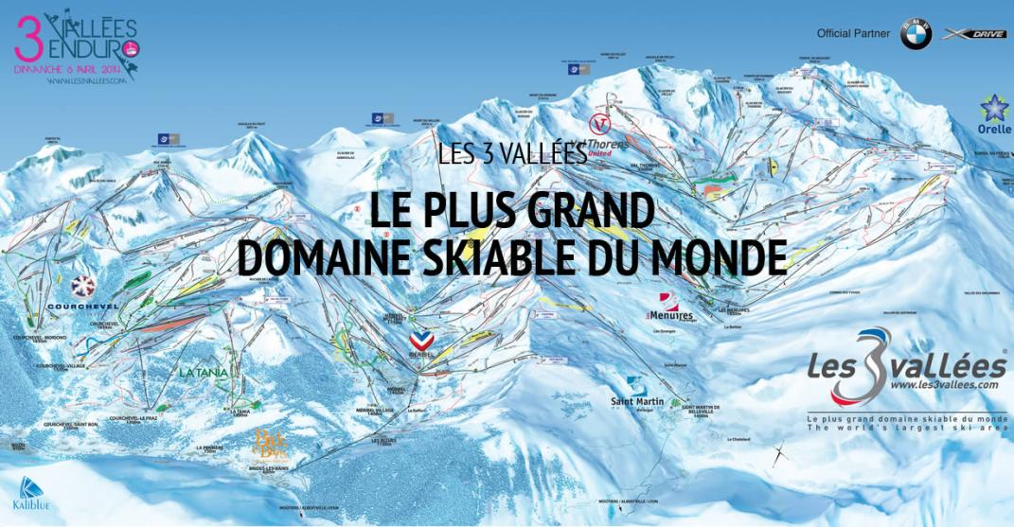
B) The French most popular skiing areas
The most popular skiing areas are Les 3 vallées, Les portes du soleil, Paradiski and Evasion Mont-blanc
600 km of slopes for skiers and snowboarders

Slide 17
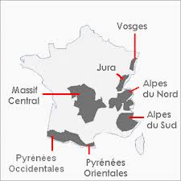
C) Our French mountain ranges

Slide 18
The Alps

Slide 19
a) The northern Alps ski resorts
The Northern Alps present the highest concentration of ski resorts, more than the Southern Alps, the Vosges and the Massif central.
135 ski resorts Highest summit (4465m) a lot of glaciers
Avoriaz 1 800 m
Haute Savoie
Courchevel 1 100 m
Savoie
La Plagne 1 250 m
Savoie
Alpe d’Huez 1 860 m
Isère
Flaine 1 600 m
Haute Savoie
Les Menuires 1 850 m
Savoie

Slide 20
b) The south Alps ski resorts
65 ski resorts in this massif
Isola 2 000 m
Alpes Maritimes
Montgenèvre 1 860 m
Hautes Alpes
Serre-Chevalier Vallée 1200 m
Hautes Alpes
Praloup 1 600 m
Alpes de Haute Provence
Les Orres 1 550 m
Hautes Alpes
Les Orcières 1 850 m
Hautes Alpes

Slide 21
The Massif central

Slide 22
d)The Massif central ski resorts
Massif Central
37 ski resorts
Jura
42 ski resorts
Lioran 1 160 m
Cantal
Métabief 1 000 m
Doubs
Besse Super Besse 1 350 m
Puy de Dôme
Les Rousses 1 120 m
Jura

Slide 23
The Pyrenees and the Vosges

Slide 24
The ski resorts of the Pyrenees and of the Vosges
« Les Pyrénées »
45 ski resorts
« Les Vosges »
24 ski resorts
Font-Romeu 1 712 m
Eastern Pyrenees
Le Lac Blanc 900 m
Haut Rhin
Saint-Lary Soulan 1 700 m
High Pyrenees
Gérardmer 750 m
Vosges

Slide 25
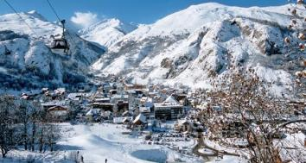
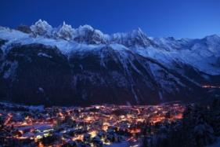
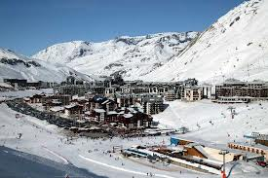
D) Economic issues of winter sports in France
IV- The engine of economy
 The winter sports are the engine of the economy.
 More than 120.000 jobs depend upon the opening days of the ski areas : Lodgeway, catering, accomodation, ski schools…
1€ spent in the ski lifts
6€ spent in the ski resorts

Slide 26
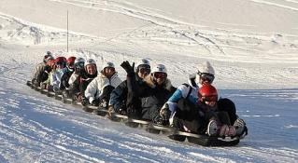
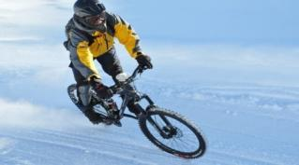
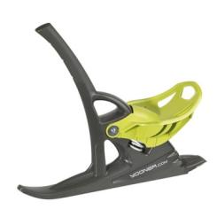
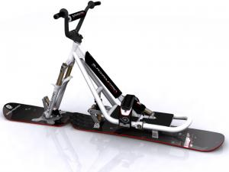
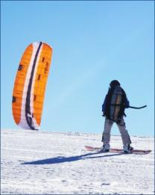
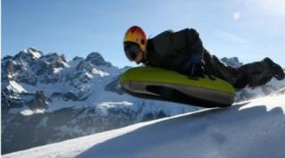
E) Different winter sports
Skiing is the first activity of the holiday-makers in ski resorts but other Winter sports are also practiced.
Snacke gliss
Mountain bike on snow
Snowcoot
Yooner
Snowkite
Airboard

Slide 27
F) Winter Olympics in France

France hosted the Olympic Winter games 3 times: 1924,1968,1992
In 1924 in Chamonix
In 1968 in Grenoble
In 1992 in Albertville

Slide 28
V- Winter Olympics 2014 in Sotchi :
Some French champions

Slide 29
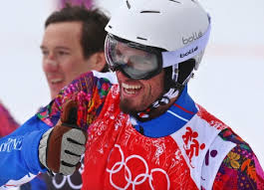
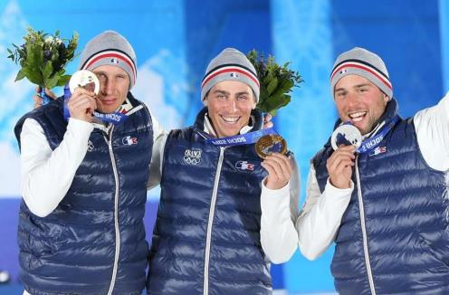
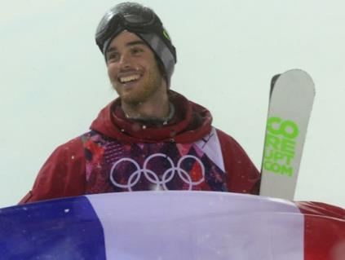
Some French medals winners in Sotchi 2014 (1)
During the Olympic games in 2014 in Sotchi, France won 15 medals

Pierre Vaultier Gold medal in Snowboard cross
Jean-Frédéric Chapuis Gold medal, Arnaud Bovolenta Silver medal and Jonathan Midol Bronze medal in Ski cross
Kevin Rolland Bronze medal in Free style ski

Slide 30
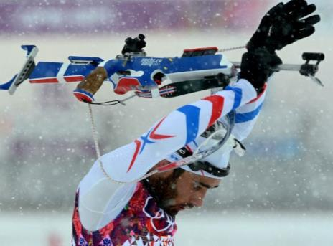
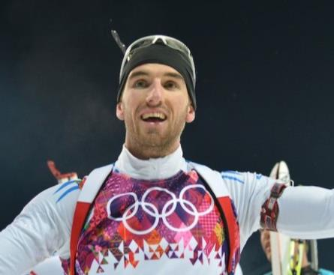
Some French olympic champions 2014

Here are some French olympic champions
Martin Fourcade
2 Gold medals in Biathlon, and Silver medal in
Biathlon mass start
Jean-Guillaume Beatrix, Bronze medal in 12,5 km Biathlon

Slide 31
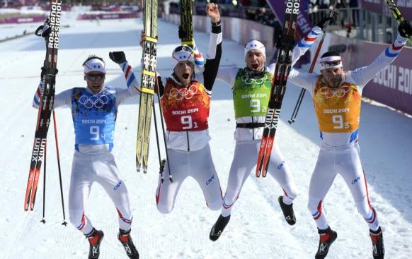
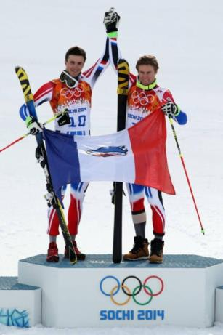
Some French olympic champions 2014

Here are some French olympic champions
Ivan Perrillat Boiteux, Jean-Marc Gaillard, Maurice Manificat & Robin Duvillar : Bronze medal in Relais nordic ski (4x10 km)
Steve Missillier Silver medal and Alexis Pinturault Bronze medal in Slalom Geant

Slide 32
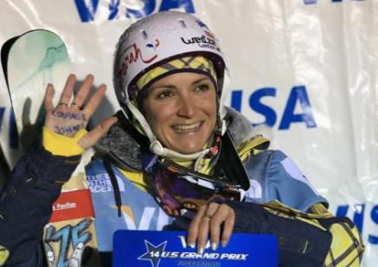
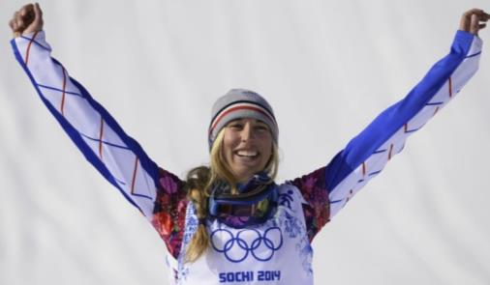
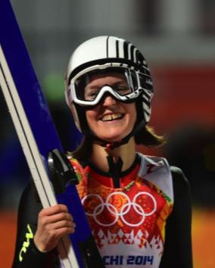
Some French olympic champions 2014

Here are some French olympic champions
Marie Martinod
Silver medal in
Half Pipe
Chloé Trespeuch
Bronze medal in Snowboard-cross
Coline Mattel
Bronze medal in
Ski Jumping

Slide 33
QUIZ 1- Our country France
How many inhabitants?
25 million
60 million
66 million

Slide 34
2- Our Capital City
Give 3 famous monuments in Paris

Slide 35
3- Our town La Ville du Bois
Where is the town situated?
from Paris
60 kms
100 kms
25 kms

Slide 36
4- Our ISC School
How many students:
1480
2500
720

Slide 37
5- Our famous mountains
Give the name of the 7 famous
mountains in France

Slide 38
6- Our famous ski resorts
☺ Give 3 ski resorts in France

Slide 39
7- Ski in France
☺ Find the numbers
10 million visitors a year
? million are skiers
? million are foreign visitors

Slide 40
8- Sotchi 2014: Our medals winners
How many medals France won during the Olympic games in 2014 in Sotchi ?
11
16
15

Slide 41
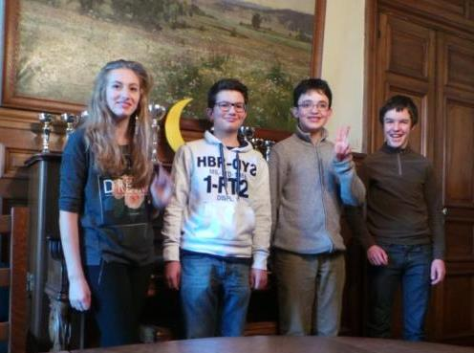
The Isc delegation of students Anne-Lou, Paul, Alexandre and Mikaël
Website of the ISC School
www.isc-villedubois.com

