Slide 1
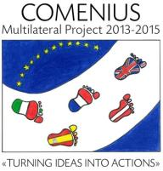
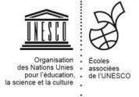
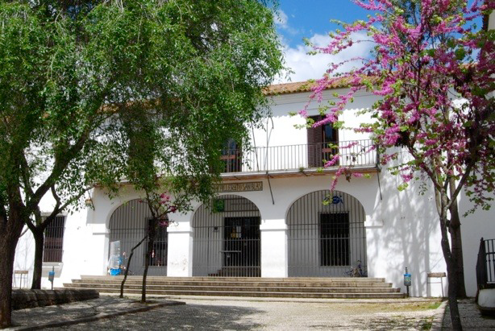
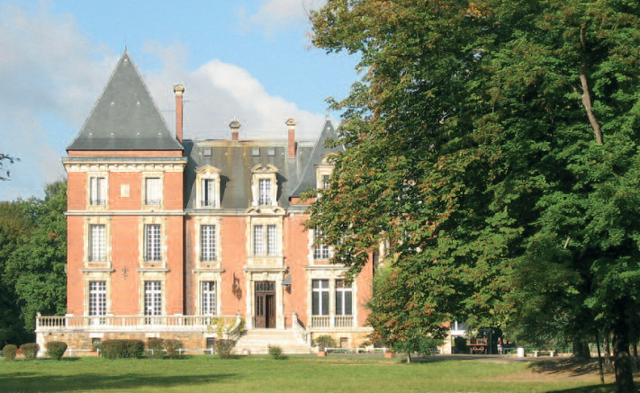
Comenius Project : Turning Ideas Into Actions
FRENCH DELEGATION’S REPORT- Teachers
IES San Blas – Aracena
ISC – La Ville du Bois
MOBILITY 3 : Aracena – Spain
From 11th to 18th May 2014

Slide 2
Summary
1 - Our Comenius project
2 - From La Ville du Bois (France) to Aracena (Spain)
3 - Sharing European experiences
At school
Social activities
Cultural and environmental visits

Slide 3
Comenius project Turning Ideas Into Actions 2013-2015 European partnership with 7 schools in 5 countries

Slide 4
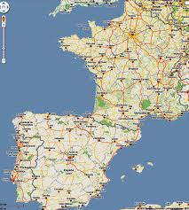
FROM FRANCE TO SPAIN
La Ville du Bois, France
Aracena, Spain
about 1 685 km

Slide 5
SPAIN
Area : 506 000 km²
Population : 47 Million people
Population density/ km² : 92.5
Capital : Madrid
FRANCE
Area : 550 000 km²
Population : 66 Million people
Population density/ km² : 103
Capital : Paris

Slide 6
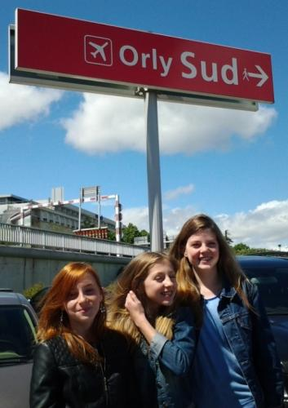
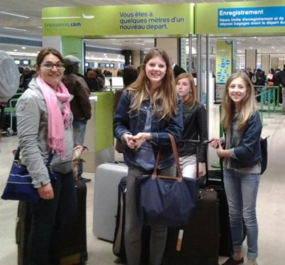
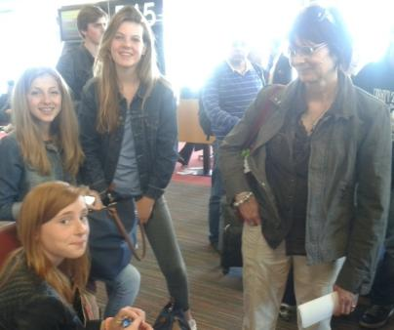
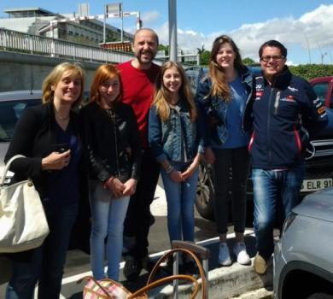
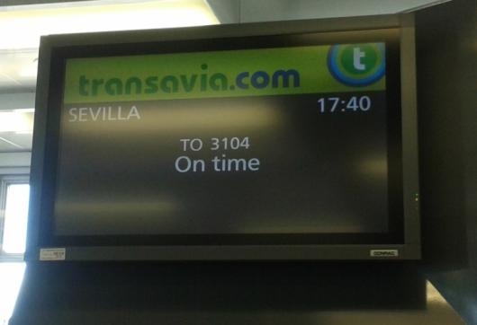
Sunday, May 11th
DEPARTURE OF THE COMENIUS FRENCH DELEGATION
Students :
Lise-Marie Baton
Anne-Lou Folliot
Cléa Jégou
Teachers :
Danielle Lavollée
Agnès Mahé
Laurence Martin

Slide 7
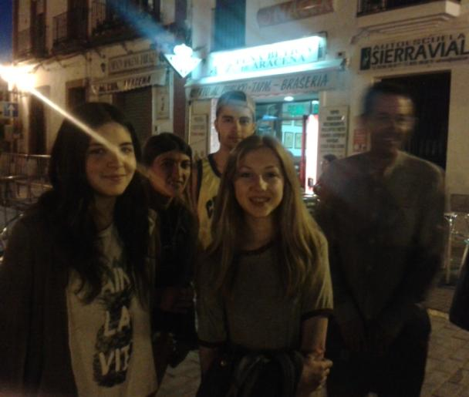
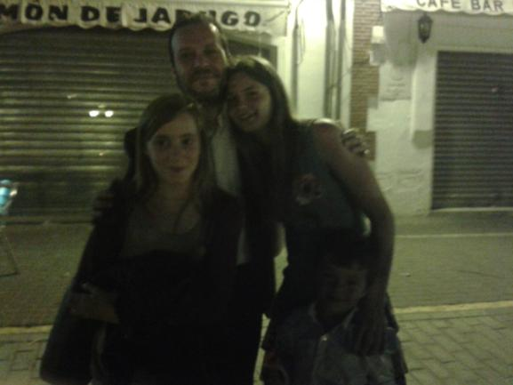
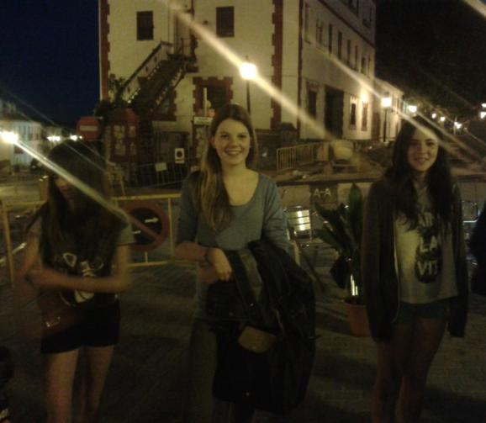
Sunday, May 11th
ARRIVAL BY NIGHT AT ARACENA
The host families welcome the Comenius French group.

Slide 8
Sharing European experiences : At school

Slide 9
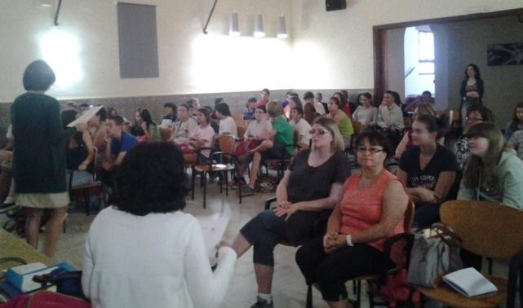
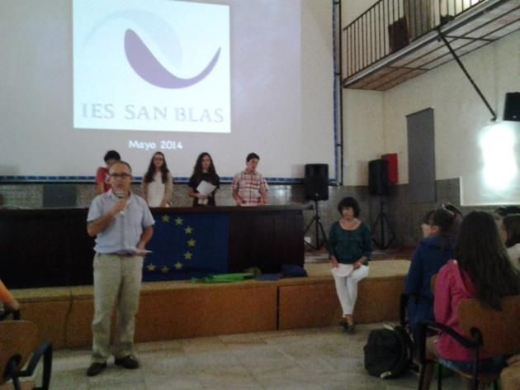
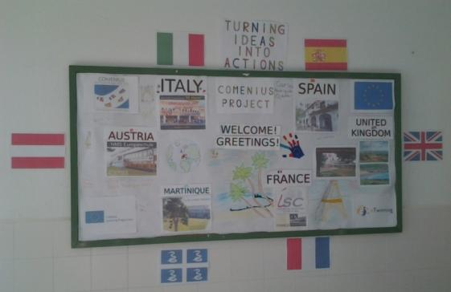
Monday, May 12th
THE HEADMASTER M. GABRIEL DE LA RIVA AND THE COMENIUS SPANISH COORDINATOR LOLA MÁRQUEZ WELCOME
ALL THE DELEGATIONS OF
Austria, France: Métropole and Martinique, Italy, Spain, U-K
AT SAN BLAS INSTITUTE)
A group of Spanish students present their school.

Slide 10
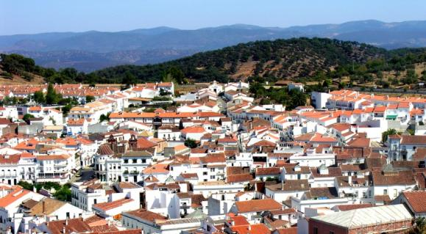
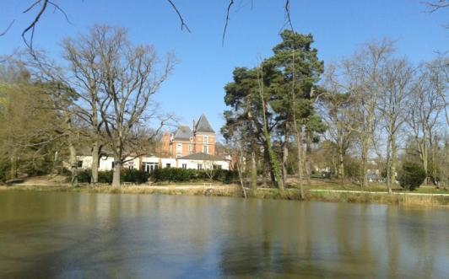
OUR SCHOOL :
ISC (Institution du Sacré Cœur)
Location : La Ville du Bois, France
25 km from Paris.
Environment :
At the heart of a very nice park including a lake.
Students : 1480
Headmaster :
Mr. Thierry Dubois
Website :
www.isc-villedubois.com
THE SCHOOL WE VISIT :
IES San Blas
Location : Aracena, Spain
90 km from Sevilla
Environment :
In a nice city surrounded by the hills of the Sierra Huelva
Students : 1380
Headmaster :
Mr. Gabriel de la Riva Pérez
Website : http://www.juntadeandalucia.es/averroes/centros-tic/21700381a/helvia/

Slide 11
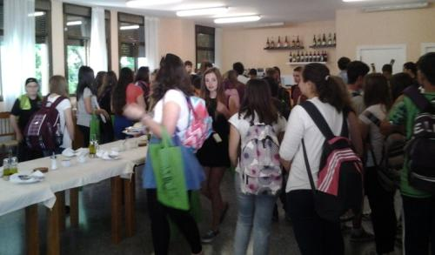
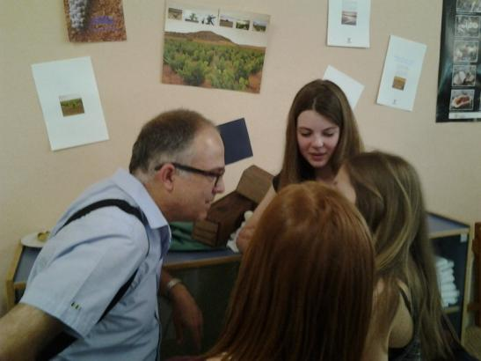
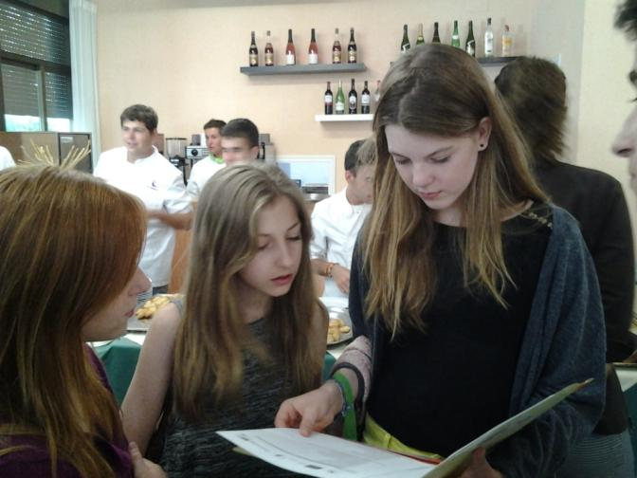
Monday, May 12th
AROUND AN ANDALOUSIAN BREAKFAST
EVERY ONE GETS IN CONTACT
A warm welcoming from the headmaster
Lise-Marie, Anne-Lou and Cléa are ready to work
even at breakfast.

Slide 12
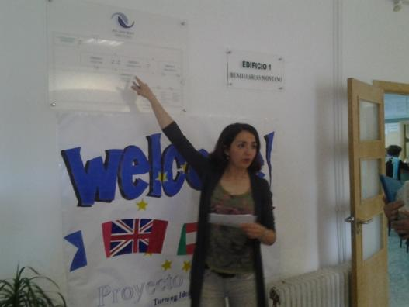
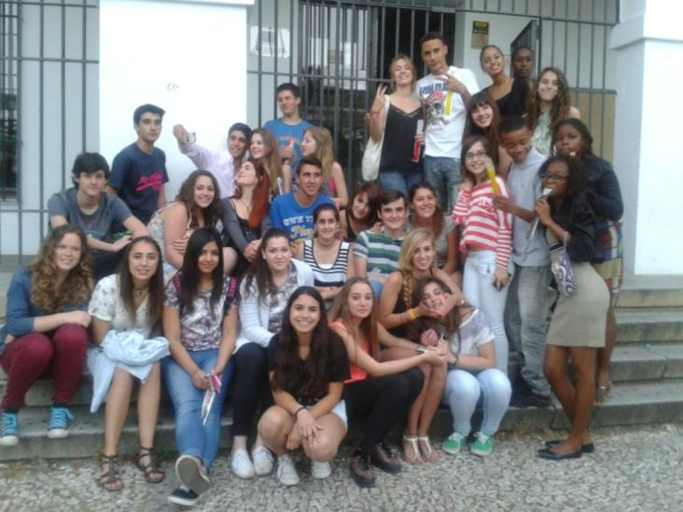
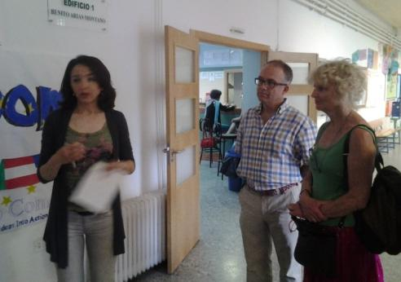
Wednesday, May 14th
1ST LESSONS AT SCHOOL
At 8:15, the headmaster
Mr. Gabriel de la Riva and
Mrs. Elena Frías, English teacher at San Blas Institute welcome the whole Comenius students who are attending some lessons
Meanwhile, Comenius teachers are shown the San Blas Institute.

Slide 13
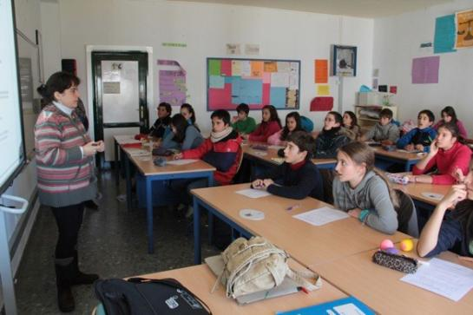
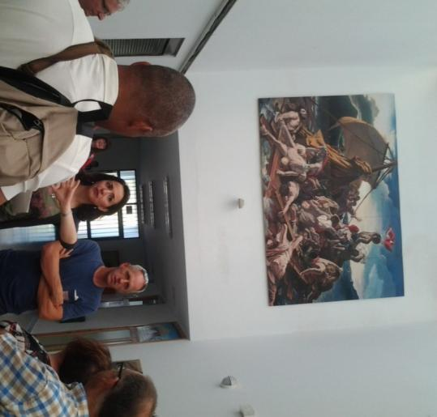
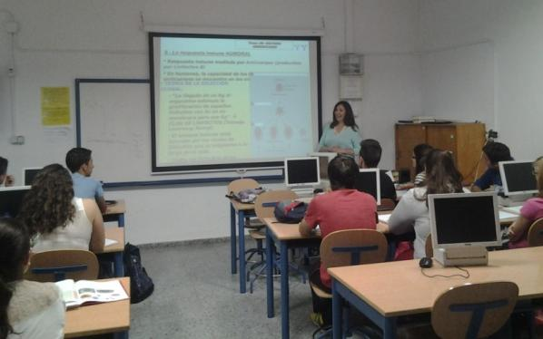
Wednesday, May 14th
DISCOVERING THE SCHOOL
The San Blas Institute is a secundary bilingual school, preparing A level in Art, Sciences and Economy. It welcomes 1380 students.
Secondary school students
Art
(Raft of the Medusa, realized by 7th form class).
High school students

Slide 14
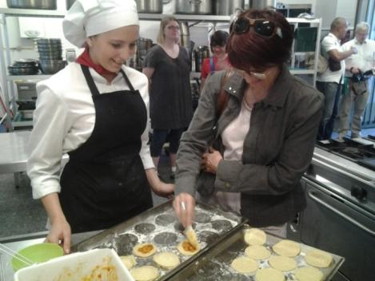
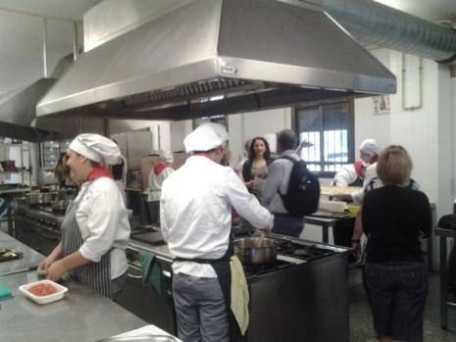
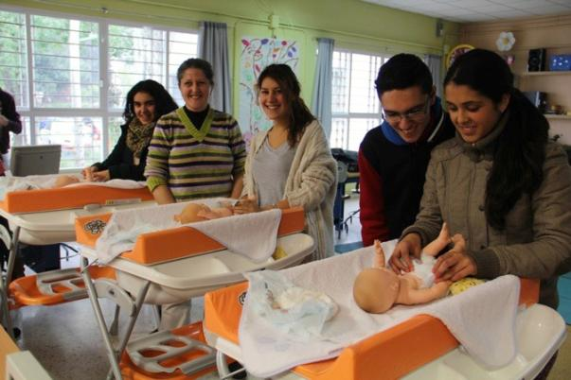
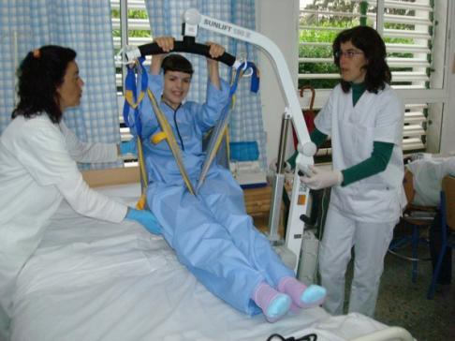
Wednesday, May 14th
DISCOVERING THE SCHOOL
It also delivers a vocational training in administration, finance, early years education, dependent care and catering.
Early years education
Catering
Dependent care

Slide 15
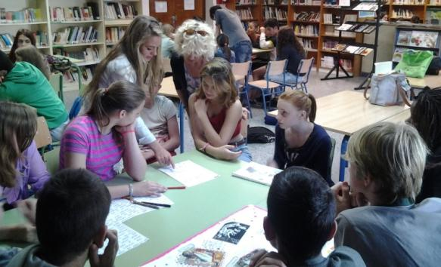
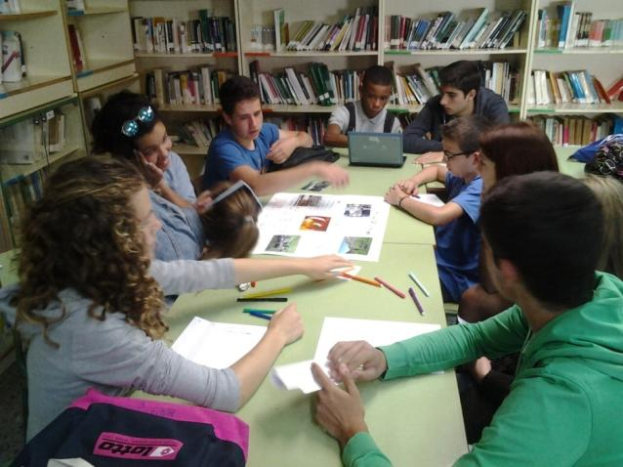
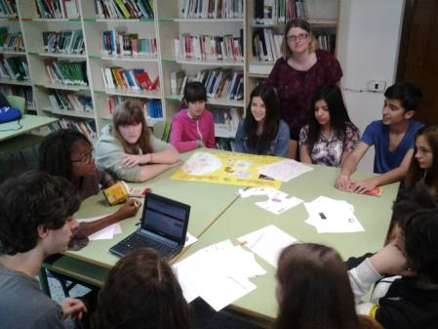
Wednesday, May 14th
WORKSHOP (PART 1)
First work meeting at school. Comenius students join their international group to work together in the library on different topics :
Iberian pig and products (green group)
Aracena’s heritage (orange group)
Sevilla’s heritage (pink group)
Tourism in rural area (yellow group)
Old jobs and new jobs (blue group)
Corkindustry in the countryside (red group)
They realize posters…
… and fill a wiki page with their researches & conclusions.

Slide 16
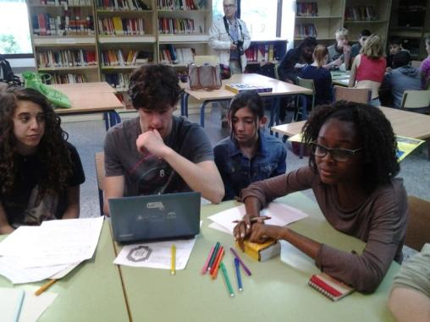
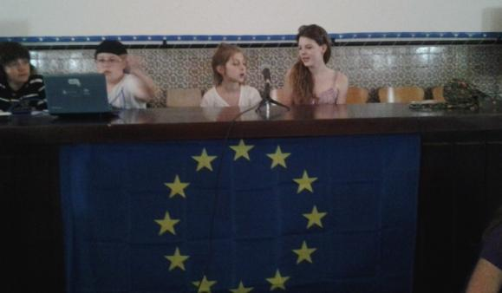
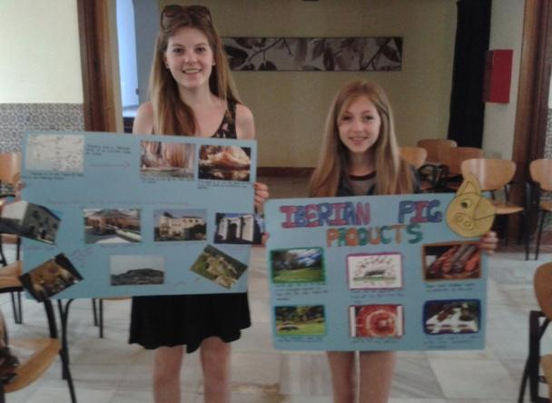
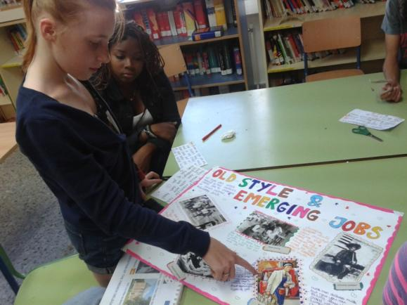
Thursday, May 15th
WORKSHOP (PART 2)
While teachers work together about wikispace with the San Blas webmaster, Mr. Francisco González, students go on working in their group on the preparation of the Wiki and posters at the library.

Slide 17
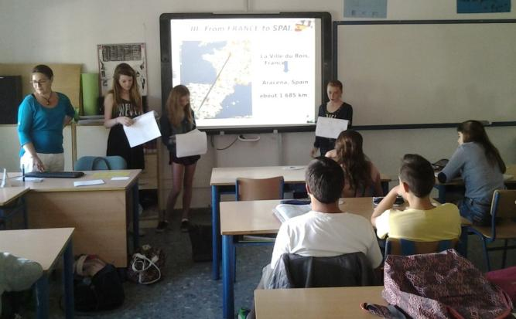
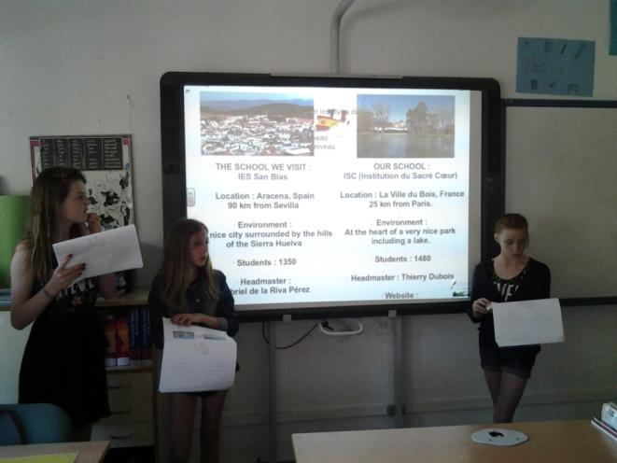
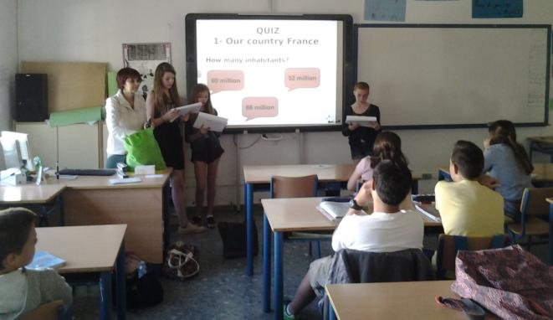
Friday, May 16th
WORK MEETING AT SCHOOL
Anne-Lou, Cléa and Lise-Marie present their Powerpoint work to an English class.

Slide 18
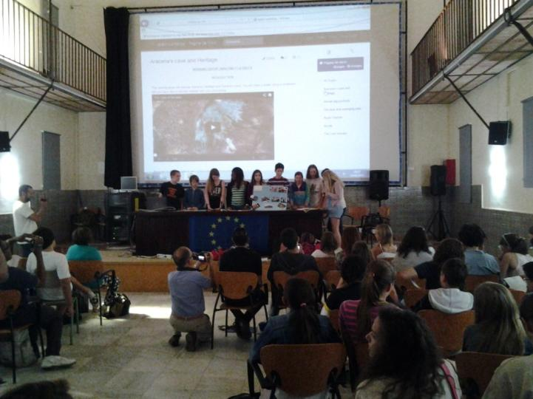
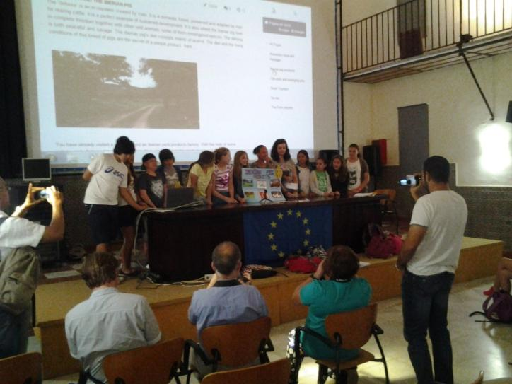
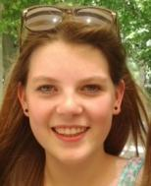
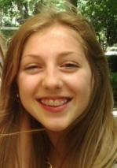
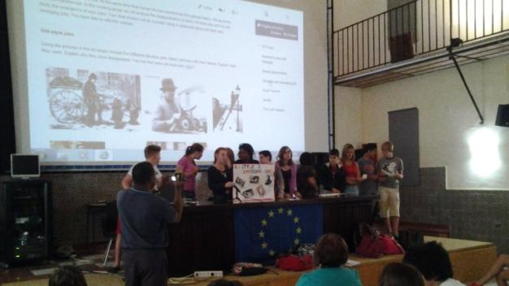
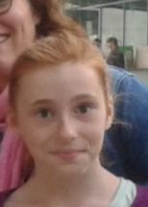
Friday, May 16th
WORKSHOP FINAL PRODUCTIONS
The six different groups present their works on wiki and posters to the European delegations, headmasters, teachers and students.
Cléa (orange group)
Aracena’s heritage
Anne-Lou (green group) Iberian pig and products
Lise-Marie (blue group)
Old and new jobs

Slide 19
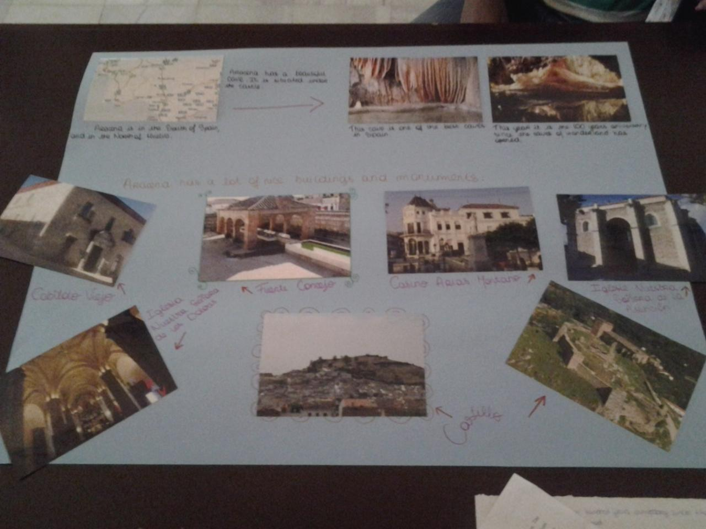
ARACENA’S
HERITAGE
WORKSHOP FINAL EUROPEAN PRODUCTIONS

Slide 20
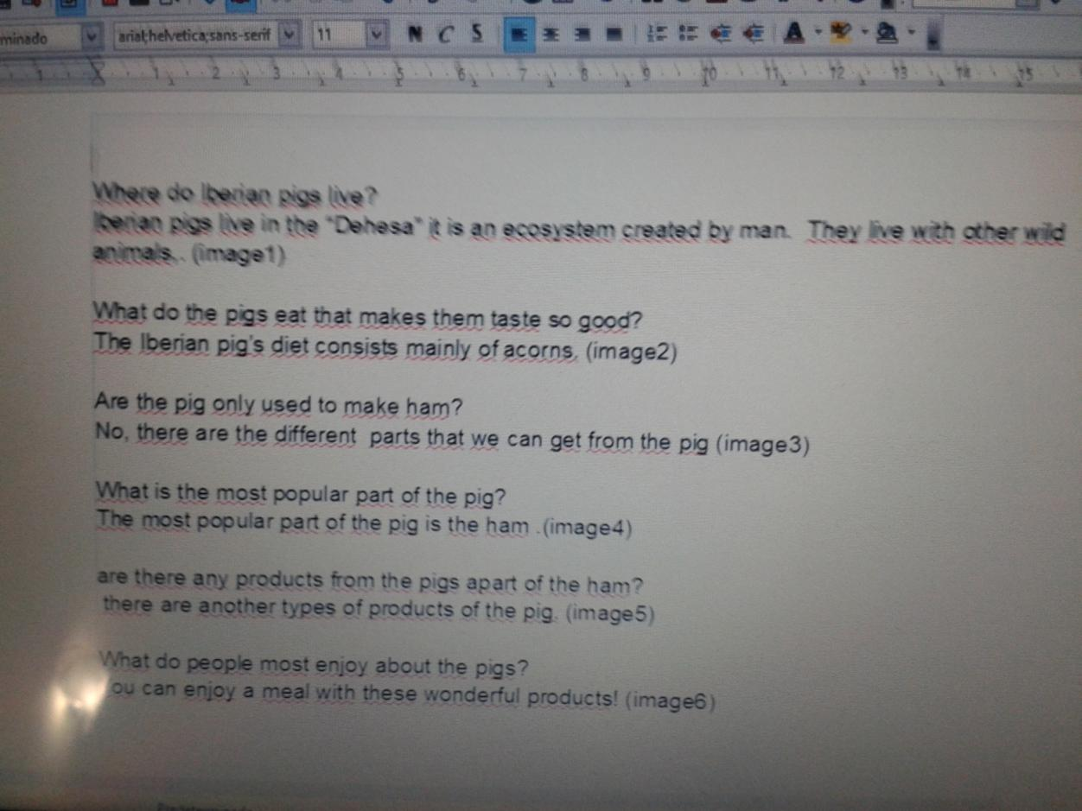
IBERIAN PIG & PRODUCTS
WORKSHOP FINAL EVALUATION

Slide 21
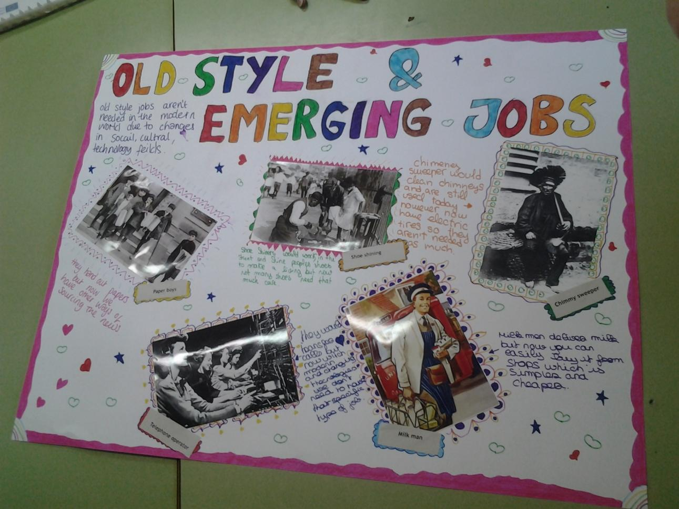
OLD AND NEW JOBS
WORKSHOP FINAL EUROPEAN PRODUCTIONS

Slide 22
TOURISM IN RURAL
AREA
WORKSHOP FINAL EUROPEAN PRODUCTIONS

Slide 23
Friday, May 16th
SEVILLA’S
HERITAGE
WORKSHOP FINAL EUROPEAN PRODUCTIONS

Slide 24
CORK
INDUSTRY
WORKSHOP FINAL EUROPEAN PRODUCTIONS

Slide 25
CORK
INDUSTRY
WORKSHOP FINAL EVALUATION

Slide 26
WORKSHOP FINAL EUROPEAN PRODUCTION
All the posters are then hung on in the entrance hall of the school.

Slide 27
Sharing European experiences : Social activities

Slide 28
Wednesday, May 14th
CORK
INDUSTRY
HIKING ACTIVITY
In the late afternoon, the whole group enjoys a nice time hiking through the circular footpath called Los Torros.
Time to discover growing fruits, olives, chestnuts and cork.
Raising cattle, sheep and goats (as much for cheese as for meat).
Oaks of various kind abound, especially holm oaks and cork oaks, the acorns from which are used to fatter up the pigs.
Momisa, peaches and citruses of various kind, wild cistus, lavender, thyme.

Slide 29
Thursday, May 15th
TOURISM IN RURAL
AREA
TRIP TO THE GREEN LAKE
On Thursday, after some lessons, let’s trip to the Green Lake which is located in a natural protected park. This lake provides an important ressource for birds based in this area.
The vegetation surrounding the lake is of mediterranean scrubland variety.

Slide 30
Thursday, May 15th
TOURISM IN RURAL
AREA
TRIP TO THE GREEN LAKE
Sports instructors manage for the Comenius Students and Teachers outdoor activities : canoeing, archery, zip line and rope traversing through trees, and general collective games which strengthen the cohesion of the group.

Slide 31
Thursday, May 15th
TOURISM IN RURAL
AREA
TRIP TO THE GREEN LAKE
Students are taught about the local ecosystem.
Meanwhile everyone can identify a magnificent variety of local flora and fauna (cork and evengreen oaks, polar ash, willow, maple, elm, older, myrtle, bramble, rosemary…). The mediterranean climate, the topology and geology contribute to the fact that Andalucia has the highest number of species of flora and trees in Europe. The fauna is rich in otters, wild cats, genets, weasels.

Slide 32
Sharing European experiences : Cultural and environmental visits

Slide 33
Monday, May 12th
IBERIAN PIG & PRODUCTS
TRIP TO AN ENVIRONMENTAL STUDY CENTER
IN THE NATIONAL NATURAL PARK
SIERRA DE ARACENA AND PICOS DE AROCHE
This natural park, near the Portuguese border, encompasses 184 000 hectares ; 90% of it is covered by woodland of mainly Mediterranean oaks.
For avoiding to spoil the nature with human bacteries, each one has to wear a special oversuit.

Slide 34
Monday, May 12th
IBERIAN PIG & PRODUCTS
HERE WE ARE ! FIRST CONTACT WITH THE FAMOUS IBERIAN BLACK PIG IN A LOCAL FARM
Sierra de Aracena is famous for its rearing of Iberian black pigs. They use to search acorns under the oak trees that give their ham its distinctive quality and this special flavour particularly appreciated by gastronoms all over the world.
The Iberian black pig has got folding down ears, long and thin legs, a long snout and a dark skin.

Slide 35
Monday, May 12th
WORKSHOPS FOR ALL THE STUDENTS
IBERIAN PIG & PRODUCTS
The whole group is divided in six international groups. Students build bird’s nesting boxes and create badges. A great time to share and exchange.

Slide 36
Monday, May 12th
IBERIAN PIG & PRODUCTS
COMING BACK TO ARACENA THE GROUP IS INVITED TO VISIT THE HAM MUSEUM
This museum offers a unique opportunity to learn more about the life cycle of the Iberian pig : from when the acorns fall onto the ground in the pasture lands until the ham in the cellars is ready for eating.
IBERIAN PIG + ACORNS + PASTURE LANDS + CLIMATE + TRADITIONNAL CRAFT MANUFACTURE
= EL IBERICO JAMÓN

Slide 37
Tuesday, May 13th
SEVILLA’S
HERITAGE
TODAY IS THE SEVILLA’S DAY : REAL ALCÁZAR
Arrival at Seville at 9h45.
Let’s go for a guided visit of Real Alcazar.
The participants are all the Comenius teachers and students and a San Blas 3rd class ESO E.
The Real Alcazar of Seville is a royal palace, originally a Moorish fort. It is one of the best remaining examples of mudéjar architecture. It is still the oldest royal palace in use in Europe (the upper levels are used by the royal family as the official Seville Residence).

Slide 38
Tuesday, May 13th
SEVILLA’S
HERITAGE
LET’S CARRY ON MARIA LUISA PARK !
After a picnic lunch in the Maria Luisa Park, students join their international groups and participate to a contest all over the park discovering its wildlife.
The Maria Luisa Park is a public park that stretches along the Guadalquivir River in Seville. It is Seville’s principal green area. It serves as a botanical garden. Over a hundred tree species are representated with educational panels to inform the visitors.

Slide 39
Tuesday, May 13th
SEVILLA’S
HERITAGE
WALK AROUND THE MOST EMBLEMATIC PLACES :
CATEDRAL DE SANTA MARIA DE LA SEDE
PLAZA DE ESPAÑA
The Spain Square was built in 1928 for the Ibero-American Exposition of 1929. It is a landmark example of the Renaissance Revival style in Spanish architecture. Designed by Anibal González, this place is a huge half circle with buildings accessible by numerous bridges representing the 4 ancient kingdoms of Spain.
The Cathedral of Saint Mary of the See, better known as Seville Cathedral is a Roman Catholic cathedral. It is the largest Gothic cathedral and the third largest church in the world. It was built to demonstrate the city’s wealth : « Let us build a church so beautiful and so grand that those who see it finished will think we are mad ». Construction began in 1402 and continued until 1506.

Slide 40
Wednesday, May 14th
IBERIAN PIG & PRODUCTS
VISIT TO AN IBERIAN PORK PRODUCTS FACTORY :
CONSORCIO DE JABUGO
Factories for curing the renowned Jamón Iberico are dotted all over the Sierra. The most saught-after ham comes from the village of Jabugo, where the biggest ham producer, Consorcio de Jabugo, is based.
Jabugo is a synonym of tradition and ritual in the artisan production of Iberian ham. In this town of Sierra de Huelva, with an altitude of 700m and micro-climate that enables the hams and shoulders to cure in natural drying houses at the pace of the seasons, is the Consorcio de Jabugo's cellars, where the incomparable smell and the exquisite taste of their Iberian meats are established
Jabugo’s village
Rewards for the excellence

Slide 41
Wednesday, May 14th
IBERIAN PIG & PRODUCTS
VISIT TO AN IBERIAN PORK PRODUCTS FACTORY :
CONSORCIO DE JABUGO

Slide 42
Wednesday, May 14th
CORK
INDUSTRY
CORK OF ANDALUCIA
The cork oak crop takes place between June 15th and August 15th. Laws forbid taking cork off the trees outside this brief period. Employees have spent 2 years at college studying this subject before being allowed to work on a tree with special cork kniwes. The cork is in fact a sort of parasite on the bark of the tree beneath.
The Iberian cork industry, as well as bottle-stoppers, is also used in diverse processes from car construction to aeroplane insulation. Spain has become the world’s biggest producer of cork .

Slide 43
Friday, May 16th
ARACENA’S
HERITAGE
VISIT TO THE CAVES
The municipality of Aracena is situated at the heart of the natural park Sierra de Aracena and Picos de Aroche . We start our tour with the visit of the gorgeous Gruta de las Maravillas (caves of Marvels), which is one of the most emblematic natural monuments in Andalusia and the main tourist attraction in Aracena, it is also the most impressive limestone caves complexe in Spain.
Discovered in 1886 and opened to the public in 1914, it includes a total of 2130 meters of subterraneans. The caves are located below the hill on which stand Aracena Castle and church.

Slide 44
Friday, May 16th
ARACENA’S
HERITAGE
VISIT TO THE CASTLE
The castle itself now only consists of ruined defensive walls, but there is also a large church, the Gothic-Mudéjar Iglesia de Nuestra Señora de los Dolores built in the 13th century, by the Knights Templar.
This church is the destination of an annual procession on the Pentecost and the best place for viewing splendid panoramas of the town and countryside.

Slide 45
Friday, May 16th
ARACENA’S
HERITAGE
DESCUBRIR
ARACENA
Nearby the Plaza Alta is the newly renovated Ayutamiento (Town Hall), a red-brick building, designed by Anibal González in 1911, who worked on the great exhibition in Sevilla in 1929 and designed the Plaza de España.
The
Casino de Arias Montano was also designed by Anibal González. It is situated on the biggest place of Aracena Plaza del Marqués .
In the Town-Hall we are welcome by the mayor of Aracena.

Slide 46
Thursday, May 15th
LUNCH WITH THE HOST FAMILIES
Cléa & Adriana
Anne-Lou & Ainoha
Lise-Marie & Carlota with her big family
LUNCH AT SCHOOL FOR TEACHERS
PREPARED AND SERVED BY STUDENTS LEARNING CATERING AT IES SAN BLAS

Slide 47
Friday, May 16th
DINNER AT SCHOOL
In the evening, the Spanish families invite the Comenius group to a final dinner consisting of a selection of Spanish dishes.

Slide 48
Sunday, May 18th
DEPARTURE DAY
Special thanks to :
the headmaster Mr. Gabriel de la Riva,
Mrs. Lola Márquez, Spanish coordinator,
all the Spanish teachers involved,
and of course to our host families
for their warm and professional welcome.

Slide 49
Monday, May 19th
BACK TO FRANCE
Back to our ISC school, time to share our experience.
Firstly with our headmaster, Mr.Thierry Dubois,
and soonly with other students and teachers…

Slide 50
MOBILITY 3
Powerpoint: Danielle Lavollée, Agnès Mahé, Laurence Martin
Photos: Agnès Mahé
Students team :
Lise-Marie Baton, Anne-Lou Folliot, Cléa Jégou
Teachers team :
Danielle Lavollée (French coordinator), Agnès Mahé, Laurence Martin

