Slide 1
Going for Gold Project meeting March 2013, 9th – 16th in
Lycée Joseph Gaillard – Fort de France, Martinique
French delegation of La Ville du Bois

Slide 2
Lycée Joseph Gaillard Fort de France

Slide 3
Content
I) Departure to Martinique
II) Arrival in Fort de France
III) Welcome at school and Presentations
IV) Visits
1) St Marie
2) Fort de France
3) Mangrove de Ducos
4) Morne-Rouge
V) Conclusion

Slide 4
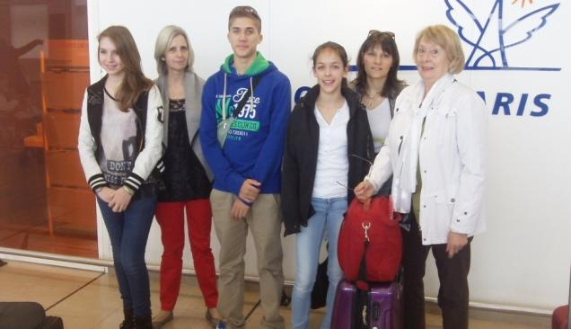
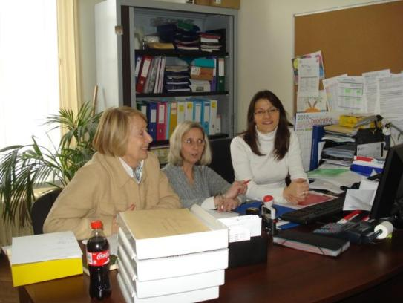
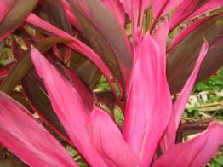
I) Preparation and Departure to Martinique

Slide 5
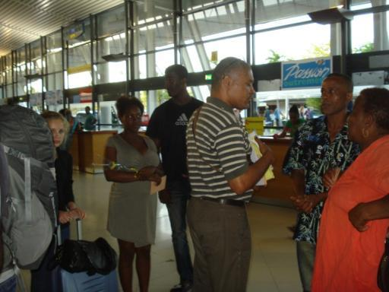
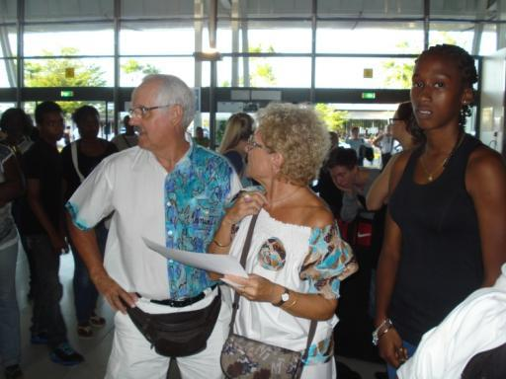
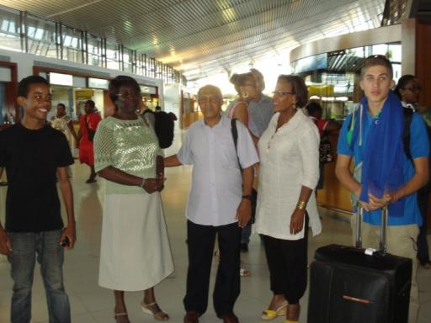
II) Arrival in Fort de France

Slide 6
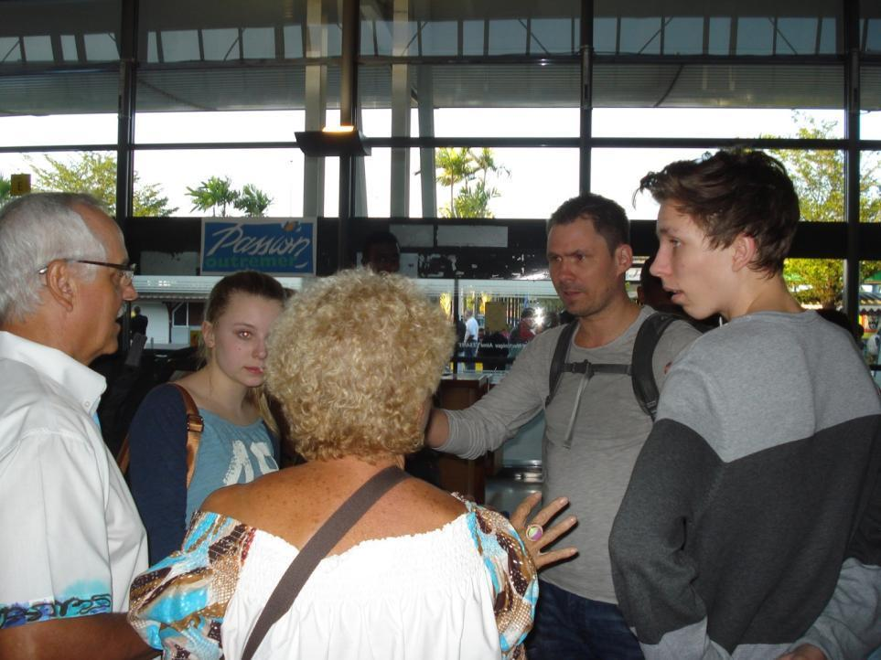
II) Arrival in Fort de France

Slide 7
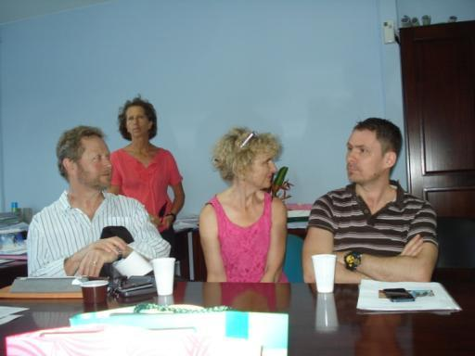
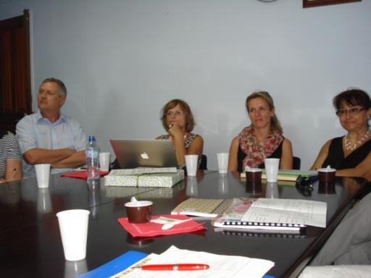
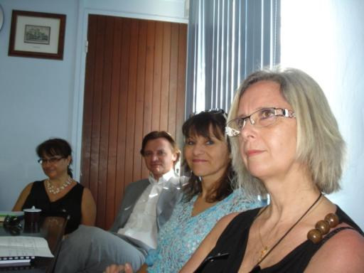
III) Welcome at school…

Slide 8
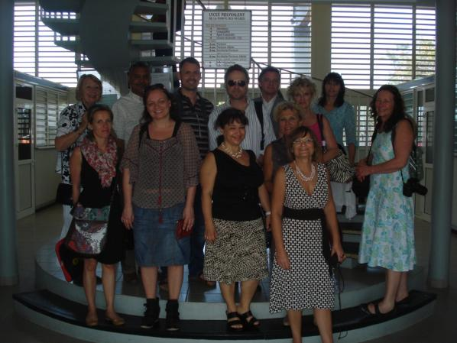
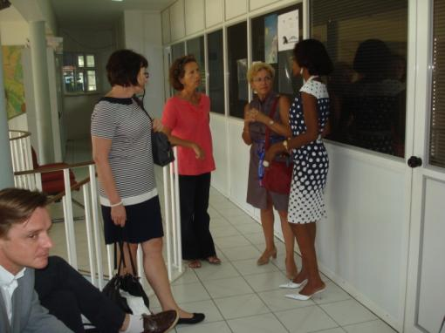
III) Welcome at school…

Slide 9
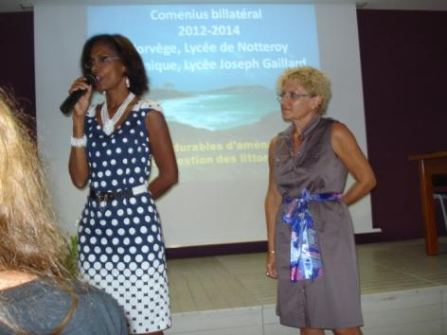
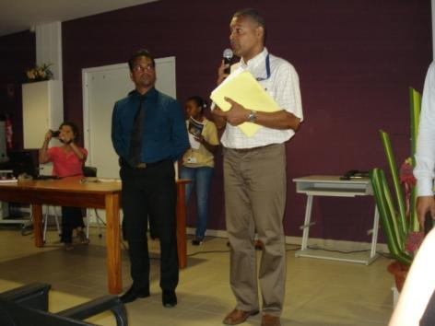
III) …and Presentations made by the delegations : Subject the world of work

Slide 10
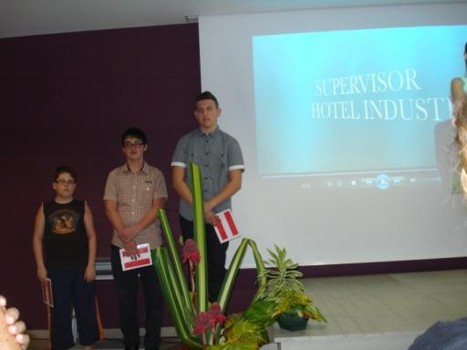
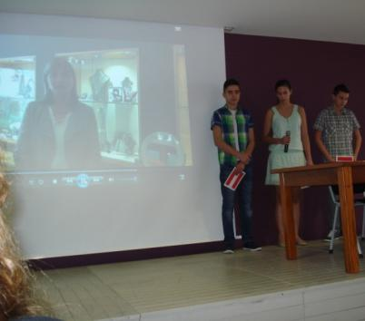
III) …and Presentations made by the delegations : Subject the world of work
Europa Schule, Wiener Neustadt -
Austria

Slide 11
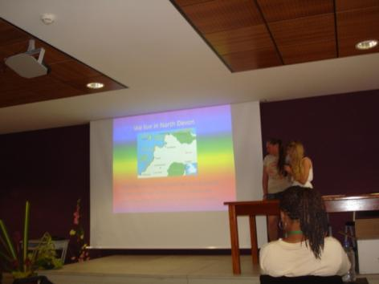
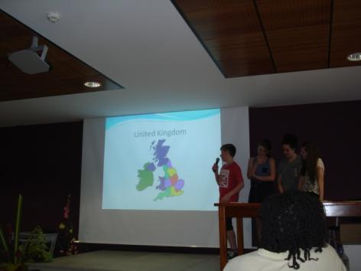
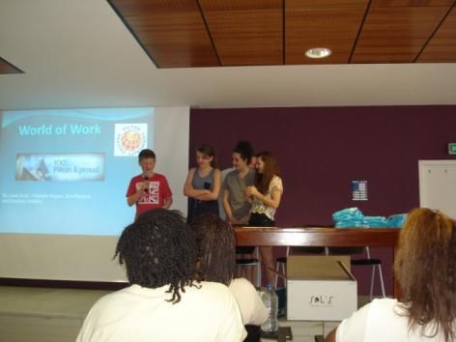
III) …and Presentations made by the delegations : Subject the world of work
Community College Pilton - UK

Slide 12
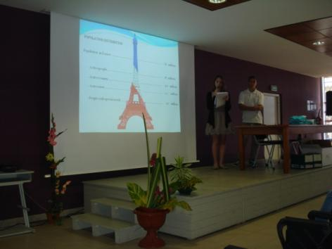
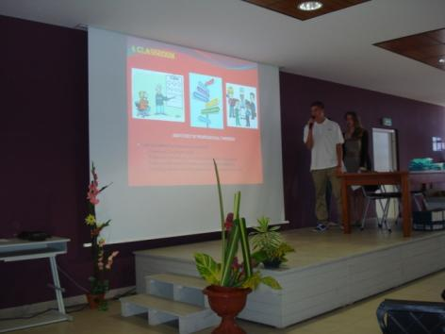
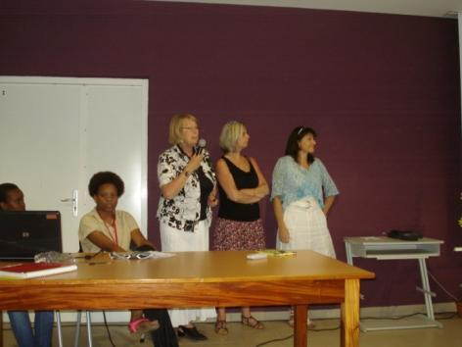
III) …and Presentations made by the delegations : Subject the world of work
ISC La Ville du Bois - France

Slide 13
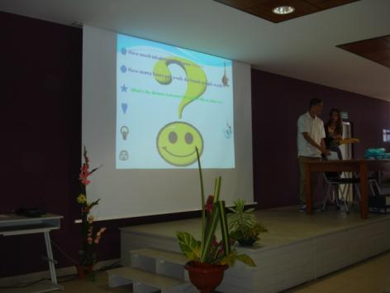
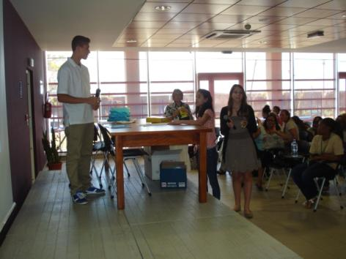
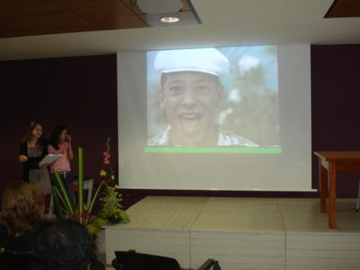
III) …and Presentations made by the delegations : Subject the world of work
ISC La Ville du Bois - France

Slide 14
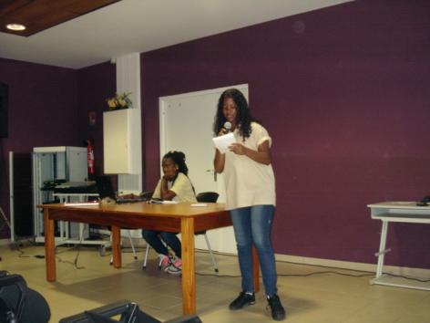
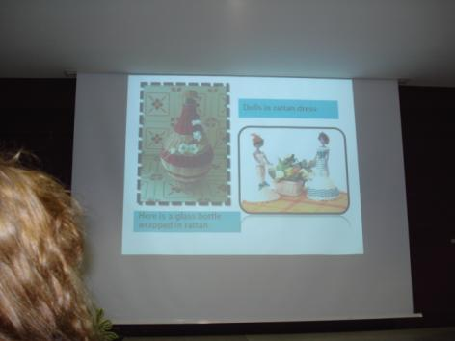
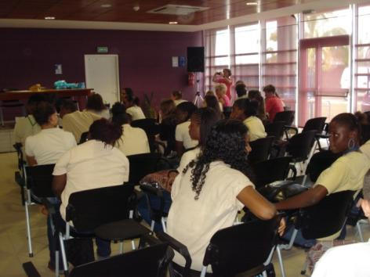
III) …and Presentations made by the delegations : Subject the world of work
Lycée Joseph Gaillard Fort de France - Martinique

Slide 15
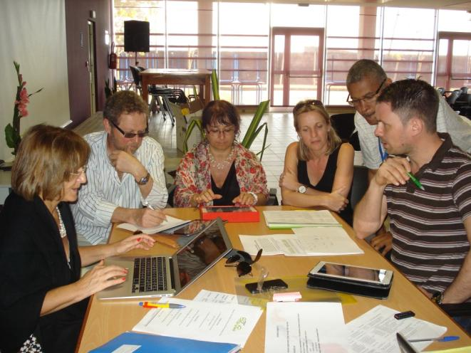
Project Meeting of the teachers

Slide 16
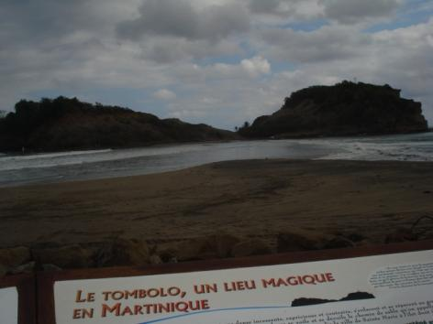
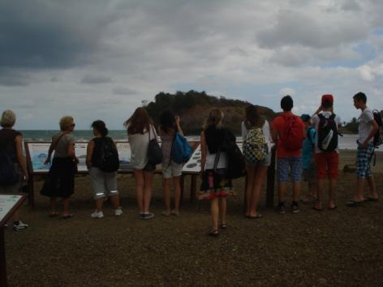
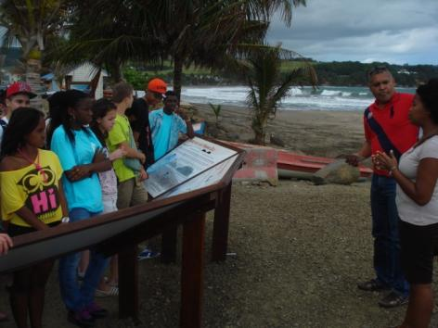
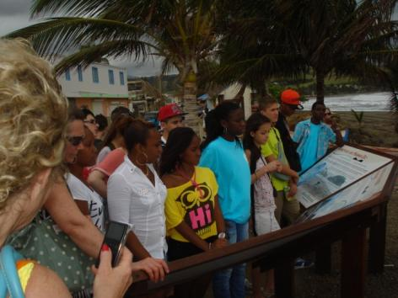
IV) Visits
1) To St Marie

Slide 17
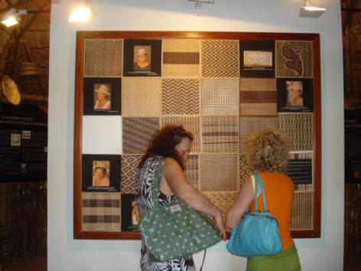
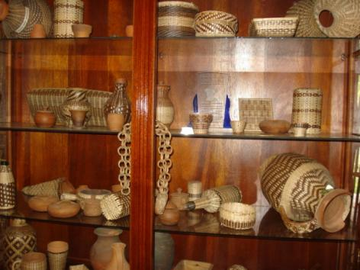
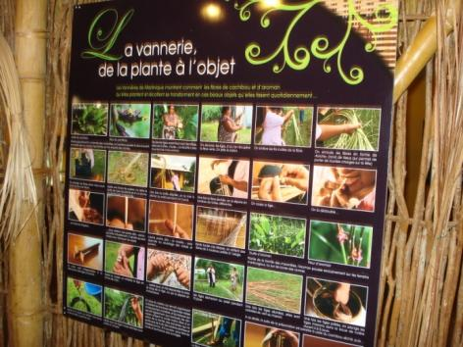
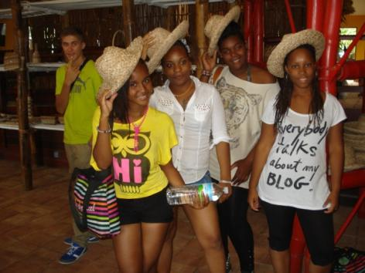
IV) Visits
1) St Marie : La vannerie

Slide 18
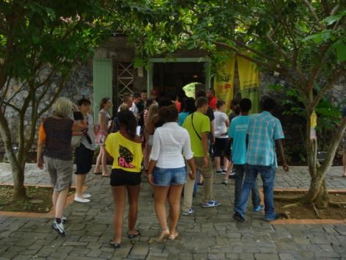
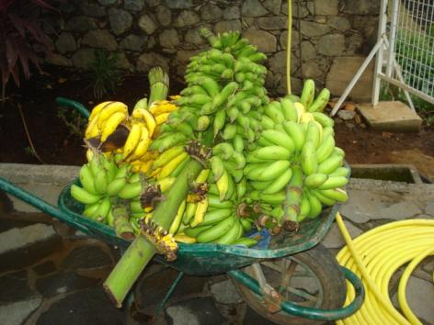
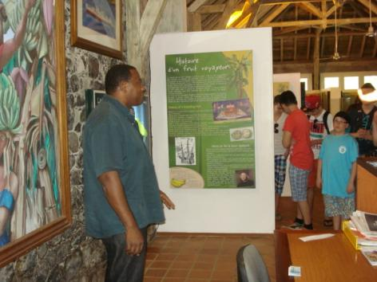
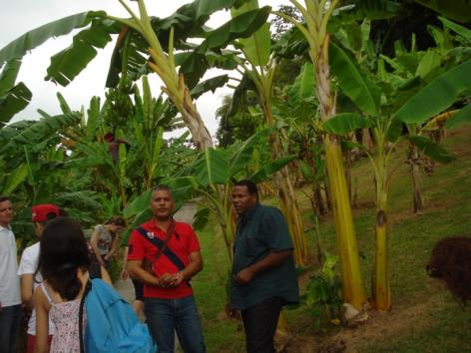
IV) Visits
1) St Marie : Musée de la banane

Slide 19
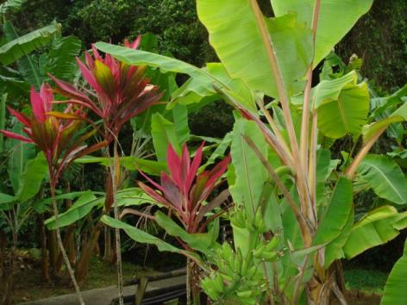
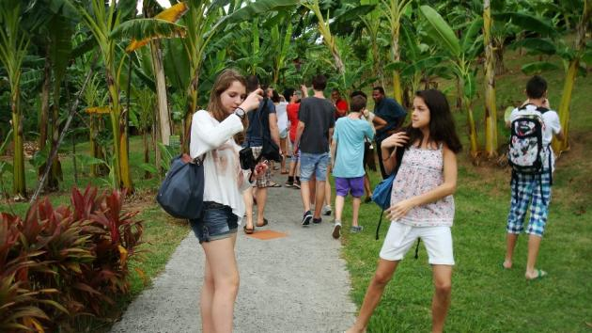
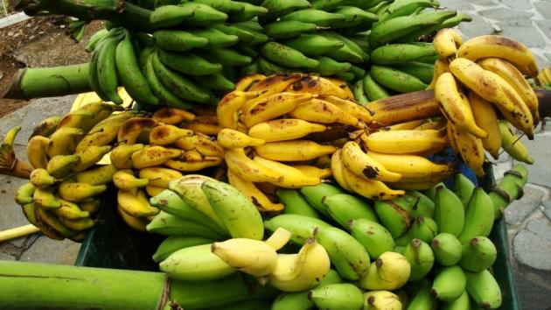
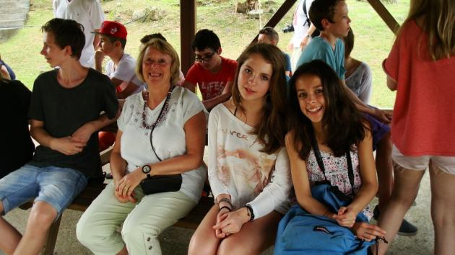
IV) Visits
1) St Marie : Musée de la banane

Slide 20
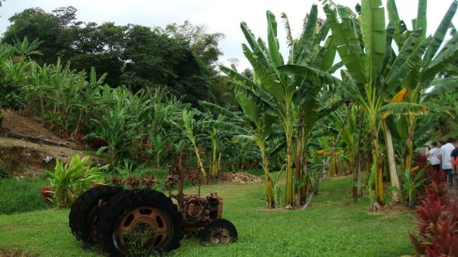
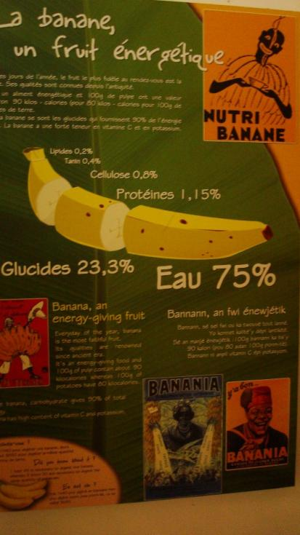
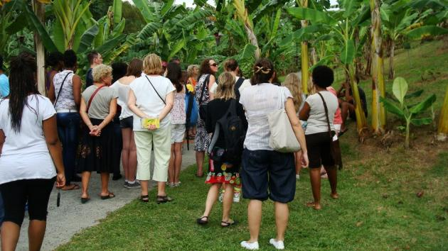
IV) Visits
1) St Marie : Musée de la banane

Slide 21
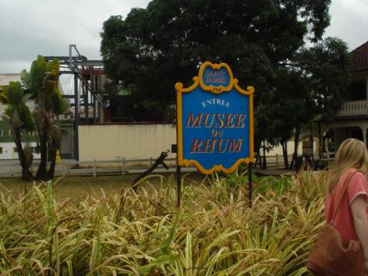
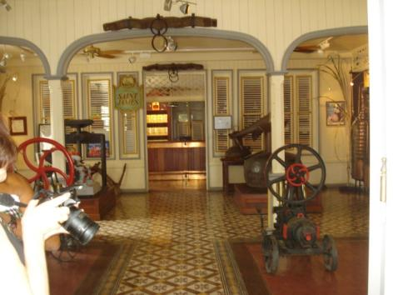
IV) Visits
1) St Marie : Musée du rhum

Slide 22
IV) Visits
1) St Marie : In the forest

Slide 23
IV) Visits
2) Fort de France : departure to « Les 3 Ilets »

Slide 24
IV) Visits
3) Mangrove of Ducos in kayak

Slide 25
IV) Visits
3) Mangrove of Ducos in kayak

Slide 26
IV) Visits
4) Montagne Pelée and Morne-Rouge

Slide 27
V) Conclusion
Photos: Mrs. Goupil, Mrs Lavollée and Mrs Villet
Powerpoint:
Mrs Lavollée, French coordinator of the project
Mr. Riffaud, Computer technician
with the cooperation of all the delegations
This project is funded by the European Commission

