Slide 1
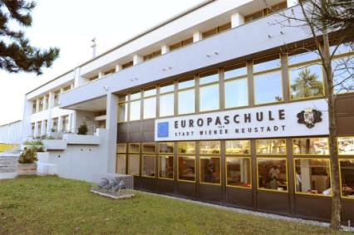
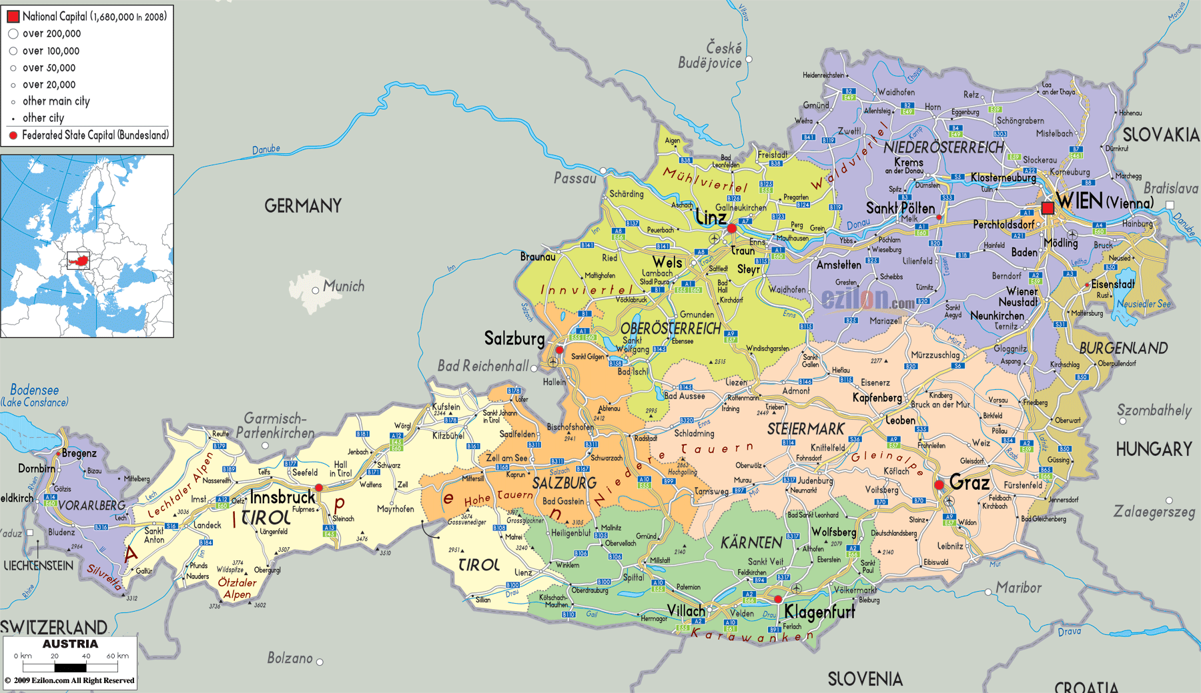
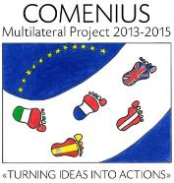
Comenius project Turning Ideas Into Actions
(2013-2015)
Mobility 2 : March 2-9 2014 in Europaschule
Wiener Neustadt-AUSTRIA
Mikael’s presentation
ISC School- La Ville du Bois- France

Slide 2
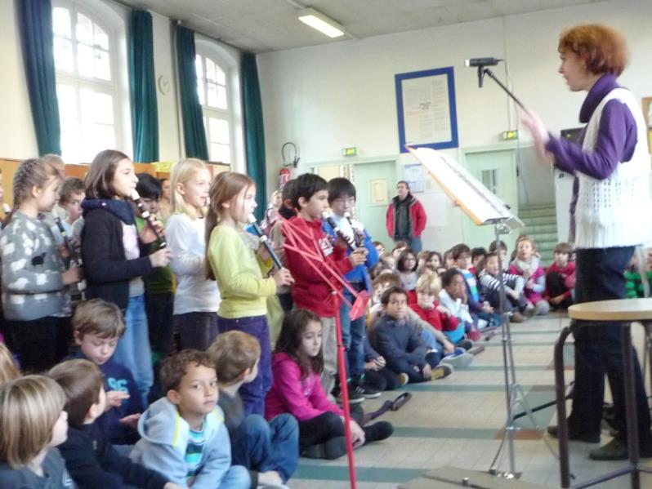
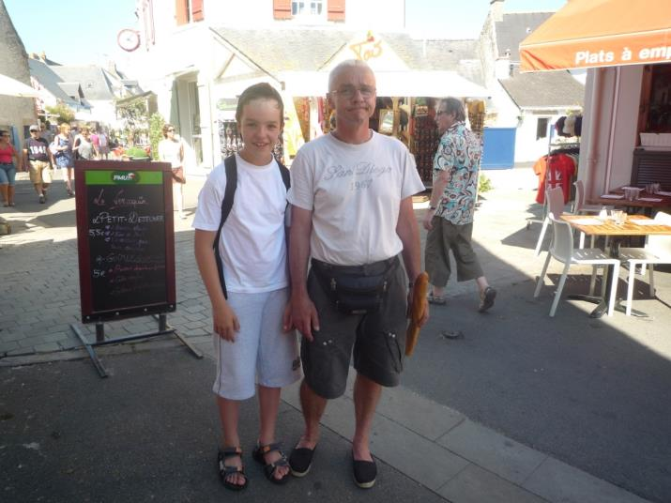
Sunday February 1st 2014 Hello my name is Mikael. I have got a mother who is music teacher: her name is Florence. My dad’s name is Dominique.

Slide 3
Last winter I went to la Cluzaz with my mother, this is a very nice mountain village in France

Slide 4
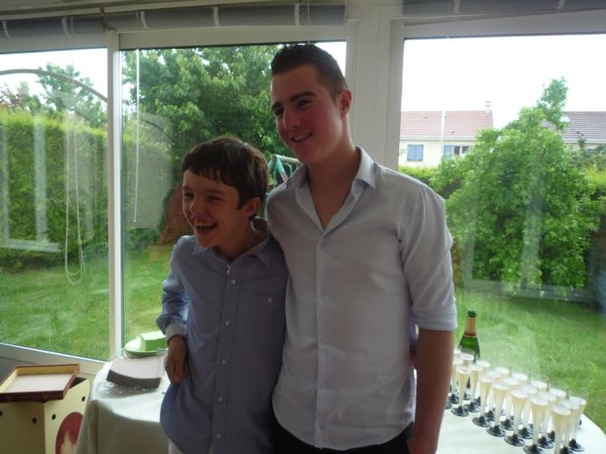
I have got one brother whose name is Geoffrey. He is twenty years old.

Slide 5
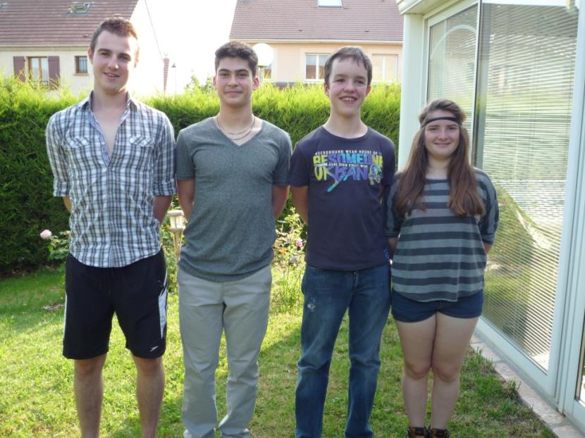
My two cousin’s names are Mary and Vincent. They are fourteen and seventeen years old.

Slide 6
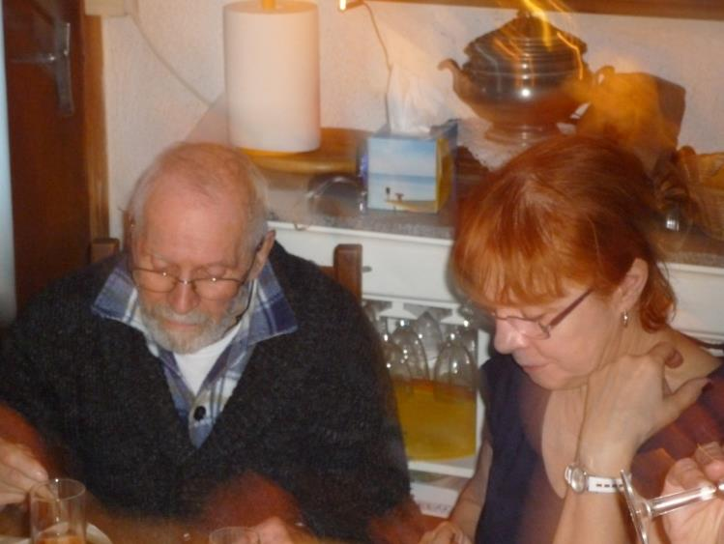
My grandmother is a music conductor and my grandfather is retired.

Slide 7
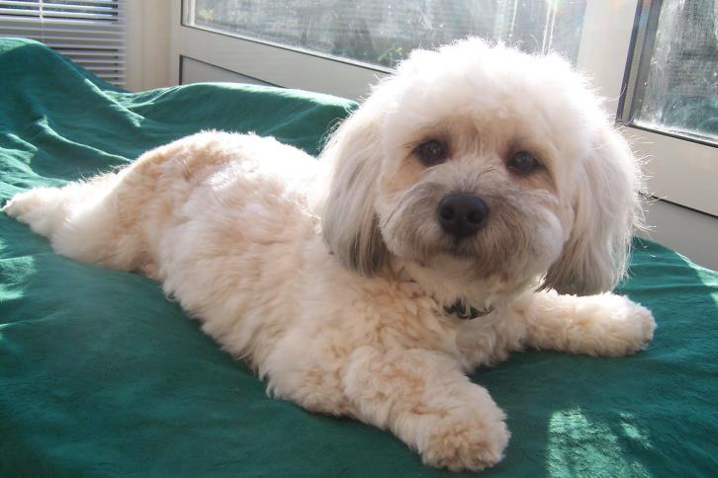
I ‘m fond of animals: I have 2 pets: one pet is Tequila. She is a very cute little dog.

Slide 8
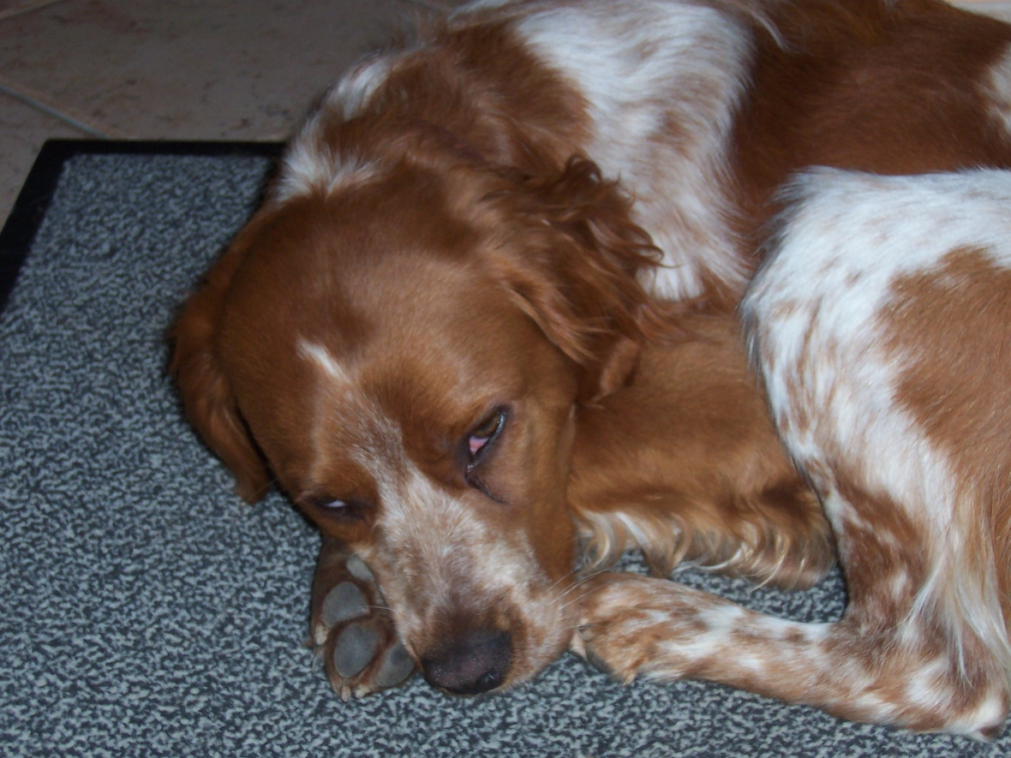
My second pet is Gros Vynile

Slide 9
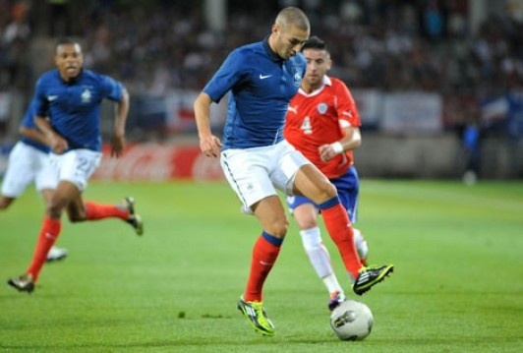
I like to play football

Slide 10
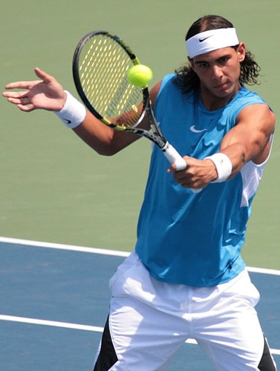
I like also to play tennis

Slide 11
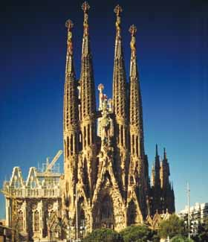
I travelled to spain when I was a little boy. It was for a wedding in Catalonia. Look at the cathedral Sagrada familia!

Slide 12
I travelled to Romania :this is my friend Larisa in Bacau.

Slide 13
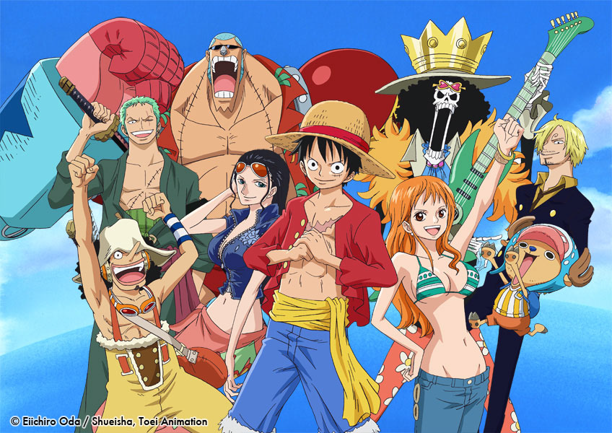
I love mangas!

Slide 14
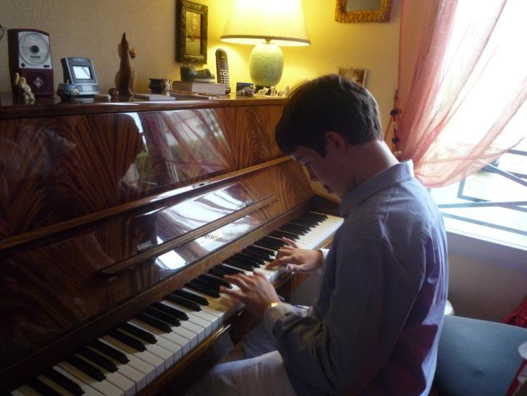
I like to play the piano and trumpet.

Slide 15
Powerpoint presentation and photos:
Mickaël G.
Ulis class- Isc School
www.isc-villedubois.com

