Slide 1
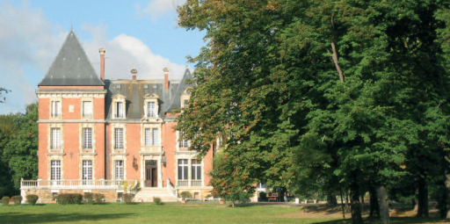
Comenius Project in Norway
Mobility 6, 14-17 May 2013 : Børstad ungdomsskole
in Hamar
GOING FOR GOLD: CITIZENSHIP
Austria: Wiener Neustadt- England: Braunton and Pilton-
France: Fort de France and La Ville du Bois- Norway: Hamar
ISC SCHOOL
Presentation of the French delegation
1

Slide 3
Content
I) Departure to Norway from Roissy
II) Arrival in Norway, Hamar
III) Welcome to school
IV) Digital stories on Citizenship
V) Sport activities : Bikes
VI) Concert at Hamar Domen
VII) National day : Friday 17th of May
VIII) Energy battle in Furuberget
IX) Picnic at City Hall with host families
X) Departure from Hamar
XI) Arrival in Roissy Charles De Gaulle

Slide 4
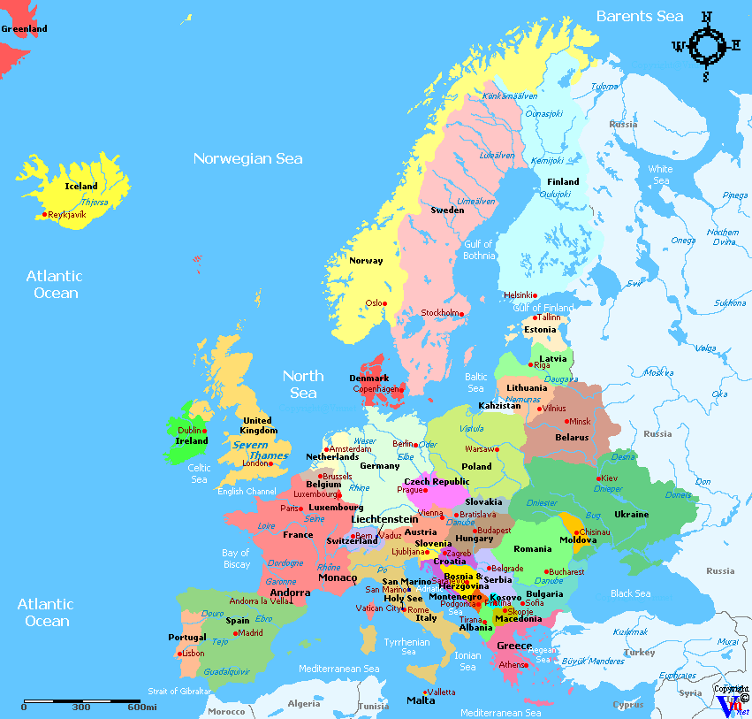
From France to Norway
La Ville Du Bois, France
to
Hamar, Norway : 2000 km

Slide 5
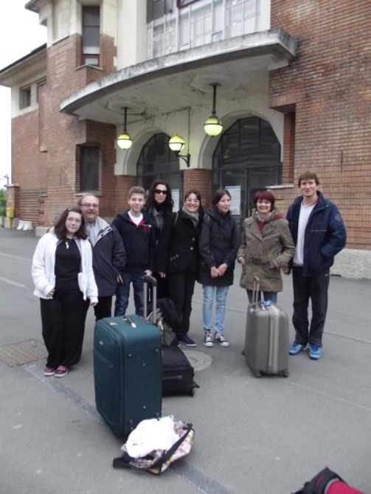
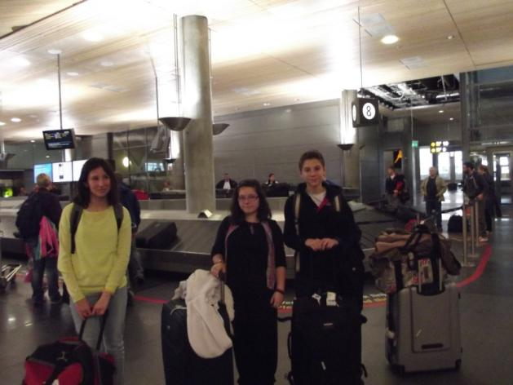
I) Departure to Norway from Roissy
French delegation of La Ville Du Bois

Slide 6
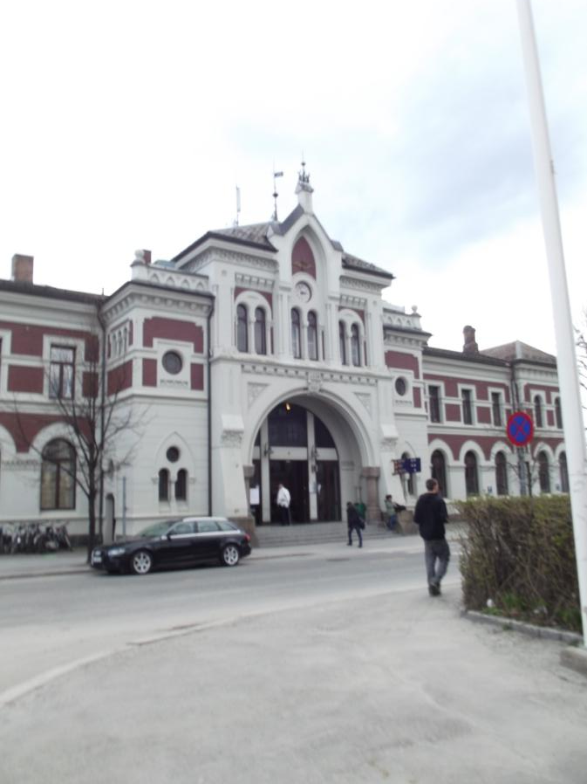
II) Arrival in Norway, Hamar (1/5)

Slide 7
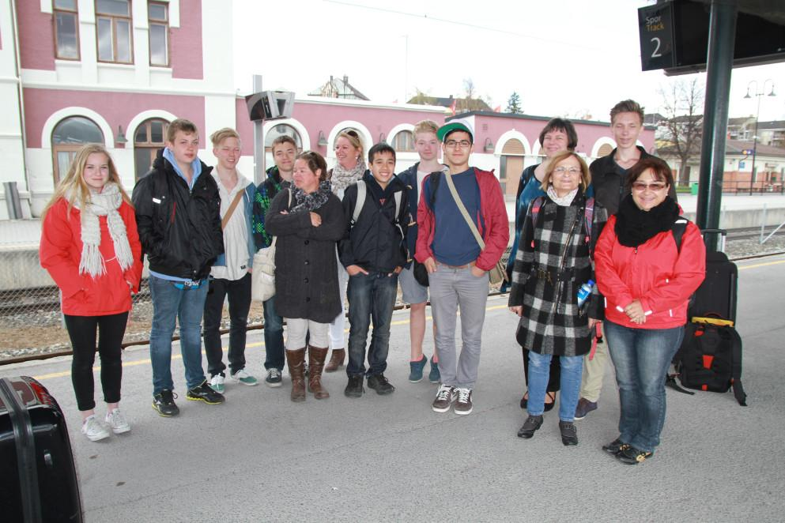
II) Arrival in Norway, Hamar (2/5)

Slide 8
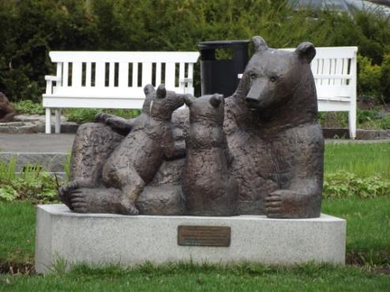
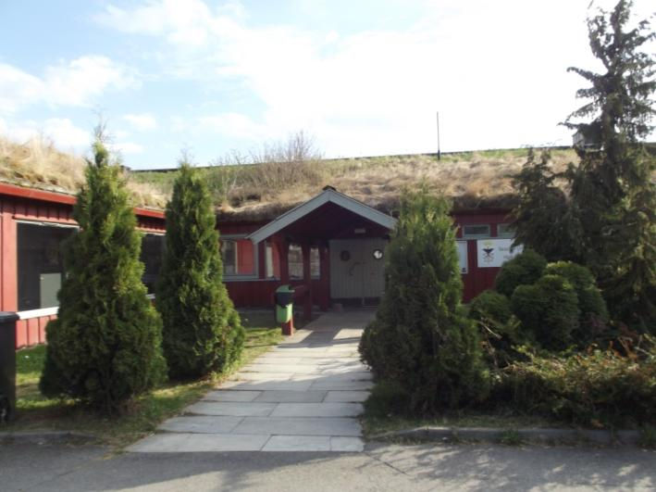
II) Arrival in Norway, Hamar (3/5)

Slide 9
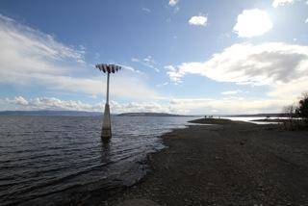
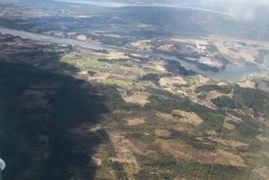
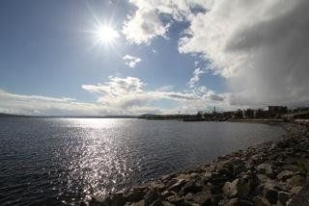
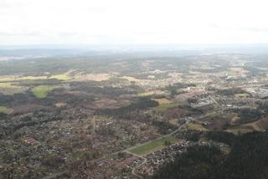
II) Arrival in Norway, Hamar (4/5)
Visit of the town

Slide 10
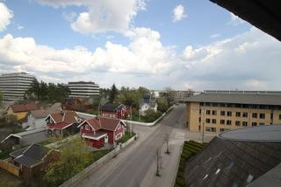
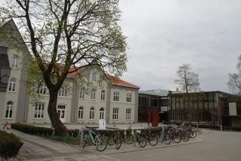
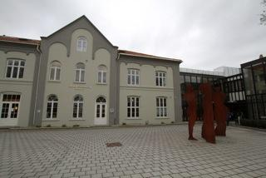
II) Arrival in Norway, Hamar (5/5)

Slide 11
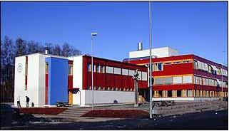
III) Welcome to school (1/6)
Børstad ungdomsskole

Slide 12
III) Welcome to school (2/6)
Mascot of our Comenius Project in Norway Going for Gold

Slide 13
III) Welcome to school (3/6)
Delegation of Lycée Joseph Gaillard, Fort de France

Slide 14
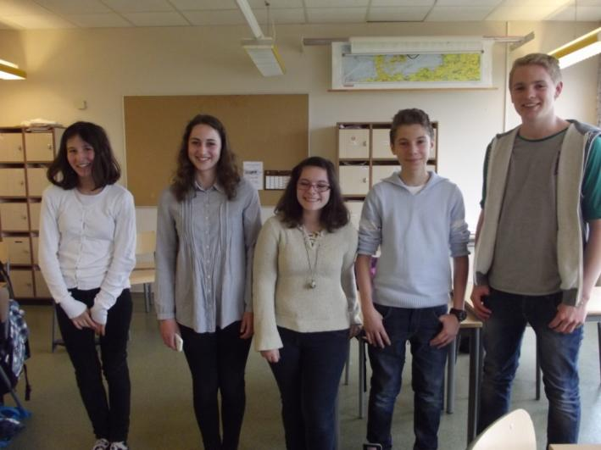
III) Welcome to school (4/6)

Slide 15
III) Welcome to school (5/6)

Slide 16
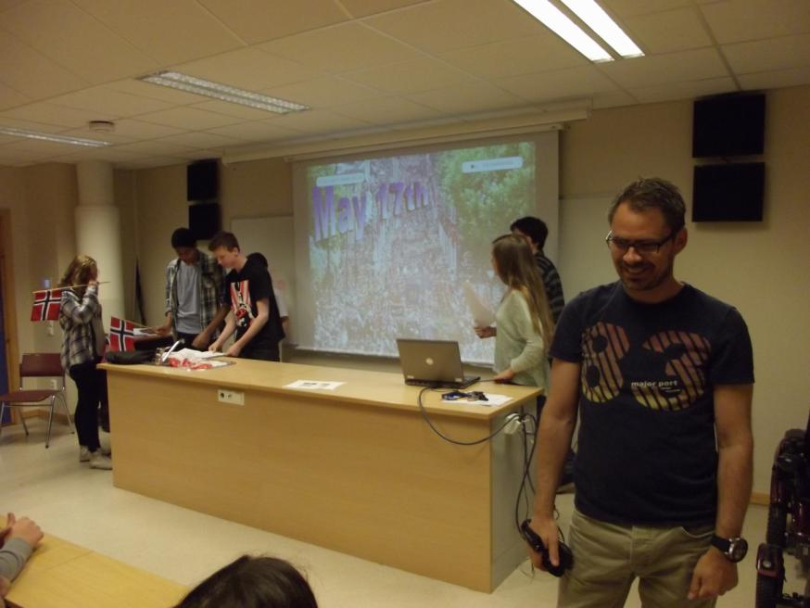
III) Welcome to school (6/6)

Slide 17
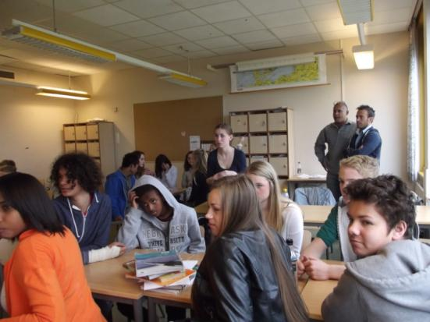
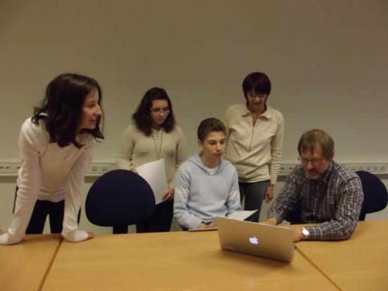
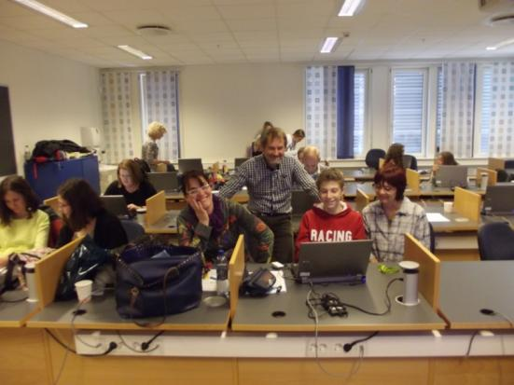
IV) Digital stories on Citizenship (1/3)
Preparation of the storyboard and of the story by each delegation

Slide 18
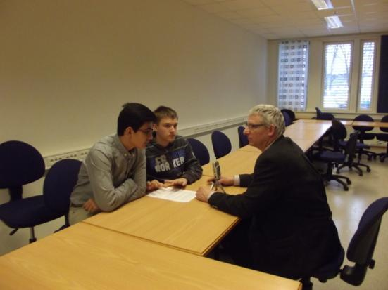
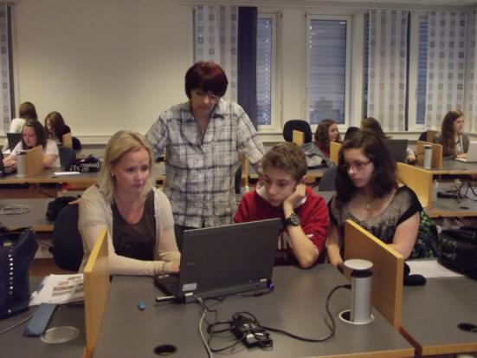
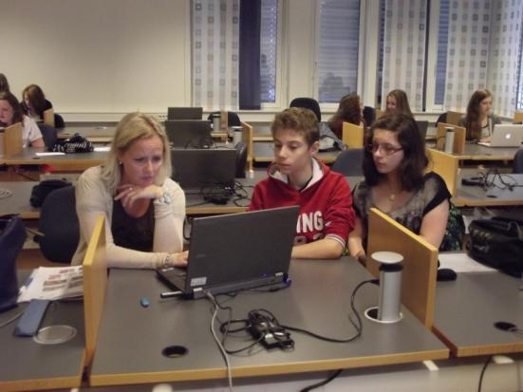
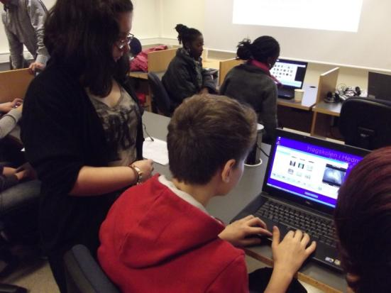
IV) Digital stories on Citizenship (2/3)

Slide 19
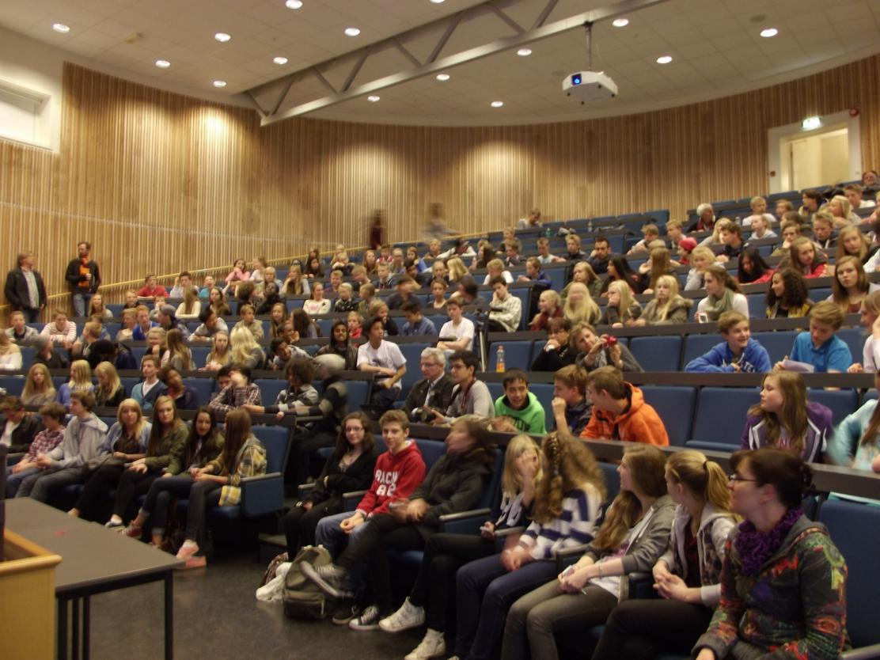
IV) Digital stories on Citizenship (3/3)
Presentation of the 6 stories at the assembly of the school

Slide 20
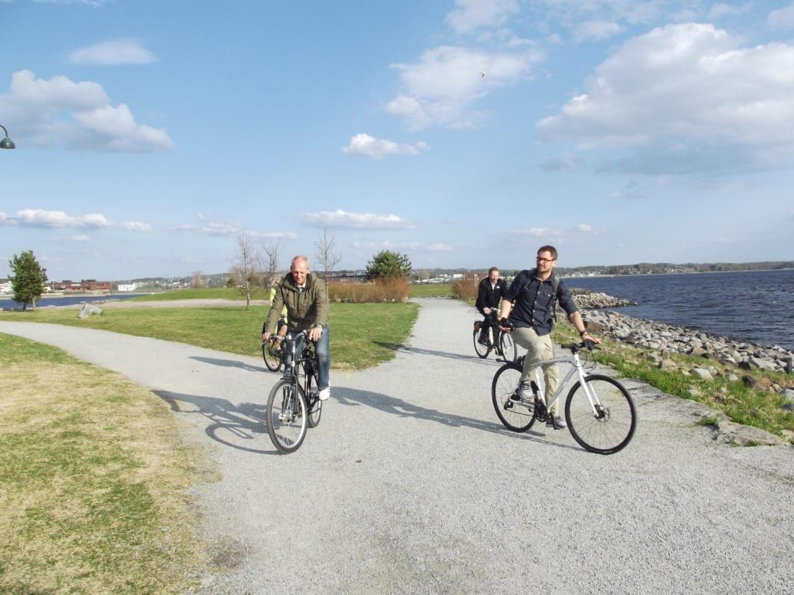
V) Sport activities : Bikes (1/2)

Slide 21
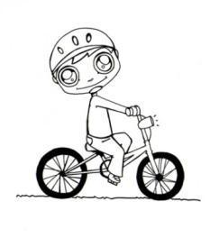
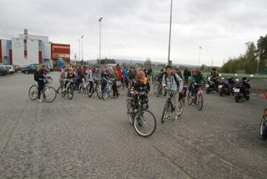
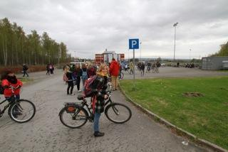
V) Sport activities : Bikes (2/2)
Ready on bikes

Slide 22
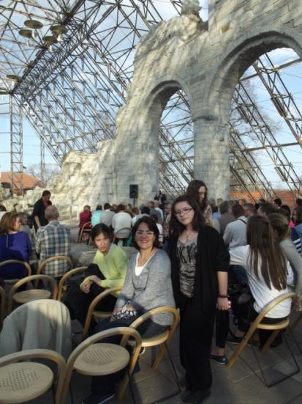
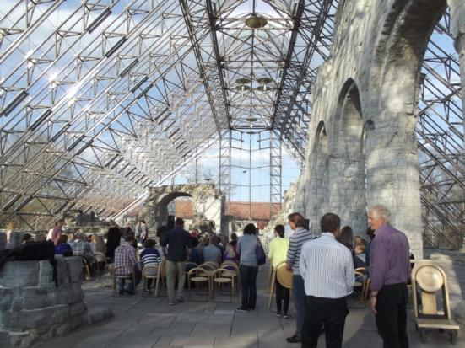
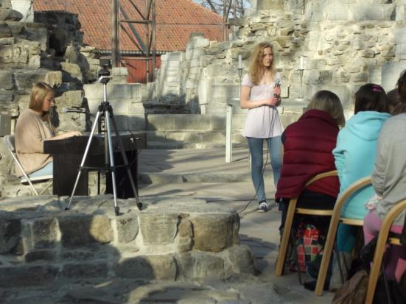
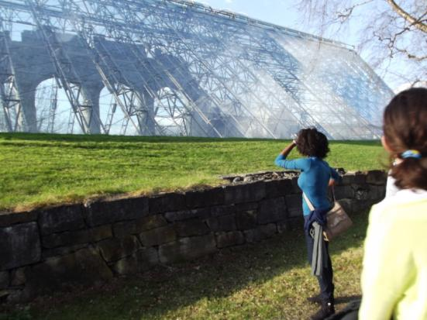
VI) Concert at Hamar Domen

Slide 23
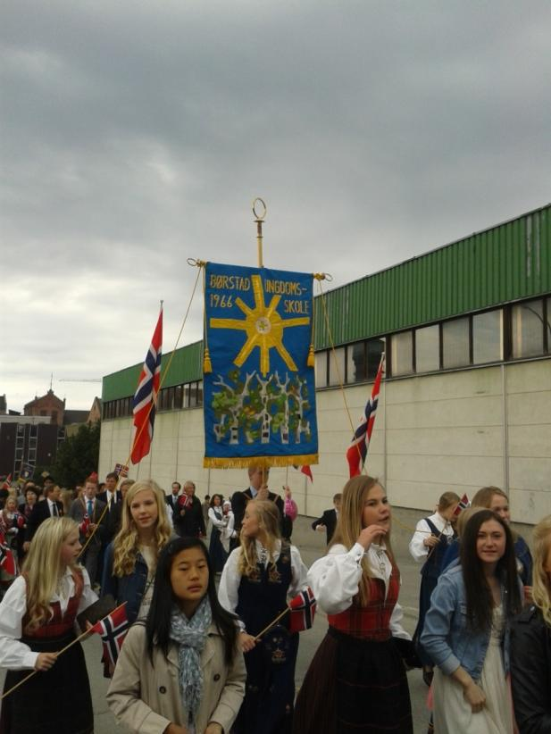
VII) National day : Friday 17th of May 2013 (1/3)
Parade through Hamar

Slide 24
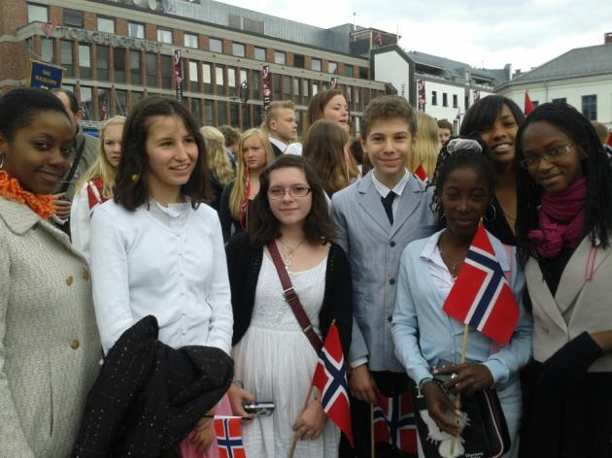
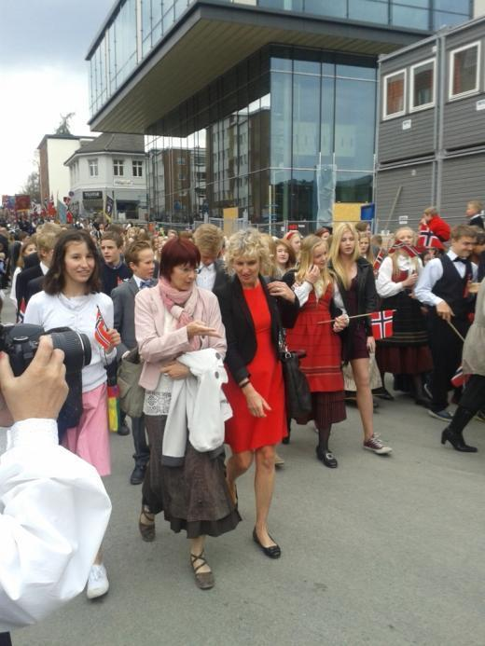
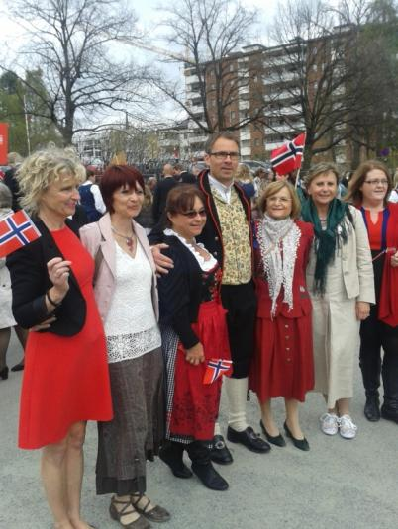
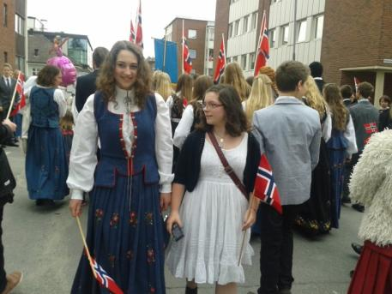
VII) National day : Friday 17th of May 2013 (2/3)

Slide 25
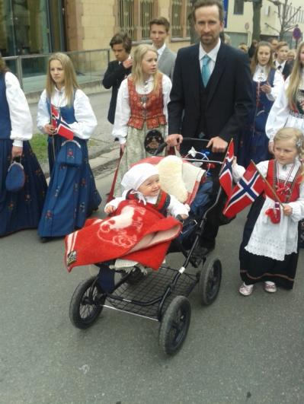
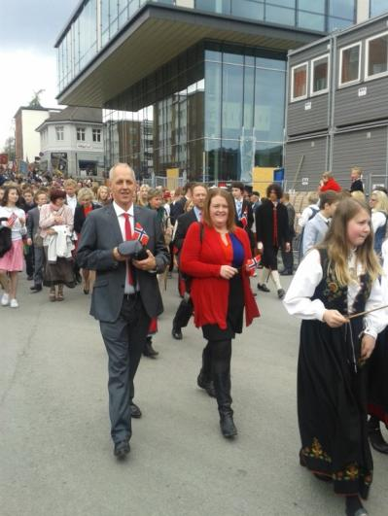
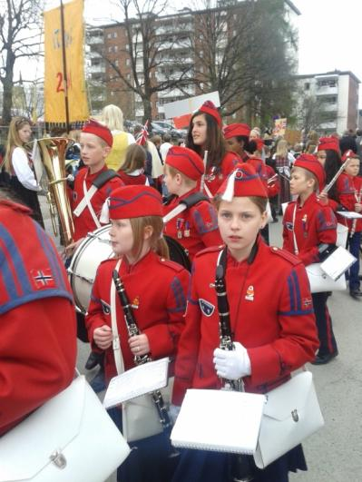
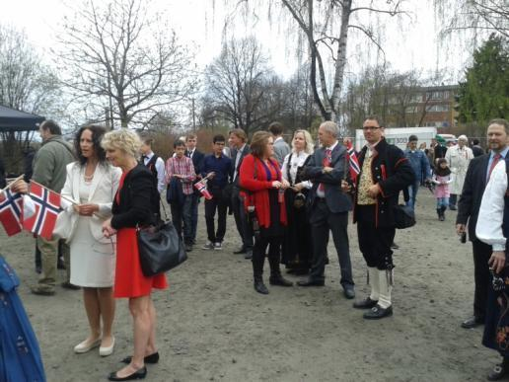
VII) National day : Friday 17th of May 2013 (3/3)

Slide 26
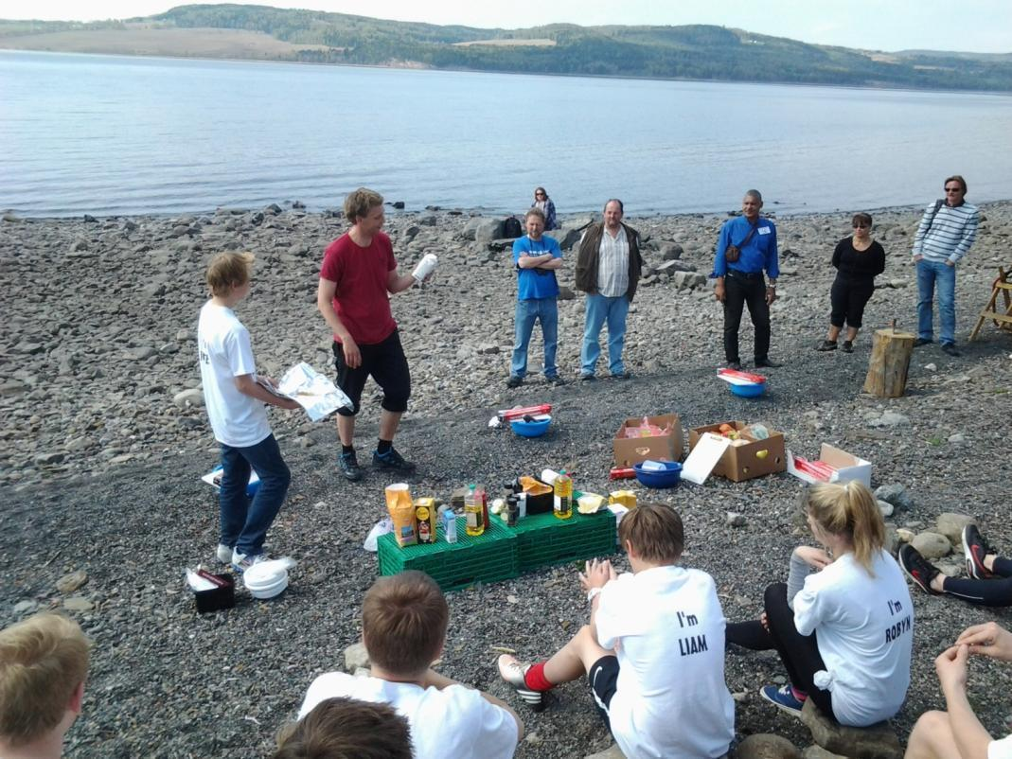
VIII) Energy battle in Furuberget (1/4)
Instructions of the teachers. The students have to cook on their own : to cut the wood, to make the fire, to prepare ingredients and lastly to eat.

Slide 27
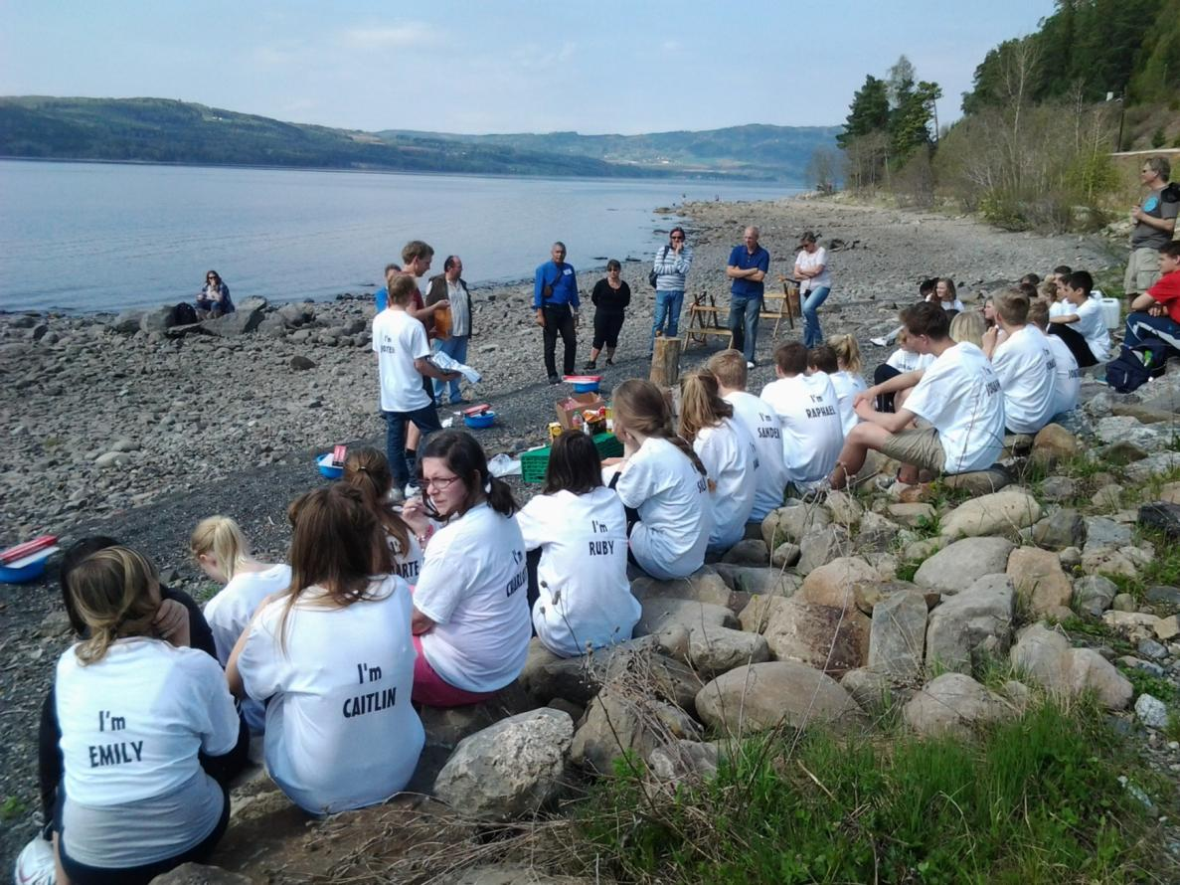
VIII) Energy battle in Furuberget (2/4)

Slide 28
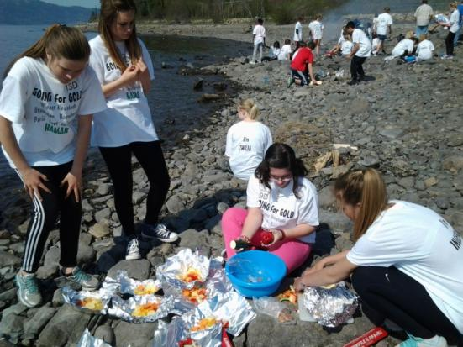
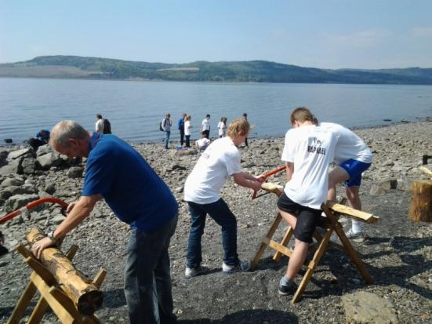
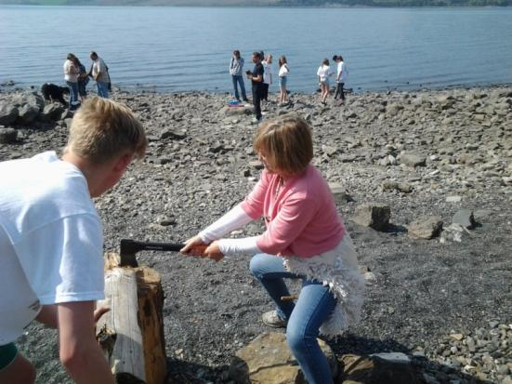
VIII) Energy battle in Furuberget (3/4)

Slide 29
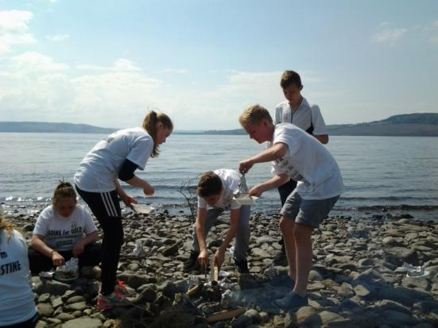
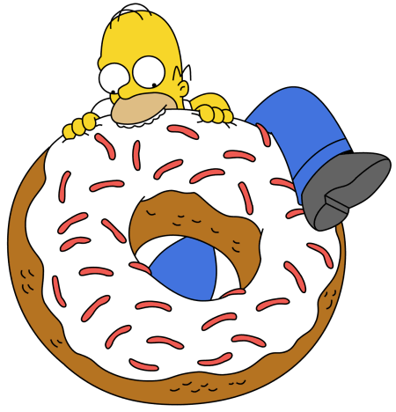
VIII) Energy battle in Furuberget (4/4)

Slide 30
IX) Picnic at City Hall with host families

Slide 31
X) Departure from Hamar (1/3)

Slide 32
X) Departure from Hamar (2/3)

Slide 33
X) Departure from Hamar (3/3)

Slide 34
XI) Arrival in Roissy - Charles De Gaulle
Students’ team :
Mellyn M
Heloïs M
Charlotte P
Teachers’ team :
Mrs. Lavollée
Mrs. Mahé
Mrs. Martin

Slide 35
Dissemination of the project in another classes

Slide 36
Dissemination in the ISC Collège Mr Brailly, the headmaster , listening with attention and interest...

Slide 37
Photos: French delegation, with photos of the Austrian delegation
Powerpoint:
Mrs Lavollée, French coordinator of the project
Mr. Riffaud, Computer technician
with the cooperation of all the delegations of the partner schools of this Comenius project
Danke, Takk, Thanks

