Slide 1
9 MARCH 16 MARCH
Comenius project
GOING FOR GOLD
THE WORLD OF WORK
AT SCHOOL
2013
Project meeting in Fort de France Martinique
Presentation of the ISC- LA VILLE DU BOIS - FRANCE

Slide 2
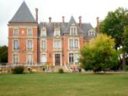
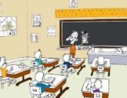
c
1 EUROPE
o
2 NATIONALY
n
t
3 LOCALLY
e
n
4 CLASSROOM
t
5 QUIZZ???????

Slide 3
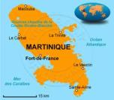
EUROPE
COMENIUS EUROPEAN PROJECT - partner schools

Slide 4
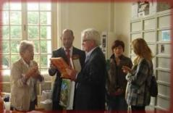
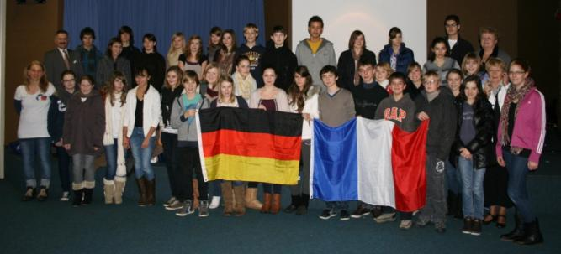
1- europe
PROJECTS AT OUR SCHOOL
Comenius project
« GOING FOR GOLD
FRENCH GERMAN project
WITH ROMANIA :
HUMANITY PROJECT

Slide 5
NATIONALY
Population distribution
Population in France ……………………………… …………………………………….. 66 million
- Active people ………………………………….. …..……………………….……… 28 million
- Women active ………………………………… ..……………………………….. 11 660 million
- Men active …………………………………… ……………………………….. 12 724 million
- People with special needs ……… ………………………….. 9.6 million
- Person without employing …….………………... 3 million

Slide 6
2 NATIONALY
* THE ADVANTAGES OF WORK IN France
-Per week : 35 hours
Fixed schedules
Variable schedules
5 weeks vacation
Information source :INSEE

Slide 7
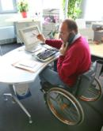
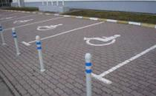
2 NATIONALY
Some avantages
Ticket for the restaurant :
partially paid by the employer
For disabled persons :
Reserved employments
Reserved parking places

Slide 8
2 NATIONALY
Retirement at 62.
We can remain active at work.
Health Insurance : « C.P.A.M. », « Caisse Primaire d‘Assurance Maladie »
Free Health system for all workers in France .
Work done by SIRHINE MAHJOUB
Information source : Wikipedia

Slide 9
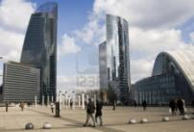
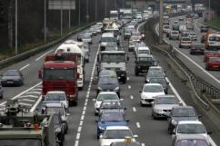
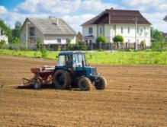
ILE-DE-FRANCE
3 LOCALLY
DEFENSE - PARIS
28,6 miles
ESSONNE DEPARTMENT

Slide 10
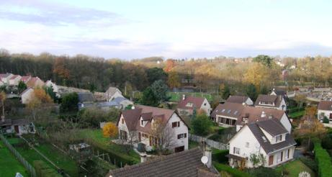
3 LOCALLY
La Défense in Paris
Rural area in La Ville Du Bois

Slide 11
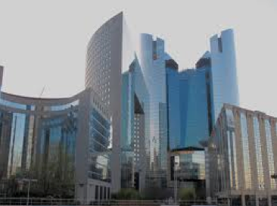
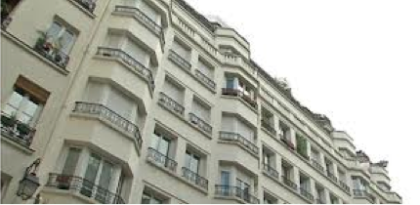
La Défense in Paris is the first European business center
3 LOCALLY
It accommodates 20,000 people and 2,500 businesses.
180 000 employees work in 71 towers.

Slide 12
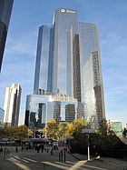
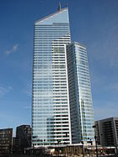
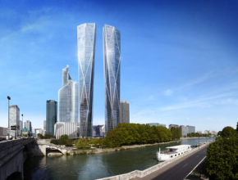
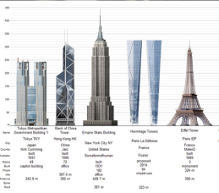
3 LOCALLY
TOWERS IN PARIS
Areva Tower
- 184 m
- 44 floors
Total Tower
- 187 m
- 48 floors
« First » Tower
- 231 m
- 50 floors
In 2018 :
Hermitage Plaza
- 323 m
- 93 floors

Slide 13
3 LOCALLY
THERE ARE …
11% Technicians
67 % Managers
17 % Employees
5 % Others
1 % Workers
40,000 new employees
will be added in the future.

Slide 14
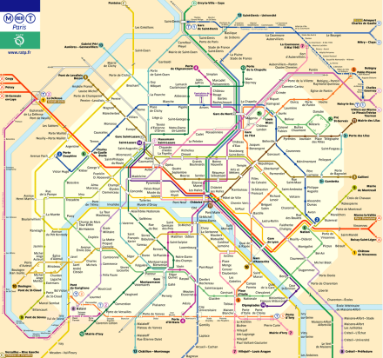
3 LOCALLY
Different means of transport
We have many public transportation:
Train, bus, car, plane, metro, RER, etc…
From Défense to La Ville Du Bois
- 28,6 miles
- about 40 minutes by car
To work in La Défense :
- 90% of the employees go by RER and métro
- 10% by car

Slide 15
3 LOCALLY
This contract allows young people to perform at the same time theoretical training and
concrete experience. Young people begin to work in a company in the first year.
With 912 young professional contracts
in 2012, Ile-de-France has trained 53%
more young people than last year.
Professional Contract
for young people
Work done by ELOISE ANDRES

Slide 16
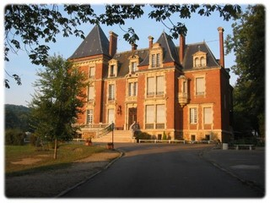
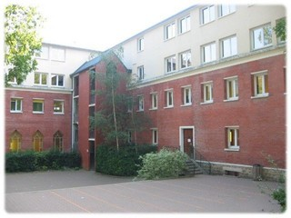
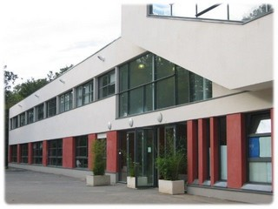
4 CLASSROOM
The ISC School includes
a secondary school (10-14)
a high school college (15-18)
1400 students and 100 teachers

Slide 17
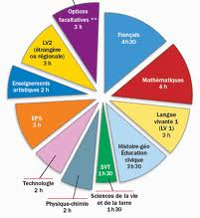
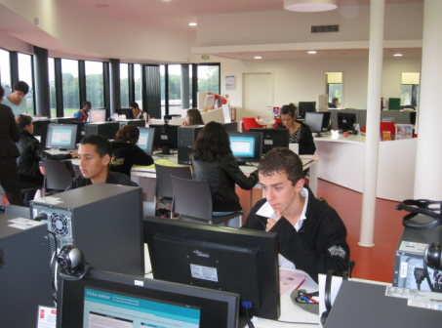
4 CLASSROOM
A new subject :
Discovery of vocational carriers

Slide 18
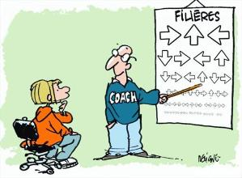
4 CLASSROOM
DiscoverY OF professional CARRIERS:
Optional subject for students (14 years old)
A course of 3 hours per week
To discover professional, economical and social environment
To discover the world of business and training possibilities
To develop the interest of the students for the professional world

Slide 19
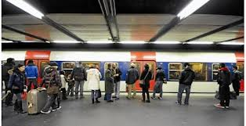
GOING FOR GOLD

Slide 20
How much inhabitants in France ???????
How many hours per week do French people work??
What is the distance between Paris and la Ville Du Bois ?????
Which category of people is the most representated in La Défense ?
How long do we have for “Discovery of vocational carriers” ?????
On which website have the students found the informations
for the PowerPoint Presentation ??

Slide 21
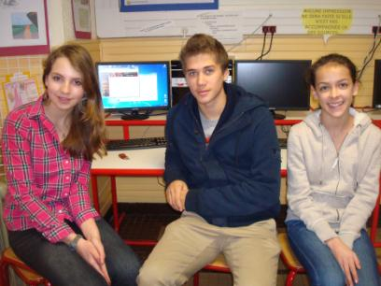
Thank you
MARTINIQUE, NORWAY, UNITED KINGDOM, AUSTRIA
SIRHINE M
ELOISE A
ALEXANDRE L
Teachers team : Nicole Villet, Agnes Goupil, Danielle Lavollée

