Slide 1
France
Elaboré par 2 élèves de l’ISC, LA VILLE DU BOIS – France :
MATHOUX Julien et PHILIPPE Justine

Slide 2
Things you should know about France

Slide 3
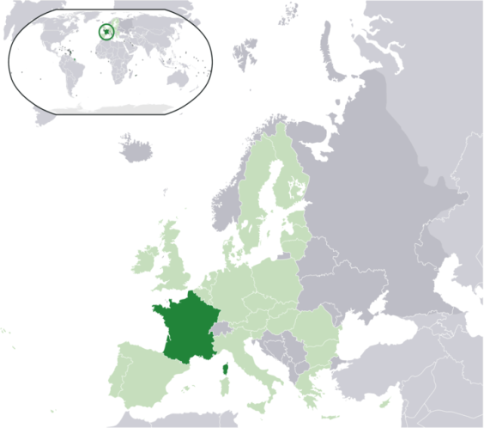
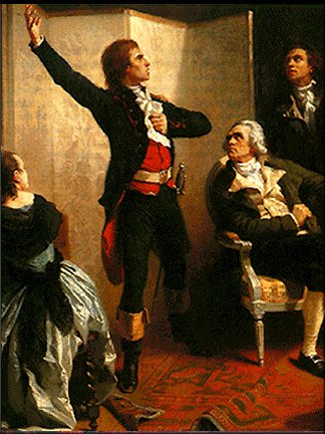
France is located in Western Europe. Metropolitan France is bordered by Belgium, Luxembourg, Germany, Switzerland, Italy, Monaco, Andorra, and Spain. The capital city of France is Paris.
The French motto is "Liberté, Egalité, Fraternité" (Freedom, Equality, Brotherhood).
"La Marseillaise" composed by Isidor Pils, was adopted as the national anthem in 1795.

Slide 4
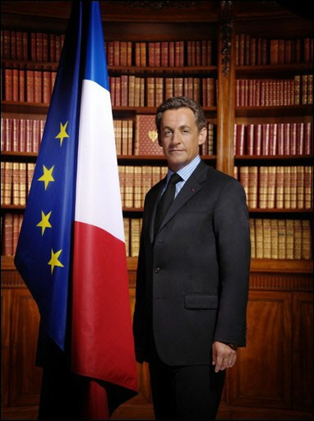
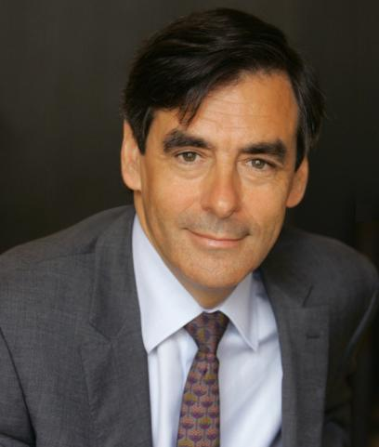
The French President is Nicolas Sarkozy. He was elected on May 16th 2007 and his Prime Minister is François Fillon.
France is one of the founding members of the European Union.
Metropolitan France covers 547 thousand square kilometres. It is slightly larger than Spain. There are 65 million people living in France.

Slide 5
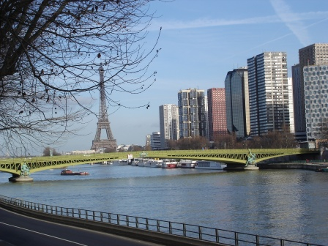
Things you should know about Paris

Slide 6
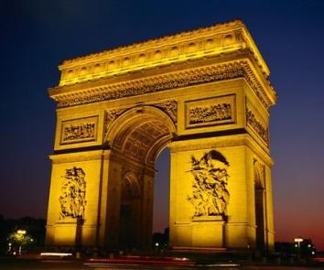
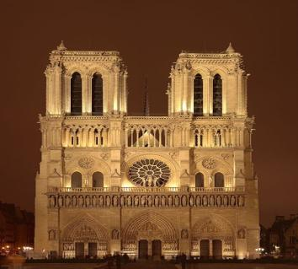
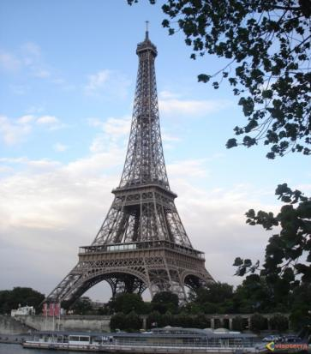
Introduction
Paris is located on the River Seine, in Northern France, at the heart of the “Île-de-France” Region.
Paris is one of the world's leading business and cultural centres and is one of the most popular tourist destinations in the world; with more than 2 million people living in Paris.
The most famous monuments are:
The Eiffel Tower, The Arc de Triomphe and the cathedral, Notre Dame de Paris, built in 1160.

Slide 7
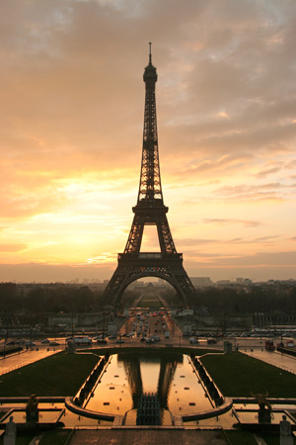
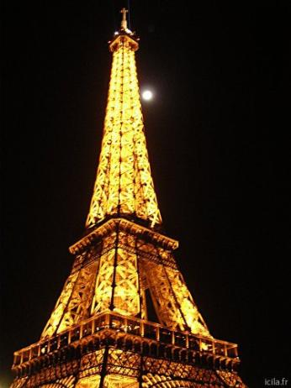
The Eiffel Tower
The Eiffel Tower is a 19th century iron tower, located on the Champ de Mars in Paris. It has become both a global icon of France and one of the most recognizable structures in the world.
It is the tallest building in Paris and the most visited monument in the world. Indeed, almost 7 million people pay to visit the tower each year.
In France, the Tower is also known as “La Dame de Fer”, which means “The Iron Lady”. It was named after the designer, Gustave Eiffel.
The tower stands at 324m tall. It has three levels for visitors.

Slide 8
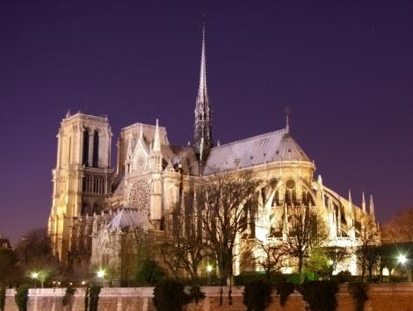
Notre Dame de Paris
Notre Dame de Paris is a Gothic Cathedral on the eastern half of “The Ile de la Cité” in the fourth “arrondissement” of Paris. Notre Dame de Paris is widely considered as one of the finest examples of French Gothic architecture in the world. It was restored and saved from destruction by Eugène Viollet-le-Duc, who is one of the most famous French architects. The name “Notre Dame” means "Our Lady" in French and is often used in the names of churches in French speaking countries.
Notre Dame de Paris was one of the first Gothic Cathedrals. It’s sculptures and stained glass windows show the heavy influence of naturalism.

Slide 9
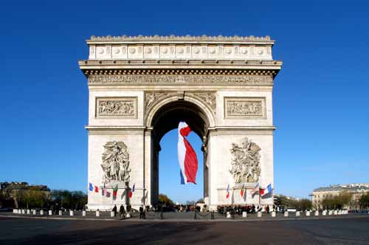
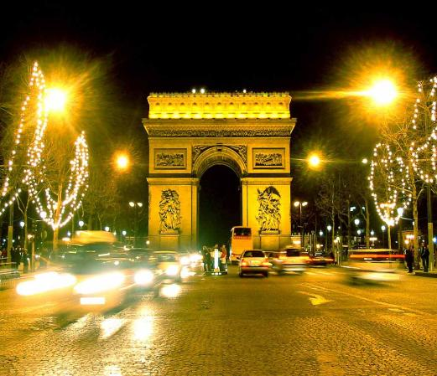
L’Arc de Triomphe
“The Arc de Triomphe” is a monument in Paris that stands at the centre of “The Place Charles de Gaulle”, also known as “The Place de l'Étoile". It is on the western end of “The Champs-Élysées”. “The Arc de Triomphe” honours those who fought for France. At the top of the Arc there are the names of generals who fought during the wars. The Tomb of the Unknown Soldier is underneath the Arc.
The monument was designed by Jean Chalgrin in 1806.

Slide 10
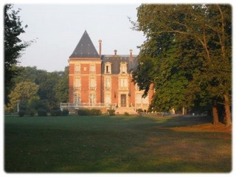
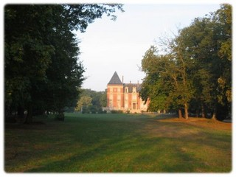
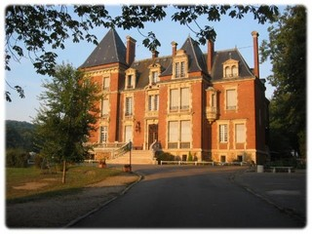
Our school : the I.S.C.

Slide 11
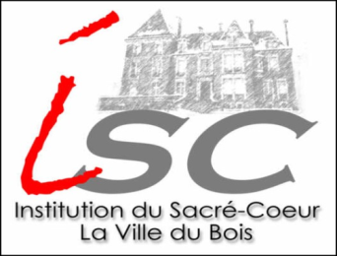
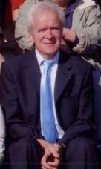
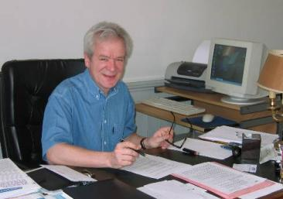
Our school : The I.S.C
The Institution du Sacré- Cœur (ISC) has existed as a school since 1938 and has approximately 1400 students and over 90 teachers.
The headmaster is Mr Brailly.
His office is situated inside the castle.

Slide 12
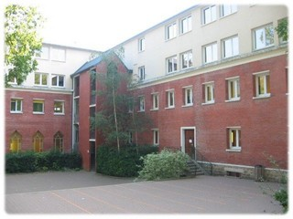
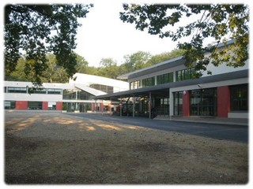
The “Collège” is the first step of the secondary education in France. There are approximately 850 students aged from 11 to 15.
The “Lycée” is the second step of the secondary education in France and has approximately 500 students aged from 15 to 18.

Slide 13
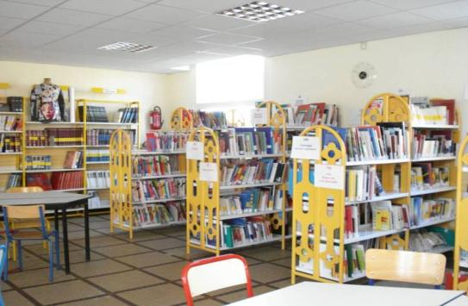
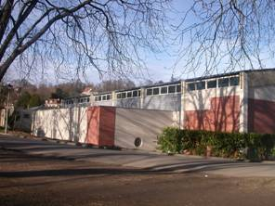
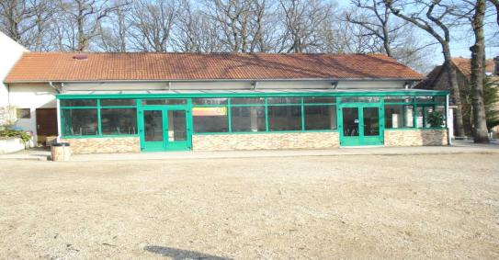
The library has a good selection of books to read.
Here is the Sports Hall →
If you are a little hungry, here is the cafeteria! ->

Slide 14
The End

