Slide 1
Going for Gold Project meeting June 2012, 9th – 14th Our olympic hopes
Braunton School and Community College
&
Pilton Community College UK
Presentation of the French delegation of La Ville du Bois

Slide 2
All the European Delegations in London for the Olympic Stadium

Slide 3
CONTENT
I) Departure to UK from Roissy
II) Arrival to UK
III) Visit of London
IV) Welcome at school and Presentations
V) Sport activities
VI) Visits
Conclusion

Slide 4
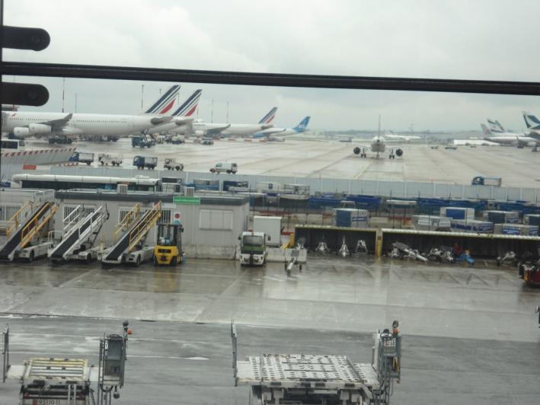
I) Departure to UK from roissy

Slide 5
II) Arrival to uk

Slide 6
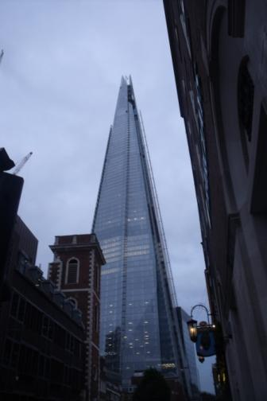
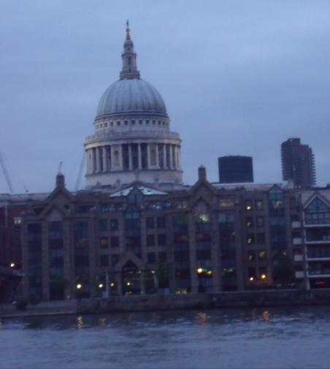
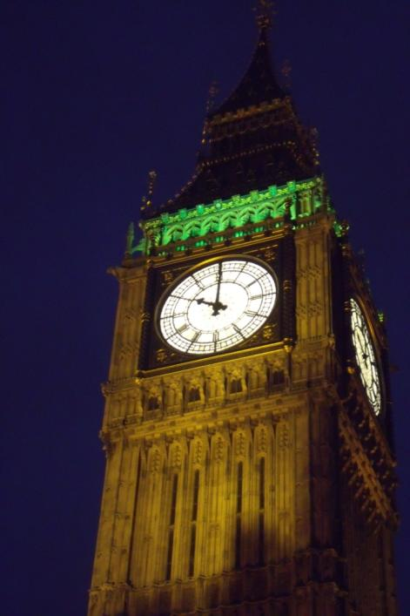
III) Visit of london

Slide 7
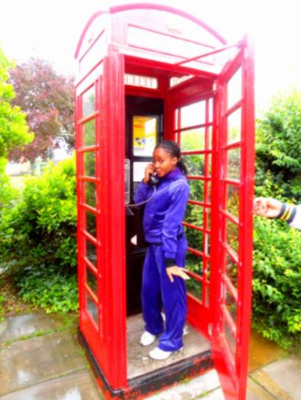
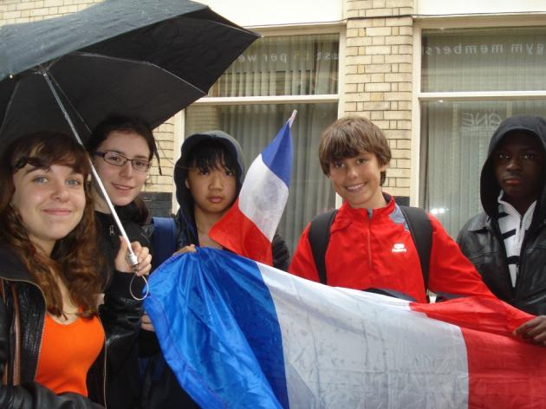
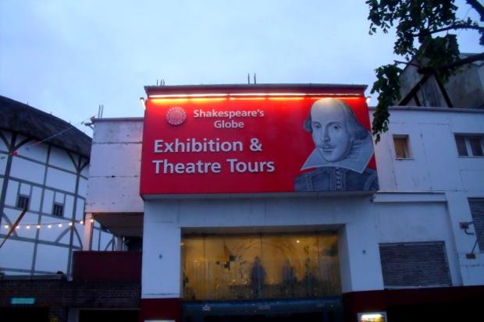
III) Visit of london

Slide 8
III) Visit of London : the olympic stadium

Slide 9
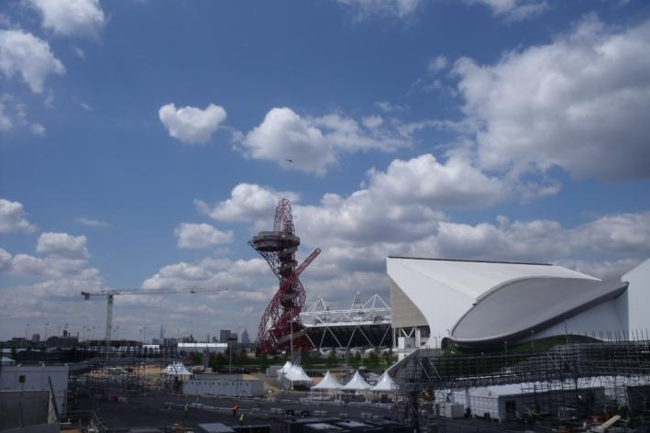
III) Visit of london : the olympic stadium

Slide 10
IV) Welcome at school and presentations

Slide 11
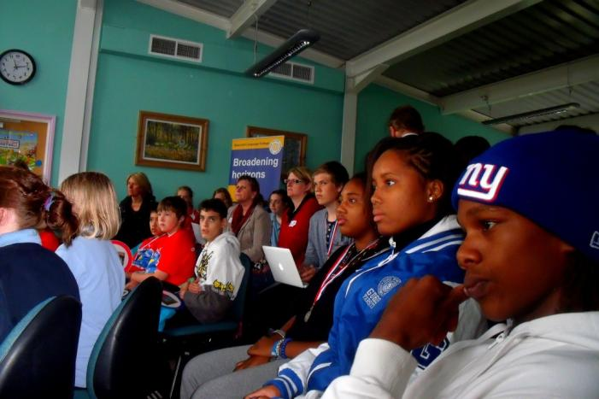
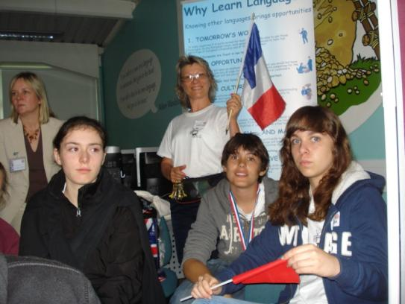
IV) Welcome at school and presentations

Slide 12
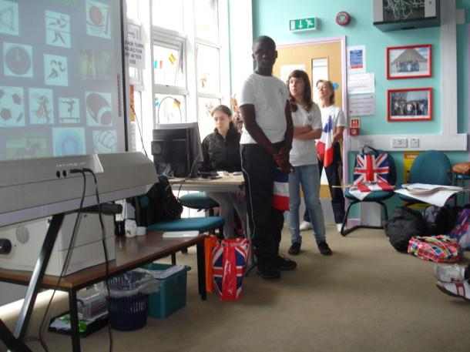
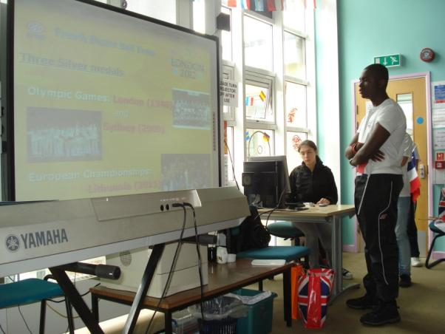
IV) Welcome at school and presentations

Slide 13
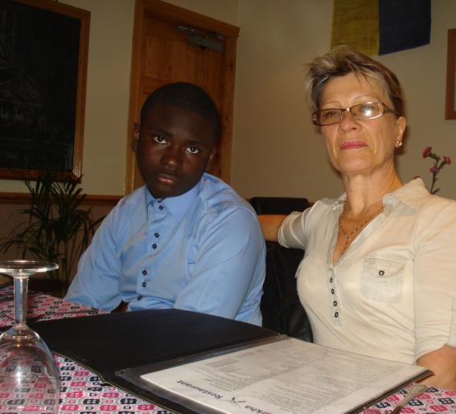
IV) Welcome at school and presentations

Slide 14
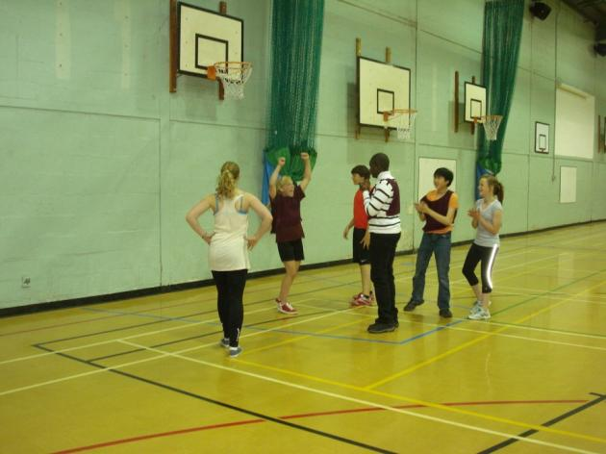
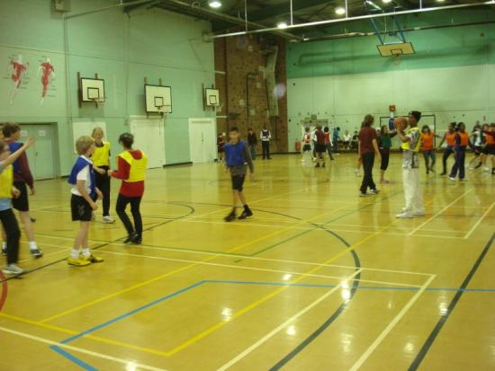
V) Sport activities

Slide 15
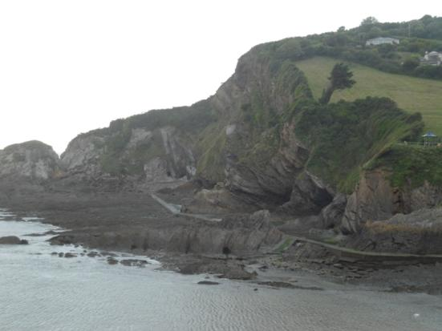
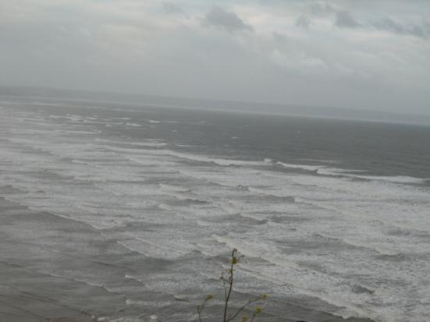
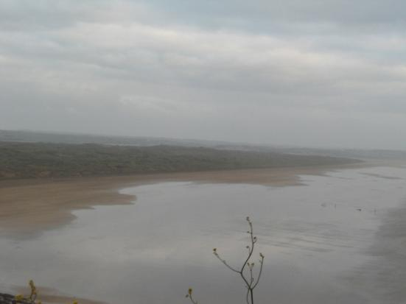
VI) Visits : the coast in devon

Slide 16
VI) Visits : braunton and pilton

Slide 17
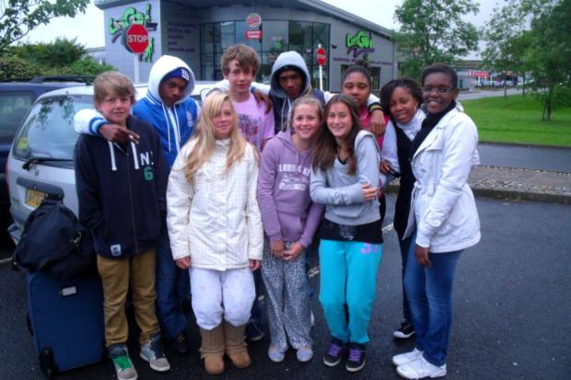
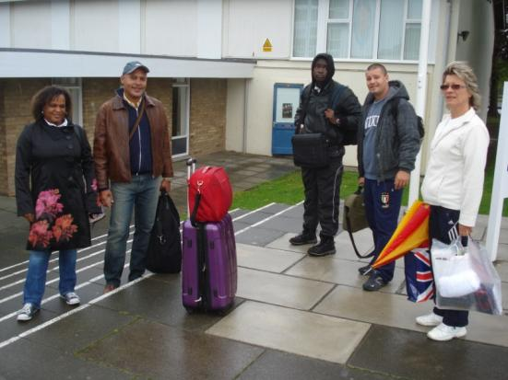
VI) Visits : students and teachers group

Slide 18
Conclusion : Londres 2012 for France : 34 médailles françaises, onze titres olympiques

Slide 19
Photos:
French delegations of La Martinique and La Ville du Bois
Powerpoint:
Teachers team: Mrs Domagata and Mrs Lavollée, French coordinator of the project
Mr. Riffaud, Computer technician
with the cooperation of all the delegations
See you soon next during the next meeting
October 2012
in ISC School, La Ville Du Bois, France !!

