Slide 1
Comenius Project
Mobility 1, 14-17 September 2011
ISC, La Ville du Bois. FRANCE
GOING FOR GOLD: New project
Austria: Wiener Neustadt- England: Braunton and Pilton-
France: Fort de France and La Ville du Bois- Norway: Hamar
This project is funded by the European Commission
ISC SCHOOL

Slide 2
La Ville du Bois

Slide 3
La Ville du Bois : Town Hall

Slide 4
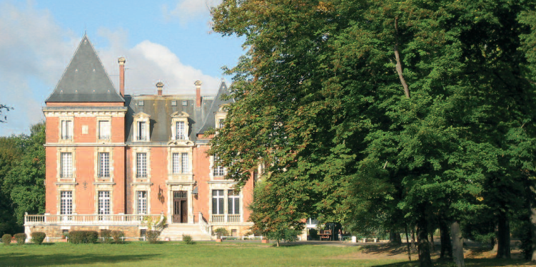
La Ville du Bois : ISC School (1404 students)

Slide 5
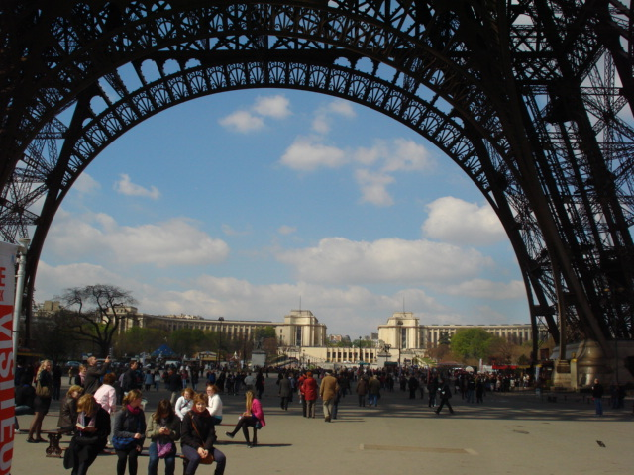
La Ville du Bois : 25 km from Paris

Slide 6
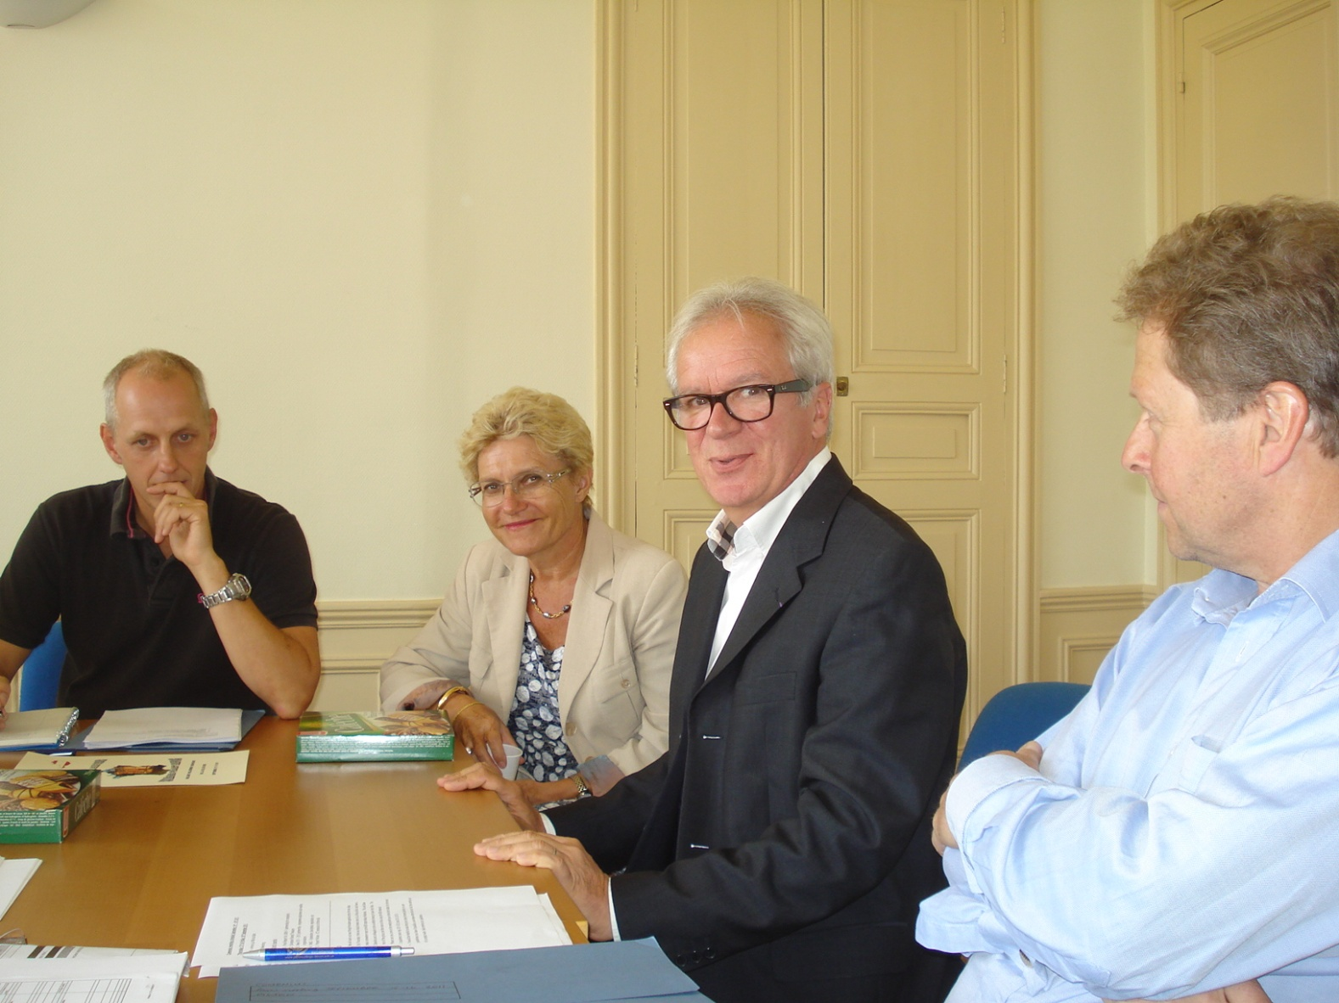
The project meeting at the ISC with all the delegations : welcome words by the headmaster Mr. Brailly

Slide 7
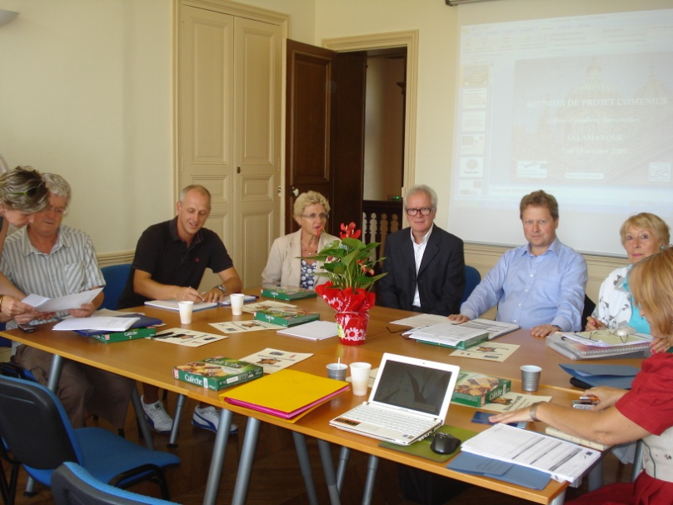
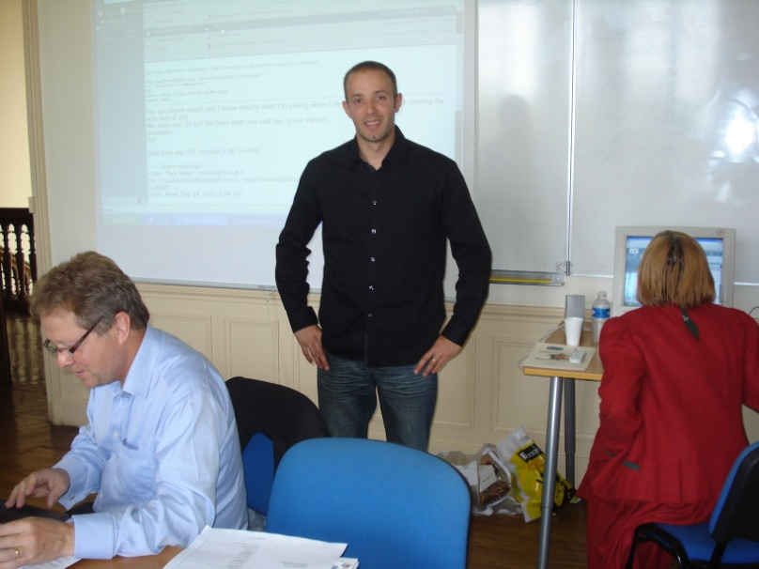
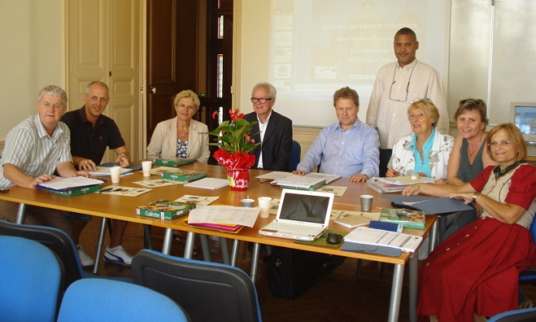
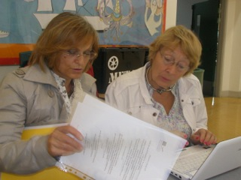
All the delegations at work

Slide 8
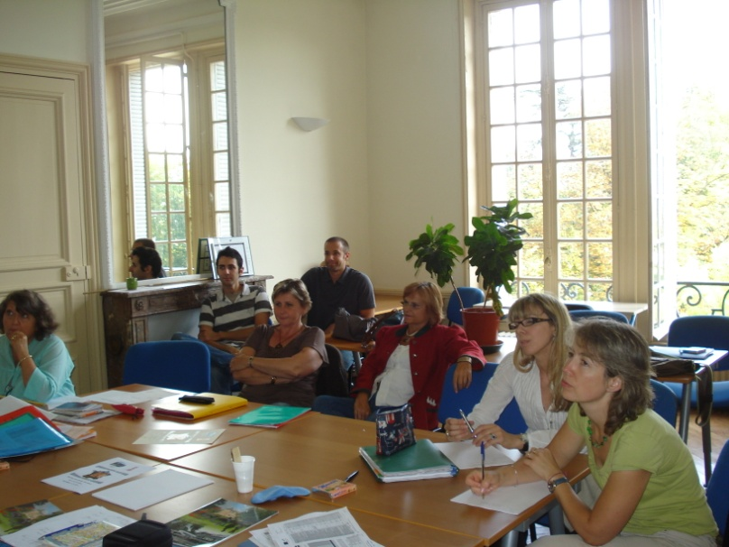
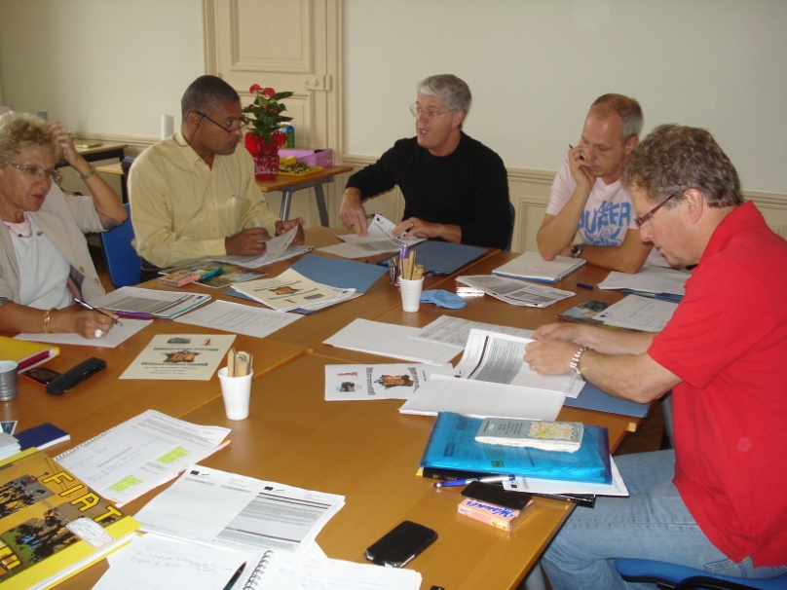
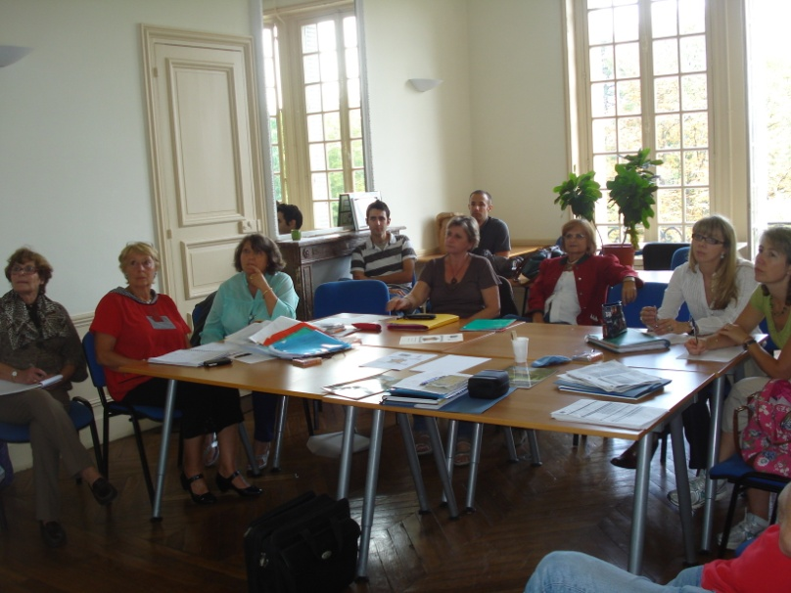
Working for the new project

Slide 9
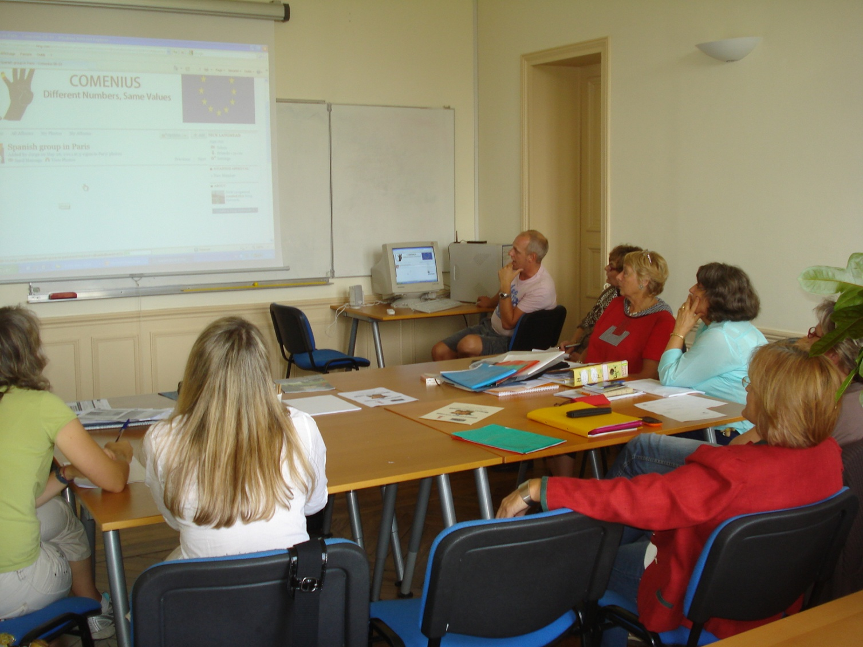
Discovering the NING platform for the project

Slide 10
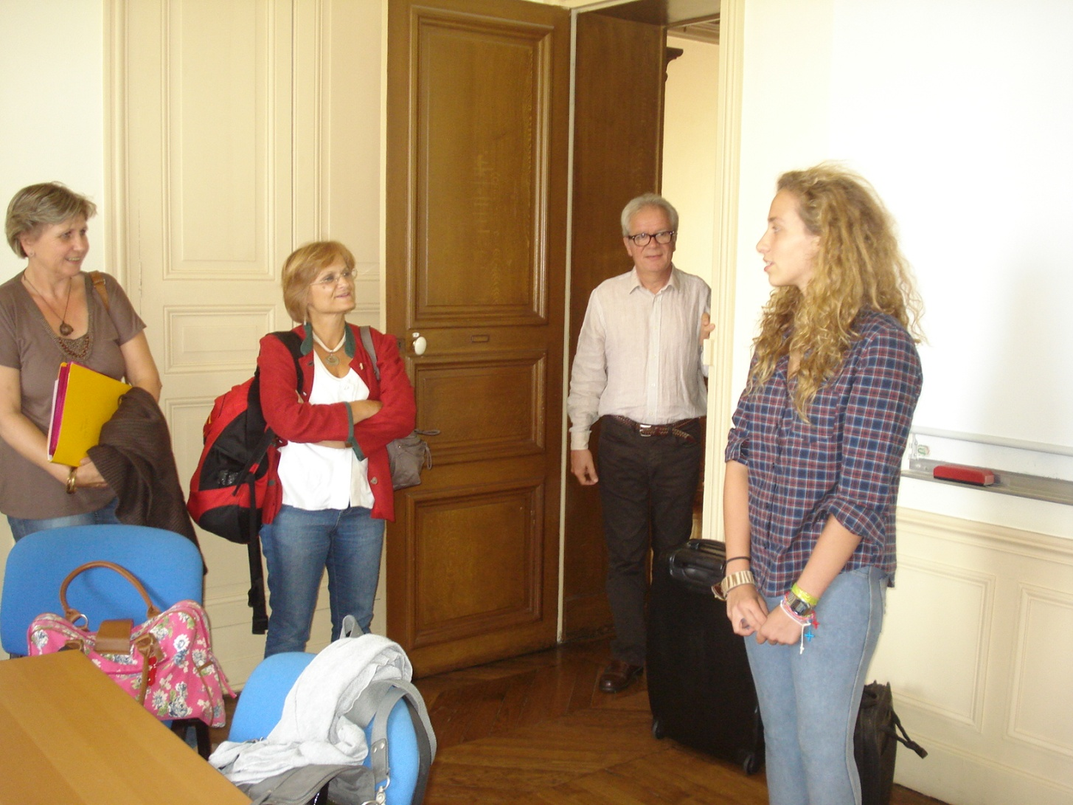
A spanish student for a Comenius Individual mobility of 4 months learning at the ISC school

Slide 11
Powerpoint
Photos: Mrs. D. Lavollee
Powerpoint:
Mrs Lavollée, French coordinator of the project
Mr. Riffaud, Computer technician
See you soon for the next mobilities in :
Austria, UK, La Ville du Bois, Fort de France and Hamar

