Slide 1
Comenius project
Turning Ideas Into Actions
Lycée Joseph Gaillard, Fort de France
Project meeting
Saturday,16 th – Saturday, 23 rd November 2013
Presentation from the following students of the ISC School in La Ville du Bois, France :
-Matthieu
-Louis
-Marie
-Lucie

Slide 2
Content
Where are we coming from?
FRANCE
- Métropole : Paris
- Collège du Sacré-Cœur ISC, La Ville du Bois
Where are we going to?
FRANCE
- Martinique : Fort-de-France
- Lycée Joseph Gaillard
- I) Banana history
- II) Banana growing
- III) Banana production
- IV) Sentences for fun

Slide 3
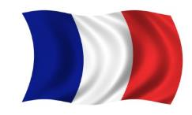
Where are we coming from ?

Slide 4
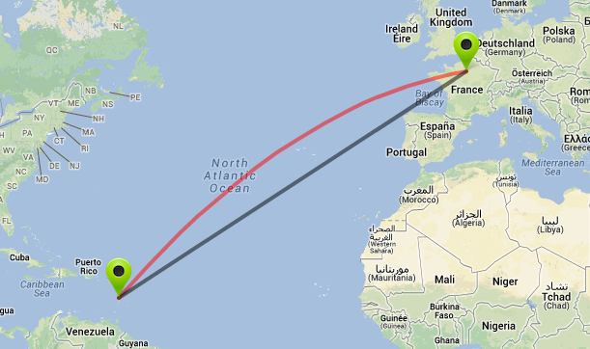
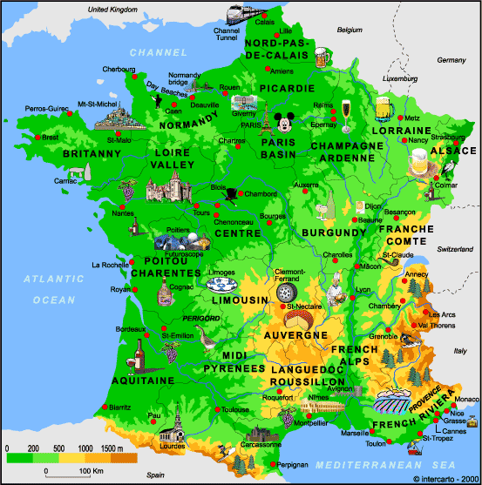
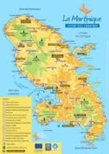
FRANCE
Area :
550 000 km²
Population :
66 Mio
Density /km²:
103
Area :
1128 km²
Population :
413 000
Density /km²:
350
7000 km

Slide 5
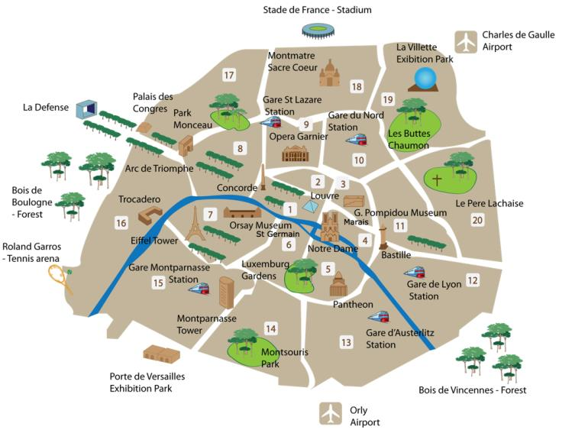
Métropole : Paris, 2.3 Mio inhabitants

Slide 6
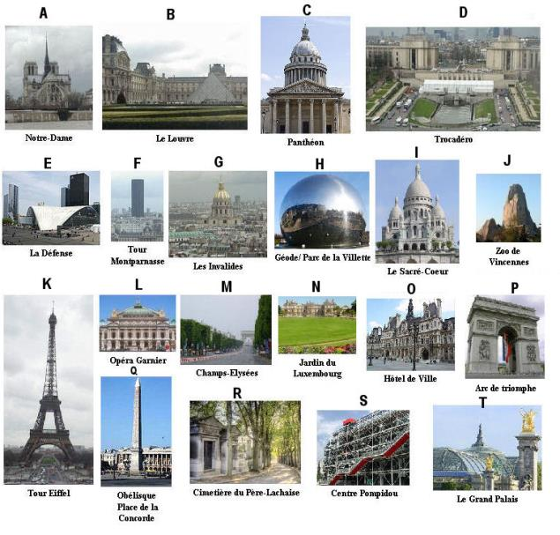
Métropole : Paris’ monuments

Slide 7
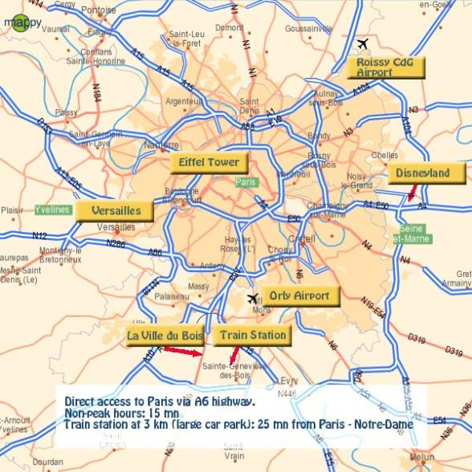
La Ville du Bois, 7500 inhabitants
La Ville du Bois

Slide 8
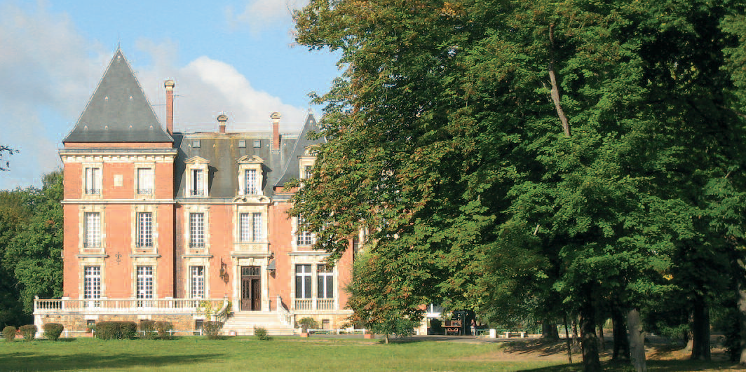
Collège du Sacré-Coeur
The ISC School
is located in a very nice green park with a lake
has 1480 students and a staff of 130 persons
its motto :
«The reason of being is to permit pupils to reach their own level of excellence».

Slide 9
Where are we going to ?

Slide 10
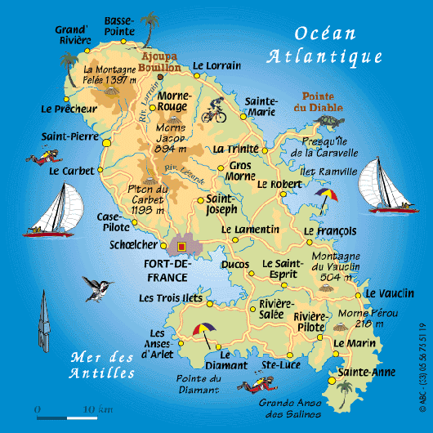
Martinique : Fort-de-France, 89 000 inhabitants
Fort-de-France

Slide 11
We are here today together !

Slide 12
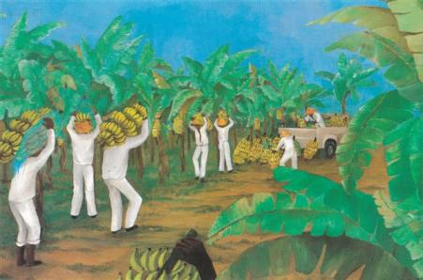
I- History of the banana

Slide 13
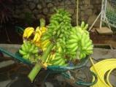
1) Discovery of the banana
The banana is :
a fruit in a white and sweet pulp
appeared in the South East of Asia towards 500 before J-C.
Today :
The biggest producers of banana are situated in every corner of the globe
Brazil
Ecuador
India
Indonesia

Slide 14
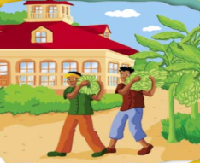
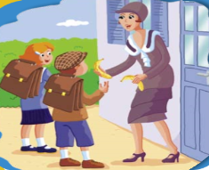
2) History timeline of the banana
In 18 th century = Introduction of the banana in Martinique and Guadeloupe
In 19 th century = International exchanges of the banana
In 20 th century = Discovery of the banana by the European population

Slide 15
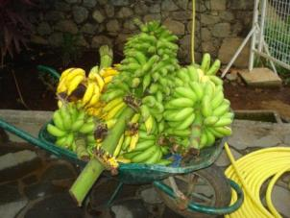
3) Types of bananas
There are two big categories of banana:
banana fruits
banana vegetables
Bananas cultivated for the export are essentially banana fruits.

Slide 16
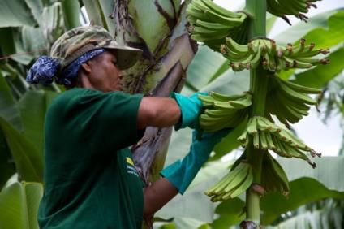
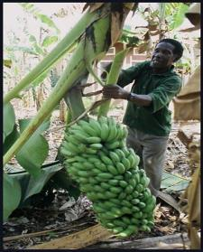
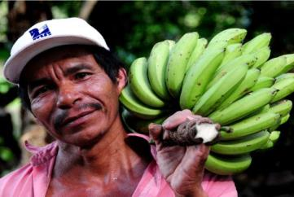
II- Banana growing

Slide 17
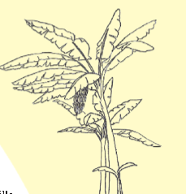
A « banana tree » is
not a tree
a huge herb
the tallest herb in the world
Its leaves
curl
form like a trunk
The real stem of the plant
is underground (called a rhizom)
gives regurlarly new banana trees
Family
This herb belongs to the « Musacées »
Varieties
One thousand varieties
Export
Two main varieties are exported in Europe: Giant Cavendish and Gros Michel.

Slide 18
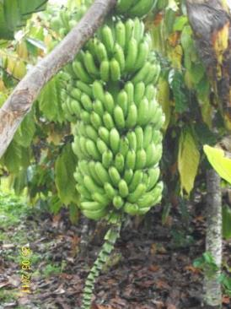
The banana tree grows up in a tropical or sub tropical climate :
a hot, humid and stable climate
Ideal temperature = 27 ° C
Precipitations >120 mm/month
Sunshine = 2000 hours of sun/year

Slide 19
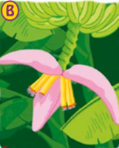
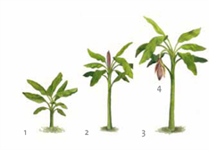
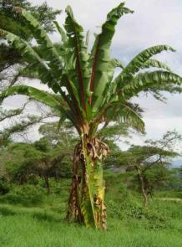
1) Plantation of the bananas
The banana tree reaches its adult height in 6 or 7 months
Then the banana tree’s flower (called “popotte”) appears
Adult: size
6-7 meters

Slide 20
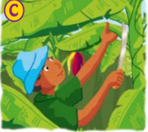
2) Treatments of the bananas
The banana trees need a lot of treatment :
watering
putting up of stake
cut of flowers and cumbersome leaves

Slide 21
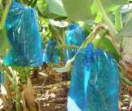
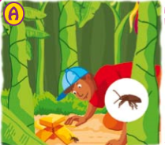
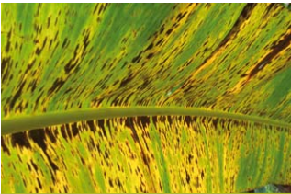
3) Protection of the bananas
A lot of things needs to be done to protect the banana trees from deseases:
trap for insects at the bottom of the banana tree
protection with bags
use of the minimum of chemicals products
preservation of the environment
One parasite of the banana : The « Cercosporiose ».
It’s a microscopic mushroom

Slide 22
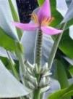
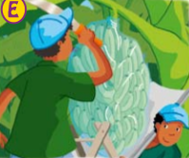
4) Harvesting bananas
Bananas
are picked all year round
contrary to other fruits like strawberries or apples which
are collected during specific periods of the year.

Slide 23
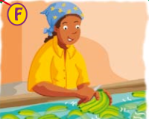
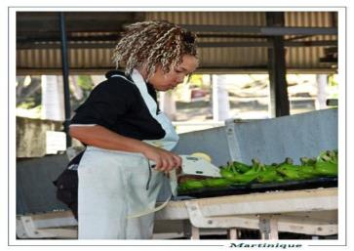
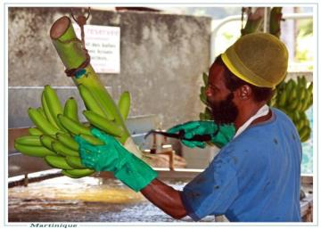
5) Preparation of the bananas
After the cut the bunches are
separated by hand (10 at 20 bananas)
washed
jagged in new bunches (4 at 7 fruits)

Slide 24
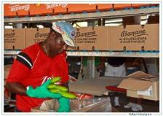
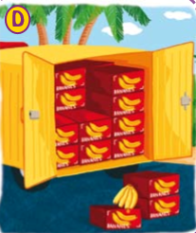
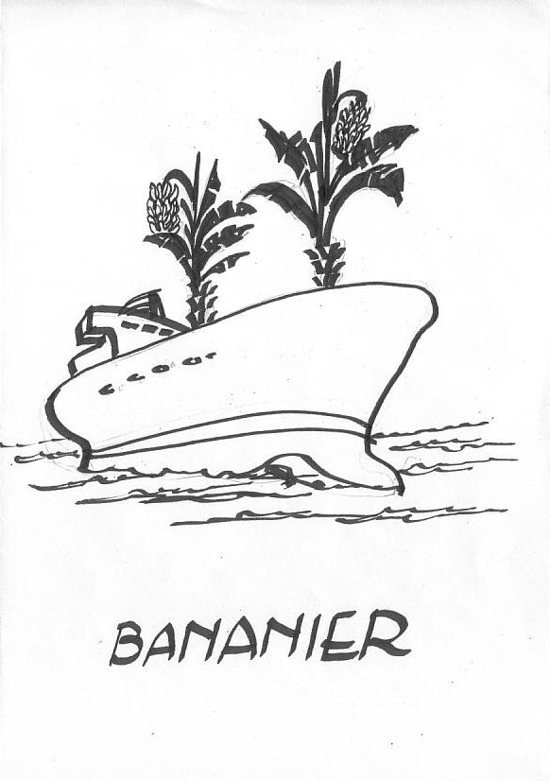
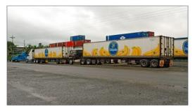
6) Transport of the bananas
The bunches are
sorted according to their height
labeled and put in cardboard box
are loaded onto the lorrys (temperature: 13C)
will be then transported by boat all around the world

Slide 25
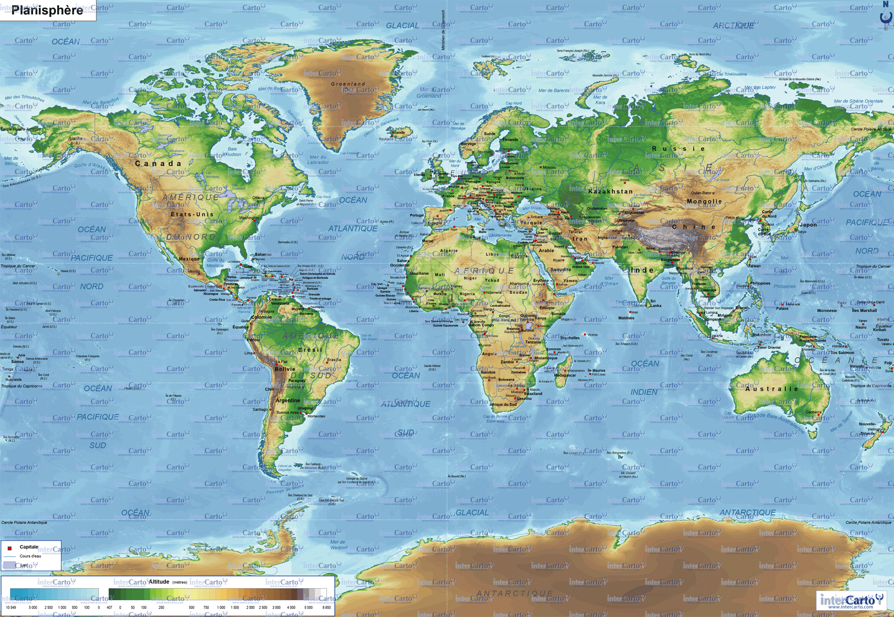
Good trip!!!

Slide 26
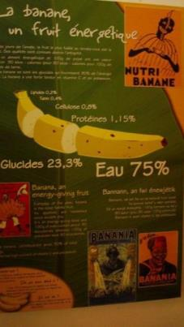
III- Production of bananas in our 5 countries

Slide 27
Production for the five countries in the project
Country | Consumption per year
Austria | 0
France Martinique | 269 000 tonnes
France Métropole | 0
Italy | 0
Spain | 350 000 tonnes
UK | 0

Slide 28
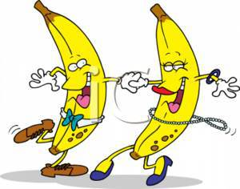
IV) Sentences for fun

Slide 29
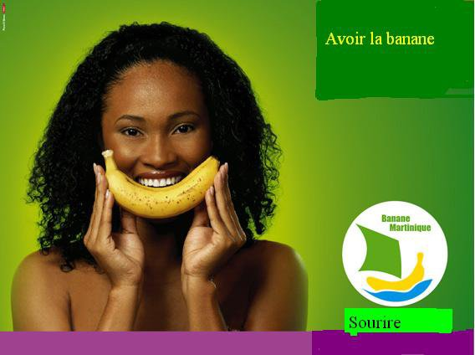
Avoir la banane: «To have a big smile»

Slide 30
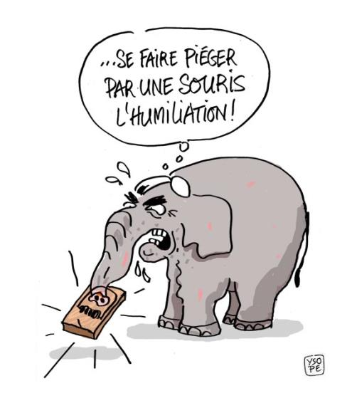
Se faire bananer: «To be conned»

Slide 31
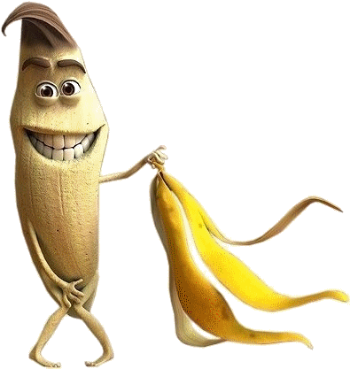
Espèce de banane: «You are stupid»

Slide 32
Faire glisser sur une peau de banane:
«Pull the rug out from under someone»

Slide 33
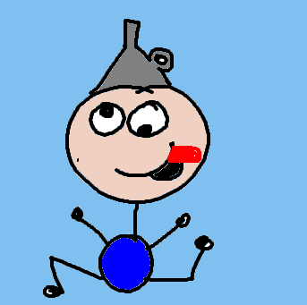
Go bananas: « Devenir fou »

Slide 34
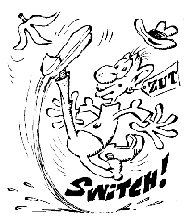
Glisser sur une peau de banane: «To slide over a banana»

Slide 35
The end
ISC Website : www.isc-villedubois.com

