Slide 1
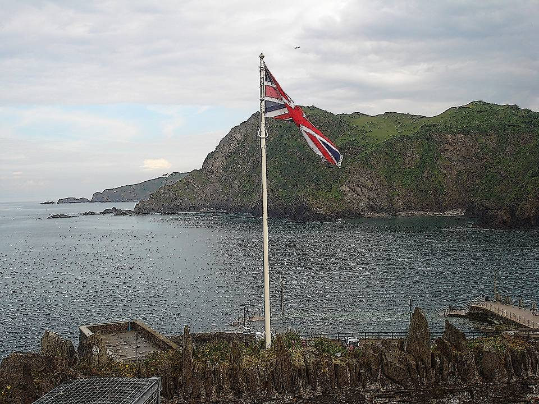

Braunton
Different numbers. Same values
Comenius’ Project meeting
9 – 13 June 2010
Photos D. LAVOLLEE et T .MARTY

Slide 2




The project and its partners
The project Comenius Different numbers. Same values is a school partnership project. It counts 6 schools of 4 countries :
Austria : Europaschule in Wiener Neustadt
Spain : Colegio Maria Auxiliadora in Salamanca
France : Martinique : Lycée Joseph Gaillard in Fort de France
Metropolitan : Institution du Sacré Cœur in La Ville du Bois
United Kingdom : Braunton School and Community College in Braunton
Pilton Community College in Barnstaple

Slide 3
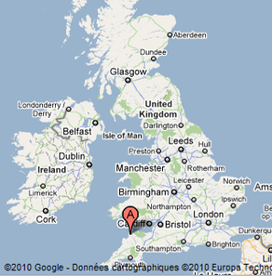
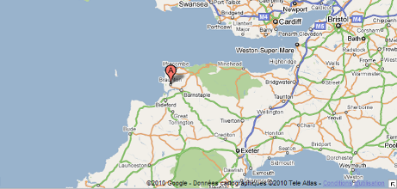
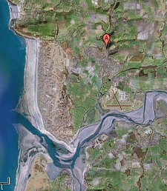

Braunton is the biggest village of England. It counts approximately 8000 inhabitants. It is situated in the North Devon, near the coast. It’s a very green region!

Slide 4

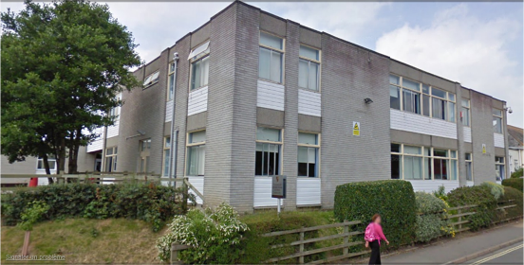
Welcome at school
Braunton School and Community College counts 751 students, aged
11 to 16. It is specialized in mathematics and computing.
In this school the creativity of the pupils is valued.

Slide 5
Programme of the European meeting
Wednesday, June 9 th: arrival of the delegations of Austria, Spain and France (Metropolitan and Martinique).
Thursday, June 10 th : surf lesson and visit of Exeter.
Friday, June 11 th: day at the partner school Braunton School and Community College and boat tour.
Saturday, June 12 th: music festival in Lynton Lynmouth
Sunday, June 13 th: departure of the Europan delegations

Slide 6

Wednesday, june 9 th

Slide 7
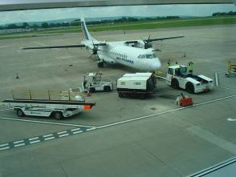
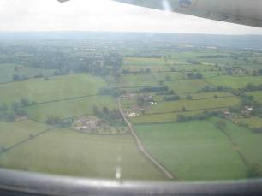
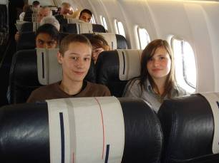
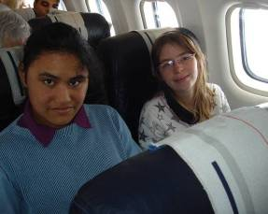
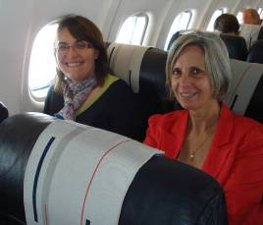
Roissy-Charles de Gaulle Airport : departure of the French delegation.
We are very happy!!!

Slide 8
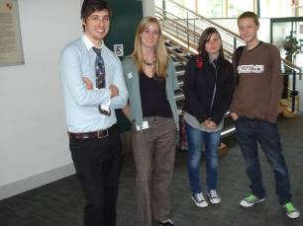
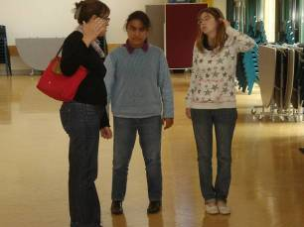
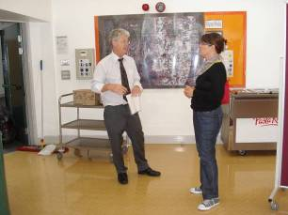
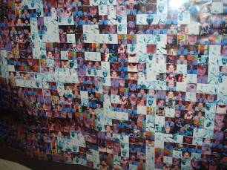
From home to school

Slide 9
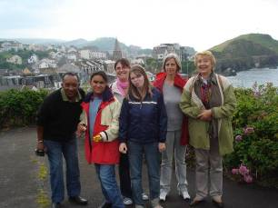
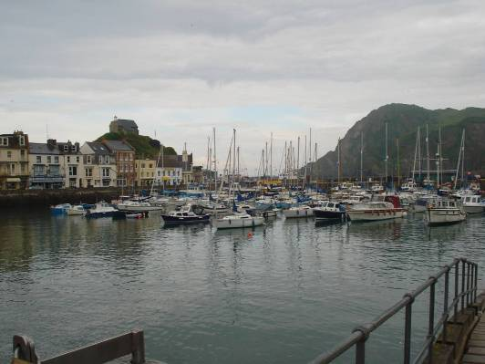
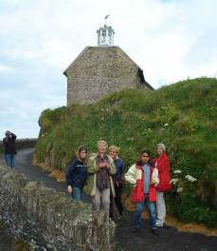
Arrival to Ilfracombe, the place of our accommodations
Meeting with the delegation of the Martinique

Slide 10
Thursday, june 10 th

Slide 11
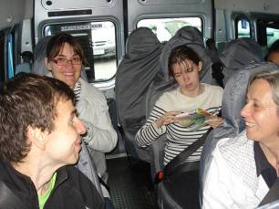
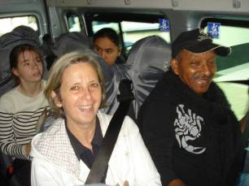
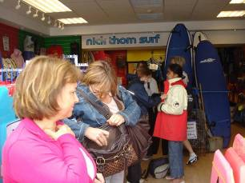
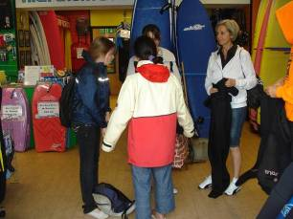
Departure for surfing with the school minibus
A passage through the store to get a waterproof and warm suit!!
The water is sure very cold!!

Slide 12

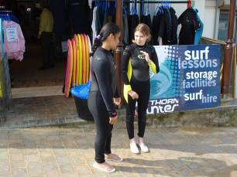
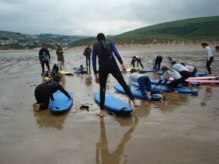
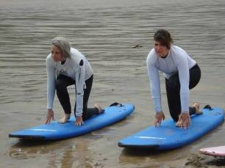
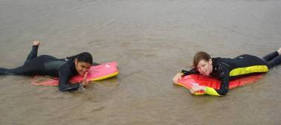

European surf lesson…
Water temperature: 12°
Teachers and students: Where are the champions?

Slide 13
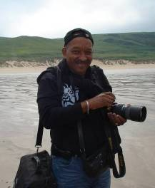
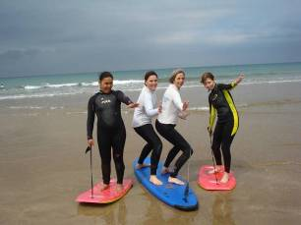


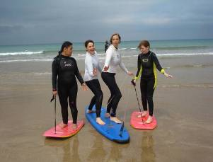
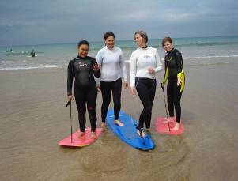
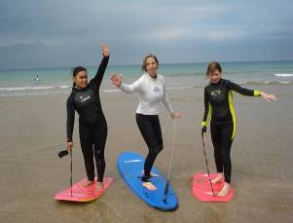
The surf lesson : great!!!
… Tony, photograph of La Martinique, makes unforgettable photos

Slide 14
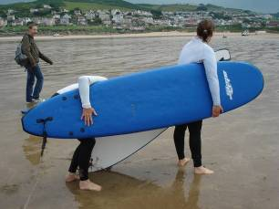
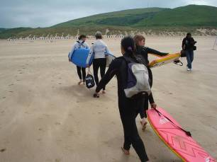
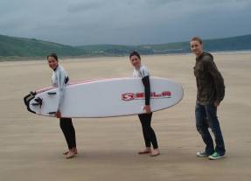
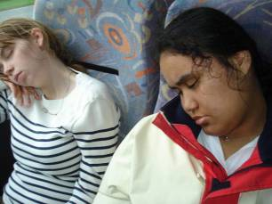


A difficult return…
… very tiring, but dreaming!!!

Slide 15
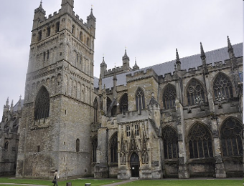
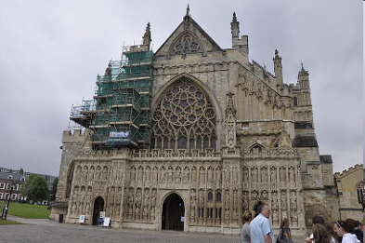
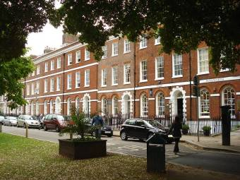
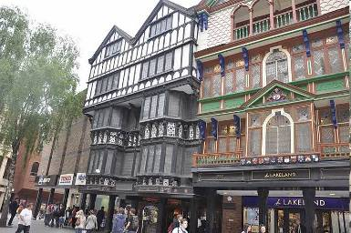
Visit of Exeter

Slide 16
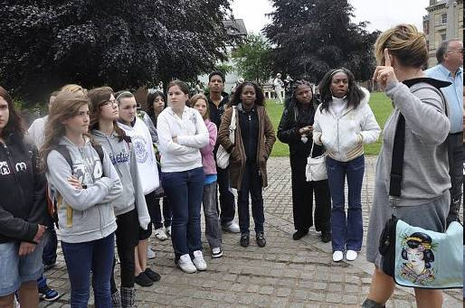
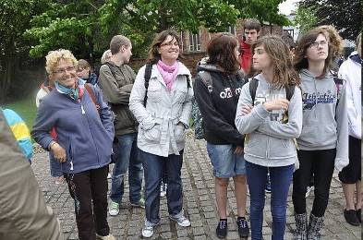
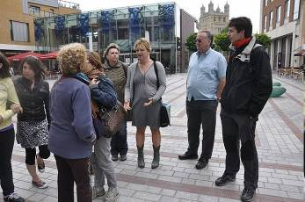
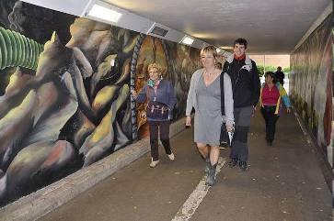

Slide 17
Friday, june 11th

Slide 18
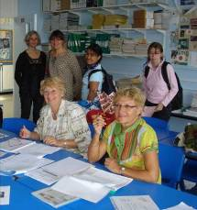
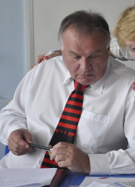
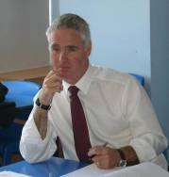
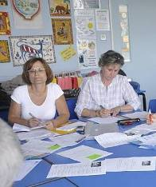
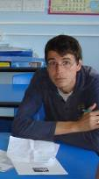
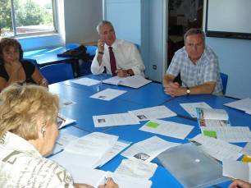
France
United Kingdom
Teachers during the meeting
Spain
Austria

Slide 19
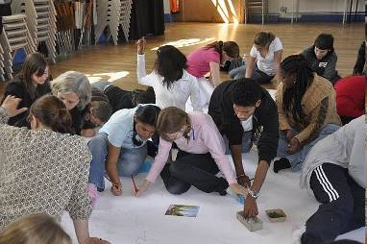
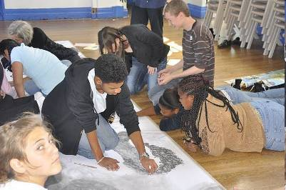


«Art morning» for all the students

Slide 20





Emies and Emmelines presentation to English students

Slide 21



Exploring the beautiful surrounding

Slide 22




Some organize…
...the others enjoy !!!

Slide 23
Saturday, june 12 th

Slide 24




Music festival in Lynton Lynmouth

Slide 25




Slide 26
Sunday, june13 th

Slide 27



« Family photo » with the teachers before departure…
And with the host families

Slide 28




Arrival at Roissy and welcome by the French families
Unforgettable!!!

Slide 29


Logos made by the students for this project
European logo makes by a spanish student, selected by all partners
French logo makes by Julien. M, student of the class 3C at the ISC-school

Slide 30

Merci et à bientôt à ...
Danke und bis bald in...
Thank you and see you in ...
Gracias y nos vemos pronto en ...
LA VILLE DU BOIS
from 7 to 11 october 2010

Slide 31

English version: Romain Fosset and Pierre Bertin, students of ISC, classes 3C/E
Pedagogical team: L. Martin, L. Villet and D. Lavollée, coordinator
MERCI
THANK YOU

